Slide 1
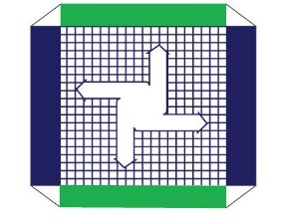
Presented By: PRAMOD KUMAR SRIVASTAVA DIRECTOR & CEO, THE PDP GROUP
Durgapur Surface Transport- Connecting the Trade with the Gateway To the East

Slide 2
The City- Durgapur
Durgapur is located in the Burdwan District of West Bengal at a distance of 175 KM from Kolkata. Durgapur has a catchment radius of approximately 200 KMs.
Durgapur is very rich in the availability of basic raw materials like coal, iron ore, manganese ore, etc. and this has prompted establishment of many Heavy Industries in the region.
It has excellent Surface Transport Connectivity with Hinterland Areas of Raniganj, Asansol, Giridih, Ranchi, Dhanbad and Bokaro.
Notes:
How presentation will benefit audience: Adult learners are more interested in a subject if they know how or why it is important to them.
Presenter’s level of expertise in the subject: Briefly state your credentials in this area, or explain why participants should listen to you.

Slide 3
Surface Transport in Durgapur
Durgapur is the focal point in the transit of Outstation Goods to/ from Kolkata Port, Haldia Port and Bangladesh LCS.
Durgapur is very well connected with high quality Highways which are a part of the Golden Quadrilateral Network.
Durgapur has major Rail Links with Kolkata, Haldia, New Delhi and other parts of India.

Slide 4
AISL- An AEO Certified ICD in Durgapur
Allied ICD Services Ltd. is an AEO Certified ICD located in Banskopa, Durgapur
Taking advantage of Durgapur’s location, ICD Durgapur offers Surface Transport connectivity to all major Eastern Gateways
ICD Durgapur to Kolkata Port | 170 KM
ICD Durgapur to Haldia Port | 260 KM
ICD Durgapur to Petrapole LCS | 200 KM
ICD Durgapur to Raxaul LCS (Nepal) | 565 KM
Notes:
How presentation will benefit audience: Adult learners are more interested in a subject if they know how or why it is important to them.
Presenter’s level of expertise in the subject: Briefly state your credentials in this area, or explain why participants should listen to you.

Slide 5
Connecting Trade with Gateway to the East
Transportation between Durgapur and Kolkata Port: Seamless Movement via NH19
Transportation between Durgapur and Haldia Port: Seamless Movement via NH19/ NH16/ NH116
With ICD Infrastructure and Road Connectivity, Durgapur plays a major role in decongesting Kolkata and Haldia Ports and in Traffic Management
Notes:
How presentation will benefit audience: Adult learners are more interested in a subject if they know how or why it is important to them.
Presenter’s level of expertise in the subject: Briefly state your credentials in this area, or explain why participants should listen to you.

Slide 6
Connecting Trade with Gateway to the East
Transportation between Durgapur and Petrapole LCS (Bangladesh)- Cargo movement via NH13/ NH34/ NH12
EXIM Cargo moves on a Priority Basis with ECTS Seal- This process enables complete cargo tracking from the Point of Origin to LCS if Customs Clearance is done at ICD Durgapur
Companies from different regions of India can use ICD Durgapur for Bangladesh exports and enjoy faster turnaround time with no queuing at the LCS
Notes:
How presentation will benefit audience: Adult learners are more interested in a subject if they know how or why it is important to them.
Presenter’s level of expertise in the subject: Briefly state your credentials in this area, or explain why participants should listen to you.

Slide 7
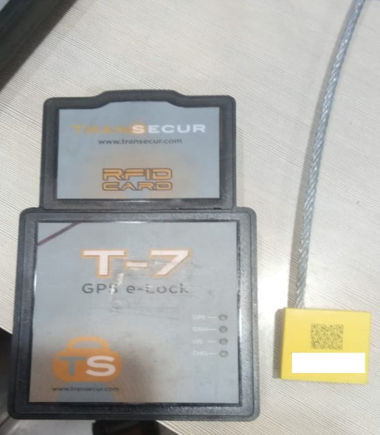
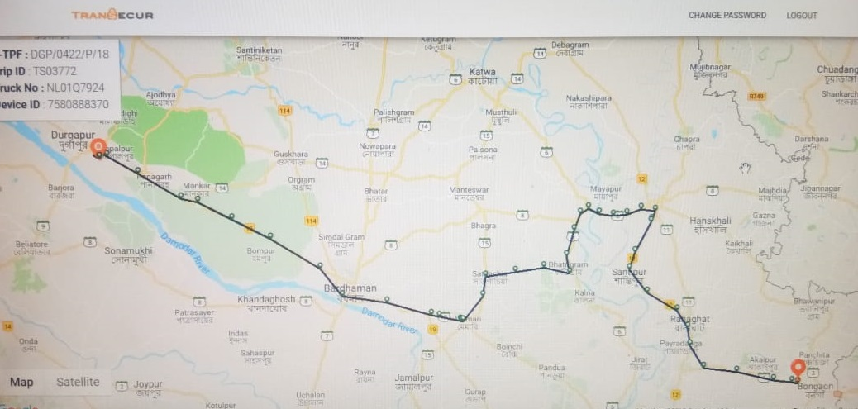
ECTS SEAL WITH COMPREHENSIVE CARGO TRACKING
Notes:
Example objectives
At the end of this lesson, you will be able to:
Save files to the team Web server.
Move files to different locations on the team Web server.
Share files on the team Web server.

Slide 8
Connecting Trade with Gateway to the East
In association with CONCOR, ICD Durgapur offers Rail Connectivity to ensure direct movement of cargo between Durgapur and Gateway Ports
Rail Transport is an effective Surface Transport option which ensures scheduled movement of cargo without causing Road Congestion
Rail Connectivity enables movement of High Volume of Containers to Gateway Ports, Petrapole LCS (Bangladesh) and Raxaul LCS (Nepal)
Notes:
How presentation will benefit audience: Adult learners are more interested in a subject if they know how or why it is important to them.
Presenter’s level of expertise in the subject: Briefly state your credentials in this area, or explain why participants should listen to you.

Slide 9
DURGAPUR- AN EXCELLENT CHOICE FOR CONNECTIVITY WITH THE GATEWAYS TO THE EAST
Durgapur is developing at a steady pace and the Government is encouraging logistics investment in the region
Due to Durgapur’s strategic geographical location, ICD Durgapur is an ideal choice for decongesting the Ports of Haldia and Kolkata, and for fast movement between Bangladesh and Nepal LCS
Notes:
Example objectives
At the end of this lesson, you will be able to:
Save files to the team Web server.
Move files to different locations on the team Web server.
Share files on the team Web server.

Slide 10
THANK YOU !

