Slide 1
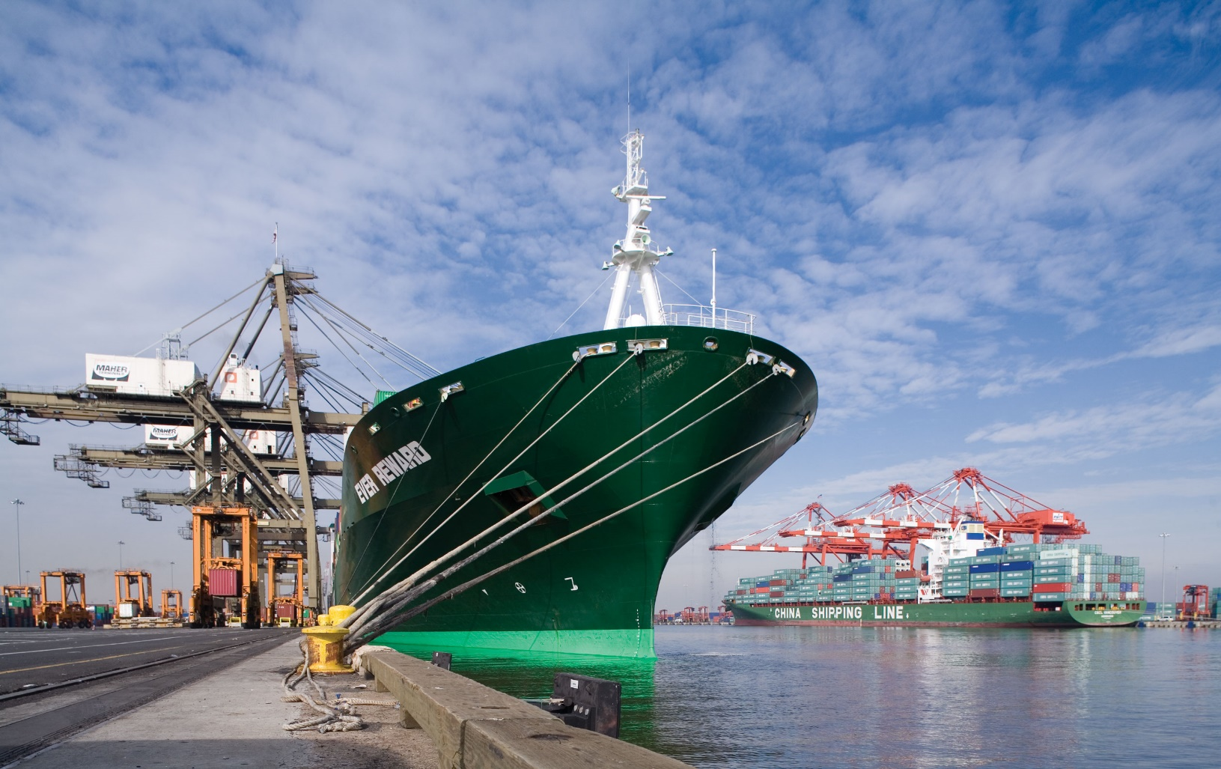
Maritime Logistics
Financing in India
Corporate Finance & Investment Banking
Unlocking Coastal Potential in India
Strictly Private and Confidential
Draft
November 2016

Slide 2
Maritime Financing Landscape
Maritime Financing
Ship Financing
Project Financing
Deep Ocean
Offshore
Coastal and Inland
Shipyard
Port Development
Multi Modal Logistics
Tankers
Gas Carriers (LNG/LPG)
Bulkers
Container ships
Specialized vessels
Rigs and Platforms
Offshore support vessels
Anchor handlers
Platform support vessels
Floating processing and storage barges
Harbour tugs
Dredgers
Barges
Service and support vessels
Floating cranes
Public shipyards
Private shipyards
Ship repair facility
Berth/ Terminal development at Major Ports through concessions with Major Port Trusts
Private Port development through concessions with State Maritime Boards
Container Freight Station (CFS)
Inland Container Depot (ICD)
Tank farmsand silos at port
Private Freight Terminals
Port connectivity projects
2

Slide 3






























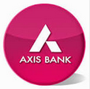












Maritime Financing Landscape
 |  | Investors / Operating Players | Equity (Project Financing) | Debt
Assets / Infrastructure
Channel | River
 | Sea
Industrial – Shipyards
Vessels
Cargo
2

Slide 4
Port Sector in India
Thirteen major ports and 186 minor ports spread across a coastline of 7,500 km
Traffic Growth in Major & Non Major ports (MMT)
Account for ~ 70% by value and ~ 90% by volume of country’s international trade
CAGR 12.1%
Total traffic handled 1,072 MMT, total capacity ~ 1,800 MMT in 2015-16
Capacity utilization at major ports ~63%, at minor ports ~56% in 2015-16
Increasing share of non-major ports – currently ~43% expected to reach 50% by 2020
As per the Twelfth Five Year Plan, investment opportunities worth USD 21 Bn expected in Indian ports
Return profiles of the port sector is highest amongst Indian infra space – Citi Research
Minor ports are favoured by investors because of less regulatory intervention in the operations (tariff fixation)
Major port development plans on anvil as per National Maritime Agenda 2020
Source: Industry; Ministry of Shipping (WS) and ICRA's Analysis
Investment Opportunity in Ports
Indian ports today are facing issues in raising capacity utilization. As against world average of 70-75%, Indian Major ports are operating at ~63% capacity utilization. The turnaround time stands at 4.5 days as against 1 day at Singapore port. Recognizing this and a near term expected increase in traffic by 2020, the government has embarked upon an ambitious plan of increasing the capacity to 2,400 MMT in next five years.
3

Slide 5
Typical Project Financing Structure for Port
Generally the Sponsors form a Special Purpose Vehicle ('SPV') towards development of a Berth/Terminal at Major Port or development of Private Port
Concessioning Authority
Independent Engineer
Banks / FI s Lenders
Special Purpose Vehicle (“SPV”) as Concessionaire
Sponsor Company
Sub Contractor - I
Sub Contractor - II
5

Slide 6
Comparative infrastructure asset economics – A project planning view
Port
Airport
Road
Power Plant
Capacity
100 million tonnes
90 million passengers
100 Km
1000 MW
Capital Expenditure
INR 100,000 million
INR 200,000 million
INR 10,000
INR 45,400 million
Funding
Equity
10%
12%
25%
25%
Debt
60%
48%
75%
75%
Internal accrual & deferred customer usage rights
30%
40%
0
0
Revenues
INR 45,000 million
100 million tonnes of cargo @blended traffic of INR 450 per tonne
INR 94500 million
90 million passengers @blended revenue share of INR 1200 per passenger
INR 2874 million
17,500 vehicles per day @ INR 3 per vehicle km
INR 18626 million
90% plant load factor @ INR 3.2 KW
Costs / EBITDA margins
Operating costs @35% of revenues
Revenue share of 46%
Operating Costs @12% of revenues
Revenue share of 20%
Operating cots of 10%
Operating costs of 35%
Resultant Return on Invested Capital
22%
17%
12%
18%
Actual Best average ROCE
12.01%
10.57%
11.55%
Actual Best average ROE
19.17%
12.22%
11.91%
6

Slide 7
Beyond Debt & Equity
Financing from Customer (s)
Real Estate

Slide 8
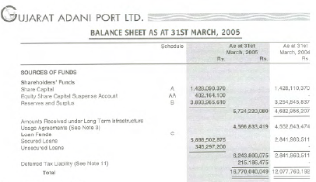
Non Dilutive, Non Interest Bearing Sources of Funds – An unique feature
Ports
Early stages of Mundra Port upto 38% of Balance Sheet Size was funded by upfront premiums on use of terminal capacity – “ Amounts Received under Long Term Infrastructure Usage Agreements”
Counter parties included Guru Gobind Refineries, Indian Oil Corporation
Amounts Received under Long Term Infrastructure 4,596,833,419 4,552,543,474
Usage Agreements

Slide 9
Indian Ports Valuations
(In USD millions)
Company Name |  | Size |  |  | LTM |  |  |  | Liquidity |  |  |  | Multiples |  |  |  |  |  |  |  |  |  | Ratios
 |  | Market Cap | EV |  | Revenue | EBITDA | PAT |  | Total debt | Cash | Net worth |  | EV/EBITDA |  |  | P/E |  |  | P/B |  |  |  | ROE | ROCE
 |  |  |  |  |  |  |  |  |  |  |  |  | TTM | FY1 | FY2 | TTM | FY1 | FY2 | TTM | FY1 | FY2
Adani Ports & Special Economic Zone Ltd |  | 9,122 | 11,769 |  | 1,066 | 727 | 438 |  | 3,452 | 207 | 2,021 |  | 15.3x | 15.0x | 13.2x | 21.3x | 18.4x | 17.9x | 4.6x | 3.7x | 3.2x |  | 23.9% | 11.5%
Gujarat Pipavav Port Ltd |  | 1,125 | 1,081 |  | 101 | 58 | 41 |  | 0 | 44 | 303 |  | 21.6x | NA | NA | 28.0x | NA | NA | 3.8x | NA | NA |  | 14.1% | 14.2%
Essar Ports Ltd* |  | 837 | 1,770 |  | 271 | 213 | 64 |  | 1,028 | 19 | 550 |  | 8.9x | NA | NA | 14.3x | NA | NA | 1.6x | NA | NA |  | 12.0% | 9.2%
Precedent Transaction
Adani Ports and Special Economic Zone Ltd (APSEZ), acquired The Dhamra Port Company Limited (DPCL), a port on the east coast of India focussed on bulk handling , from L&T Infrastructure Development Projects Limited (LTDPL) and Tata Steel Limited (TSL), at an enterprise value of INR 55bn (USD 924m).
Transaction announced in May 2014, closed June 2014.
Based on last reported financials at the time of deal reporting EV EBITDA of
FY13 - 28X,
FY14 – 20x (approximate)
*Essar Ports is delisted now
6

Slide 10
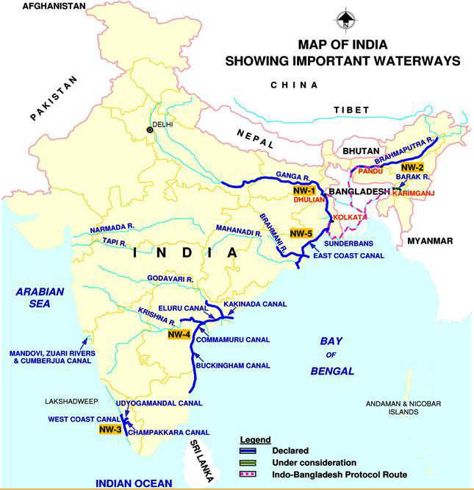
River Transportation – Inland Waterways Development
India is endowed with a variety of navigable waterways covering a length of 14,500 kms and comprising river systems, canals, back waters, creeks, and tidal inlets
However, navigation by mechanized crafts is possible only over a limited length (5,200 kms in river and 4,000 kms in canals)
Total cargo transportation through waterways accounts for ~3% of the total transportation (for China, it is ~47%, US ~21% and EU ~44%)
Current navigable waterways are:
NW2
NW1
NW | Waterway Stretch | Length (Km)
NW1 | The Ganga-Bhagirathi-Hooghly river system from Haldia to Allahabad | 1,620
NW2 | The Brahmaputra river from Dhubri to Sadiya | 891
NW3 | The West Coast Canal from Kottapuram to Kollam along with Udyogmandal and Champakara canals | 205
NW4 | The Kakinda-Puducherry stretch of Canals and stretches of River Godavari and stretches of River Krishna | 1,078
NW5 | Stretches of river Brahmani-Kharsua-Dhamra river system, stretch of East Cost Canal, stretch of Matai river and stretch of Mahanadi delta rivers | 588
NW6 | Proposed waterway between Lakhipur to Bhanga of river barak in Assam | 121
NW5
NW4
NW3
Source : Statistics of Inland Water Transport 2014
Source : Inland Waterways Authority of India website
8

Slide 11
Typical Agreement Nature
Tripartite Agreement
Take or Pay Obligation: Minimum Guaranteed Tonnage of X MMTPA
Inland Waterways Authority of India
Cargo Transporter
Cargo Receiver
Assures Least Available Depth (LAD) of 2.5 mtrs for minimum 330 days in a year and navigational aids for round the clock operation
Create the infrastructure for transferring goods/cargo from point A to point B through inland waterway
Operate and maintain the cargo movement for agreed duration (typically 7-10 years)
Commitment of X MMTPA of cargo to be transported through inland waterway for pre-decided duration in agreement on take or pay basis
9

Slide 12
Challenges identified in Financing Projects
Unrealistic Revenue Projections
In the race to win PPP Projects, developers end up quoting very high revenue share percentages which makes the project unviable and ultimately results in developers reneging on their contractual obligations with the financing banks
Environment/pollution clearances
Intentional / Non-intentional avoidance in obtaining required clearances from Ministry of Environment and Forest ('MoEF') and the Pollution Control Board ('PCB') results in stalling of the projects midway
Tenor of the project loan
Financial regulations and industry classification issues, Banks/ Financial institutions find it difficult lending funds for higher tenors (Typical concession life for projects is 30 years)
Cost of Funds
As compared to other developed nations, the general financing cost in India is high compared to international cost of funds, resulting into high cost of funds for Indian players, who borrow funds in Indian currency and reduction in their international competitiveness and attractiveness
10

Slide 13
Identified Alternative Financing Structures
Creation of Shipping Bank/Institution
Export Credit Agencies (ECA) and EXIM Bank
Ship Leasing Option
Private Equity in Shipping
Shipping bonds
A shipping focused financing institution will enable it to provide the financing gap that is left behind by the commercial banks which lacks the shipping specific domain expertise to tackle the unique requirements of the industry
A dedicated fund that specializes in financing the maritime sector can extend credit support for non fund requirements of companies like letter of credit, Bank Guarantee etc.
Primary services will include export loans, trade finance, and guarantee programs structured to meet the needs of clients in a direct effort to both complement and strengthen the clients' competitiveness in global markets
e.g. the Export Import Bank of China (World’s Largest ECA), Export-Import Bank of Korea (Korea Eximbank)
The lessor (lease finance company SPV) retains legal ownership over the asset during the lease period and the possession of the asset passes to the lessee (e.g. a traditional ship-owner) only at the end of the lease term
Higher probability of receiving bank funding as the leasing company presents a lesser credit risk
PE funds, particularly US-based funds, are targeting distressed assets sales by banks providing flexibility in extending credit
According to Tufton Oceanic estimates, over January 2012- January 2014, PE funds invested USD32 billion in the shipping industry
Through issue of bonds, the granting of capital is agreed for a fixed time period and makes long-term planning possible for both the issuer and the creditor
12

Slide 14


Shipbuilding Players in India
Location | Business Segment
Hazira (~127 acres) | Naval Submarines & Coast Guard vessels Specialised multi-purpose ‘RORO/ LO-LO' semi-submersible commercial ships
Kattupalli (1200 acres) | Very large commercial ships such as cargo carriers, specialized cargo ships for liquid/gas transportation and cruise vessels
Ratnagiri (25 acres) | Jetty - 40 m Capable of fabricating & erecting upto 14 vessels simultaneously of various sizes
Ghodbunder (12 acres) | 4 slipways suitable for building hulls upto 125m length
Goa (5 acres) | Equipped with side launching facility, CNC plasma steel cutting & preparation machines etc.
Dabhol (300 acres) | Has one of the largest floating docks in India (155m. X 40m) having 16,000 tonnes lifting capacity
Mangalore (~28 acres) | Aimed at building vessels up to 60,000 DWT
Surat (~55 acres) | Specialized multipurpose vessels, cement carriers, floating cranes, tugs & support crafts, split barges, etc.
Dahej (~165 acres) | Offshore support vessels (OSVs), Defence Vessels Bulk Carriers of capacity upto 120,000 DWT
Pipavav (782 acres) | India’s first private company to get License and Contracts to build warships for the Indian Navy Equipped with highly modern fabrication, piping, painting shops of 12000 tons p.m. capacity
Pipavav
Dahej
Kolkata
Hazira
Surat
Ghodbunder
Ratnagiri
Dabhol
Goa
Manglore
Kattupalli
L&T Shipyard
ABG Shipyard
Bharati Shipyard
Pipavav Shipyard
13

Slide 15
Indian Shipbuilders vis-à-vis Global Shipbuilders
(In USD millions)
Company Name |  | Size |  |  | LTM |  |  |  | Liquidity |  |  |  | Multiples |  |  |  |  |  |  |  |  |  | Ratios
 |  | Market Cap | EV |  | Revenue | EBITDA | PAT |  | Total debt | Cash | Net worth |  | EV/EBITDA |  |  | P/E |  |  | P/B |  |  |  | ROE | ROCE
 |  |  |  |  |  |  |  |  |  |  |  |  | TTM | FY1 | FY2 | TTM | FY1 | FY2 | TTM | FY1 | FY2
ABG Shipyard Ltd |  | 26 | 1,132 |  | 74 | -43 | -147 |  | 1,116 | 51 | 140 |  | NA | NA | NA | NA | NA | NA | 0.3x | NA | NA |  | NM | NM
Reliance Defence and Engineering Ltd |  | 623 | 1,872 |  | 48 | -22 | -91 |  | 1,256 | 7 | 306 |  | NA | NA | 74.1x | NA | NA | NA | 2.1x | 1.8x | 2.2x |  | NM | NM
Vard Holdings Ltd |  | 234 | 1,276 |  | 1,170 | -56 | -70 |  | 1,295 | 81 | 334 |  | NA | NA | NA | NA | NA | NA | 0.5x | 0.5x | 0.5x |  | NM | NM
CSBC Corp Taiwan |  | 299 | 444 |  | 558 | -7 | -19 |  | 22 | 25 | 421 |  | NA | 15.3x | NA | NA | 27.5x | NA | 0.8x | NA | NA |  | NM | NM
Dynagas LNG Partners LP |  | 492 | 1,158 |  | 159 | 124 | 65 |  | 680 | 24 | 368 |  | 9.3x | 8.5x | 8.8x | 8.0x | 7.0x | 8.6x | 1.3x | 1.4x | 1.3x |  | 19.3% | NA
Modec Inc |  | 922 | 1,077 |  | 1,963 | 113 | 65 |  | 469 | 482 | 957 |  | 9.3x | 9.0x | 7.9x | 13.7x | 10.9x | 10.6x | 1.1x | 0.7x | 0.9x |  | 7.7% | 5.3%
COSCO Corp Singapore Ltd |  | 429 | 4,563 |  | 2,275 | -452 | -444 |  | 4,610 | 1,108 | 946 |  | NA | 29.8x | 21.1x | NA | NA | NA | 0.8x | 0.8x | 0.8x |  | NM | NM
Samsung Heavy Industries Co Ltd |  | 2,135 | 5,723 |  | 9,710 | 45 | -69 |  | 4,281 | 1,778 | 3,628 |  | NA | 29.7x | 14.5x | NA | NA | 29.7x | 0.4x | 0.5x | 0.5x |  | NM | NA
Sembcorp Marine Ltd |  | 2,164 | 4,117 |  | 2,930 | -86 | -357 |  | 2,385 | 444 | 1,880 |  | NA | 15.2x | 14.4x | NA | 27.5x | 23.2x | 1.2x | 1.2x | 1.2x |  | NM | NM
CSSC Offshore and Marine Engineering Group Co Ltd |  | 4,161 | 5,359 |  | 4,044 | 9 | 103 |  | 2,710 | 2,725 | 1,598 |  | NA | 53.7x | 34.8x | 58.5x | NA | 118.8x | 3.7x | 3.8x | 3.7x |  | 6.6% | 3.3%
China Ocean Industry Group Ltd |  | 346 | 561 |  | 33 | -22 | -53 |  | 213 | 11 | -50 |  | NA | NA | NA | NA | NA | NA | NA | NA | NA |  | NA | NM
14

Slide 16
The Valuation GAP – Illustrative
–
GIL’s internal model
INR 363, 254 million (ex Intergen) translating to a per share value of INR 99
Mean analyst consensus
INR 40 per share ~ INR 162, 871 million translating to INR 42 per share
Market valuing
INR 12,8450 million ~ INR 33 per share
Maritime Logistics Financing in India • Unlocking Coastal Potential in India
19

Slide 17
The Valuation GAP
Mapping the difference
Airports
Airports linked RE
Roads
Power
SEZ
Coal
Asset Valuation at similar levels (at least 60% of internal value)
DIAL (core airport)
GEL (Barge mounted),Vemagiiri, GPCL (Chennai), Kamalamga
Technical differences
Street models do not treat net cash at each subsidiary level, net cash is valued at consolidated level after factoring in estimated cash requirements at project levels
Assets not valued by the street
Hyderabad –Vijayawada, Chennai Outer ring road
Alaknanda, Upper Karnali, Himtal, Bajoli Holi, Londa, SJK Powergen, Chhattisgarh
Assumption differences
GHAIL, SGIA
DIAL Re, GHAIL RE, (at 7% of internal value)
GTTEPL, GTAEPL, GJEPL
EMCO, Rajahmundry,
Krishnagiri (street at 25% of Internal value)
Indonesia mines, HEG (street at 15% of internal value)
17

Slide 18
Decision matrix for inclusion / non inclusion in SOTP
Plant | Size (MW) | Location | Land | Clearances | Fuel | Funding | PPA | Decision = IN / OUT
Kamalanga | 1,050 | Orissa | ✓ | ✓ | @ | ✓ | @ | IN
Kamalanga 2 | 350 | Orissa | ✓ | @ | X | X | X | OUT
EMCO | 600 | Manarashtra | ✓ | ✓ | ✓ | ✓ | @ | IN
Vemagiri 2 | 768 | Andhra Pradesh | ✓ | ✓ | X | ✓ | X | IN
Chhattisgarh | 1,370 | Chhattisgarh | ✓ | @ | X | ✓ | X | OUT
Shahdol | 1,370 | Madhya Pradesh | @ | X | X | X | X | OUT
Badrinath | 300 | Uttaranchal | @ | ✓ | Hydro | X | X | OUT
Talong | 160 | Arunachal Pradesh | X | @ | Hydro | X | X | OUT
Holi Bajoli | 180 | Himachal Pradesh | X | @ | Hydro | X | X | OUT
Upper Karnali, | 900 | Nepal | X | X | Hydro | X | X | OUT
Upper Marsyangdi | 600 | Nepal | X | X | Hydro | X | X | OUT
Land acquisition and financial closure are the key filtering criteria

Slide 19
Assets not valued by the street
SOTP Valuation
Project | Full project name | Equity ownership | GMR Discount Rate | Valuation- FCFE (Rs m) | GMR Equity Share (Rs m)
Total Shares Outstanding
GMR Energy- Generation Assets
GCEL | GMR Chattisgahr Energy Private Limited | 100.0% | 15.0% | 17,496.6 | 17,496.6
GBHPCP | GMR (Badrinath) Hydro Power Ltd (Alaknanda) | 99.9% | 16.0% | 1,557.0 | 1,555.4
UKHPL | GMR Upper Karnali | 50.5% | 16.0% | 9,990.5 | 5,045.2
HHCPL | Himtal Hydropower Corporation Private Limited (Upper Marsyangdi) | 80.0% | 16.0% | 8,051.5 | 6,441.2
GBHPPL | Bajoli Holi Hydropower | 100.0% | 16.0% | 94.0 | 94.0
GLHP | GMR Londa Hydro Power | 88.0% | 16.0% | 91.5 | 80.5
SJK | SJK Powergen Limited | 70.0% | 15.0% | 17,182.9 | 12,028.1
GMR Roads
GHVEPL | GMR Hyderabad-Vijayawada | 74.0% | 12.0% | 4,687.9 | 3,469.0
GCORRL | Chennai Outer Ring Road | 90.0% | 12.0% | 47.6 | 42.8
Other
EPC business |  | 100.0% | 12.0% | 25,221.3 | 25,221.3
- Total Value of INR 71,474 million, per share value of INR 20 per share

Slide 20
Identifying the Gap Drivers – Select Assets, Illustrative
Asset
Key Internal Assumption
Key street assumptions
Delhi Airport Real Estate
Company forecast modeled on the basis of commercial terms in first round of monetization (45 acres) in 6 phases (last phase beginning in FY14, bringing in the entire 250 acres) with 5.5% annual lease increment
Street model (A) assumes another 75 acres by FY14
Street model (E) factors in Real estate monetization as a means of finance, essentially free deposit between beginning and lend of lease periods (FY2066), assumes 60% of the remaining 215 acres to be monetized over a much longer period cumulatively 21.5 acres by FY12, 64.5 acres by FY14, 129 by FY18
GHAIL Real Estate
1600 acres monetized up to FY19 with a mix of rates based on SEZ type – aviation / non – aviation, processing/ non processing
Street model (A) assumes development of 1000 acres over a 7 year period, tying into a DCF based valuation of INR 26 million per acre
Street model (E)
Coal mines (Indonesia is a key driver, HEG at cost)
Based on cash flow from mining operations
Based on approximate “at cost” value with possible haircuts for execution delay

Slide 21
Beyond Debt & Equity
Real Estate

Slide 22
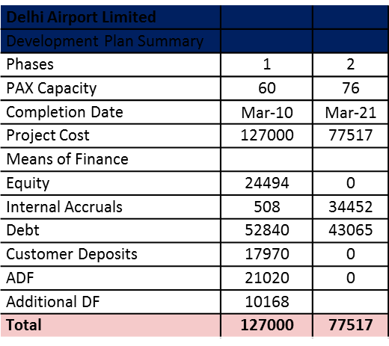
Delhi Airport Infrastructure Development
Delhi Airport Limited
Development of Plan Summary
Airports
  Customer Deposits for real estate use and development charges constituted 39% of phase one project cost and 24% percentage of overall project cost
  Equity at 11.5% of project cost
In INR millions

Slide 23
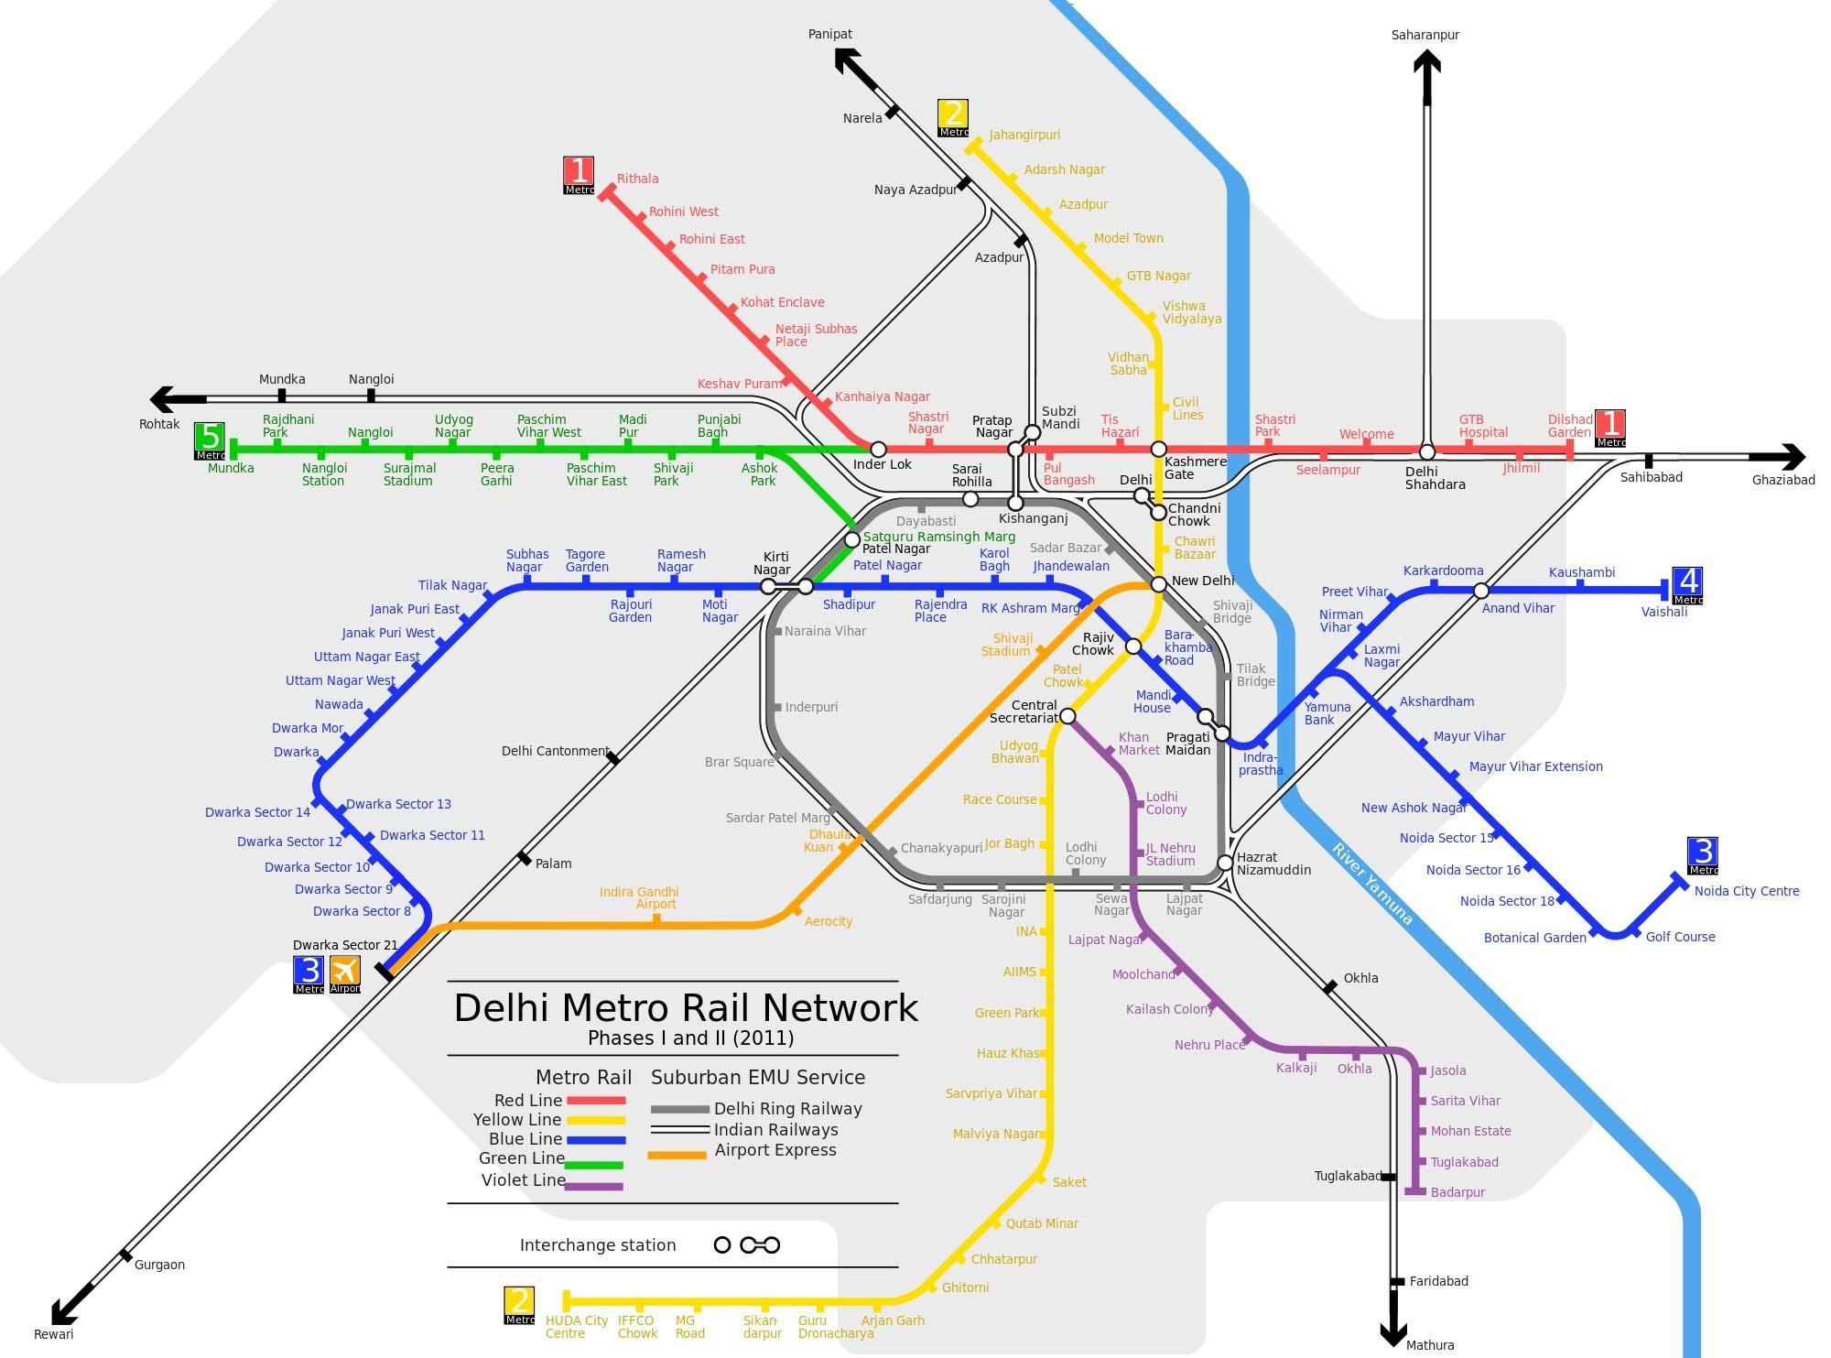
Delhi Metro Network – Did the Government Miss a Trick
–
Azadpur Gaon
Rohini
Model Town
Paschim Vihar
Janak Puri
Preet Vihar
Mayur Vihar
Lajpat Nagar
Hauz Khas
Saket
Maritime Logistics Financing in India • Unlocking Coastal Potential in India
20

Slide 24
Station Development Projects could require taking real estate risk
–
Key success factors
Understanding the micro markets
Partnering strategy
Financing & refinancing strategy (example – REITS)
29%
38%
25%
42%
15%
33%
100%
133%
200%
100%
114%
233%
89%
xx%
Location (Pre-Metro Year, Present)
Maritime Logistics Financing in India • Unlocking Coastal Potential in India
% increase in residential land values – pre & post Metro
Source: Primary Research & PwC Analysis
21

Slide 25
Global Infrastructure / Developer Universe
–
What Next ?
Developers
101
OECD like predictability
Easier ECB
Easier Extraction
Superior Execution Control
JVC
19
Infra Funds
167
Pension Funds
(Direct)
20
SWF
(Direct)
2
MLA
20
Maritime Logistics Financing in India • Unlocking Coastal Potential in India
27

Slide 26
Thank You
© 2016 PwCPL. All rights reserved. PwC refers to the Indian member firm, and may sometimes refer to the PwC network. Each member firm is a separate legal entity. Please see http://www.pwc.com/structure for further details.

Slide 27
Demand for imported coal rising steadily, which provides an opportunity for coal movement through sea
Gap filled up by imports and it’s rising every year
GW
Mn Tonnes
Source: Ministry of Coal
Source: Enerdata, 2015
Source: Energy Statistics Report 2015, Ministry of Coal
India is the world’s third largest energy consumer, and its energy use is projected to grow at a rapid pace supported by economic development, urbanization, improved electricity access and an expanding manufacturing base
According to the Ministry of Coal, although India has adequate coal reserves (over 300 billion tonnes), actual production falls short of consumption demand and the gap is met through imports
Until 2015…
2015 onwards…
Rising Opportunity to Coal Carriers
Subcritical technology
Coal quality: Less energy, High ash
Higher CO2 emissions
Lower productivity
Transformation towards supercritical technology
Coal quality: High energy, low ash
Lesser CO2 emissions
Higher productivity
India’s Thermal Power Plants
India’s Thermal Power Plants
India’s domestically produced coking coal has high amount of ash content (>30%), which makes it unsuitable for firing in thermal power plants, unless used in blended ratio with imported coal (typically 8:2)
18

Slide 28
Given this scenario, Port sector is expected to see many opportunities across major and non-major ports
Category | Opportunities | Timelines and Strategies
Major Port Terminals | Over 17,000 crores across 26 projects under RFQ/RFP stage 2000 crore projects in the pipeline | 12 to 24 months. To be evaluated on a case-t0-case basis
New Major Ports | Sagar Island and Dugarajapatnam Closer to CBIC and VCIC economic corridors Identification of Port Clusters and new ports for development as part of Sagarmala Project | 3-5 years
Existing Non-major ports fronted by non-construction companies | Strategic port projects looking to expand massively in coming years Dhamra Port Krishnapatnam Gangavaram Jaigad Port Nargol Port | Immediate Sub-concession Minority Stake to fund expansion Stake in allied connectivity projects
New non-major ports | Ports in Andhra Pradesh and Tamil Nadu (mainly driven by coal, liquids and containers) | 12-60 months Opportunistic
18

Slide 29
Key Investment Opportunities in Indian Maritime Industry
1
Opportunity for investing in capacity expansion across many vessel classes. VLCCs for POL crude, POL product tankers, LNG carriers, VLGC for LPG etc.
2
Opportunity to upgrade current bulk carrier and tanker fleets to take advantage of increased draft and higher productivity equipment upgrades in ports
3
Infrastructure expansion in the ports (development of SBM, pipelines & storage facilities)
4
Investment in new technology solutions (RFID, Container Scanners etc.) in container ports
5
Opportunity to invest in green field International Trans-shipment hubs in Enayam (T.N.) and Vizhinjam (Kerala) by developing terminals, CFSs, logistic parks, warehousing, Ship repair etc.
6
Investment in expanding logistic inter linkages and land side logistics for EXIM cargo, marine logistics, 3PL services for coal, freight forwarding (FCL, LCL, Ro-Ro, specialize cargo), warehousing etc.
7
Opportunity to invest in expanding market for ship chartering, ship brokerage services
18

