Slide 1
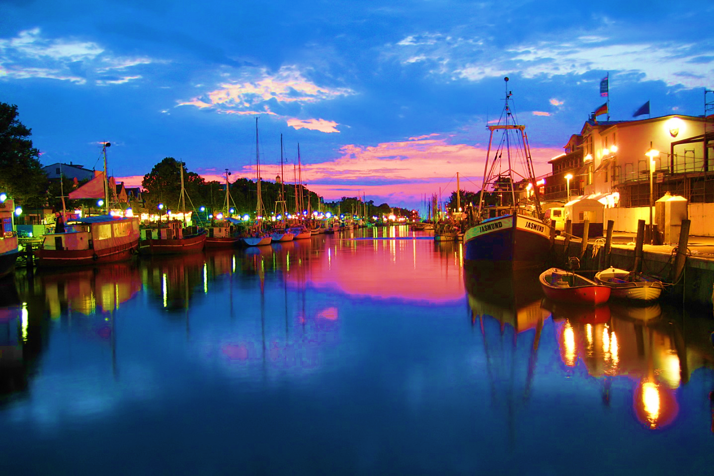

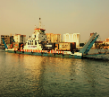
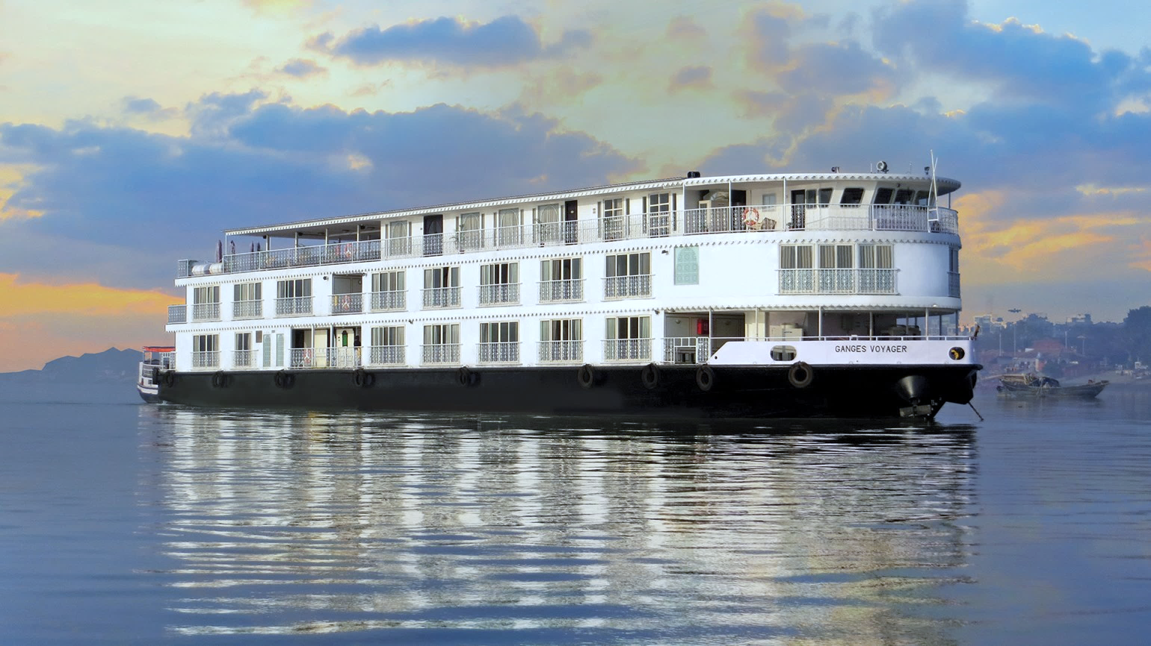
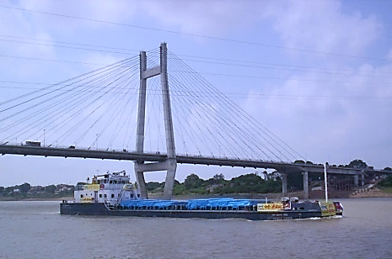

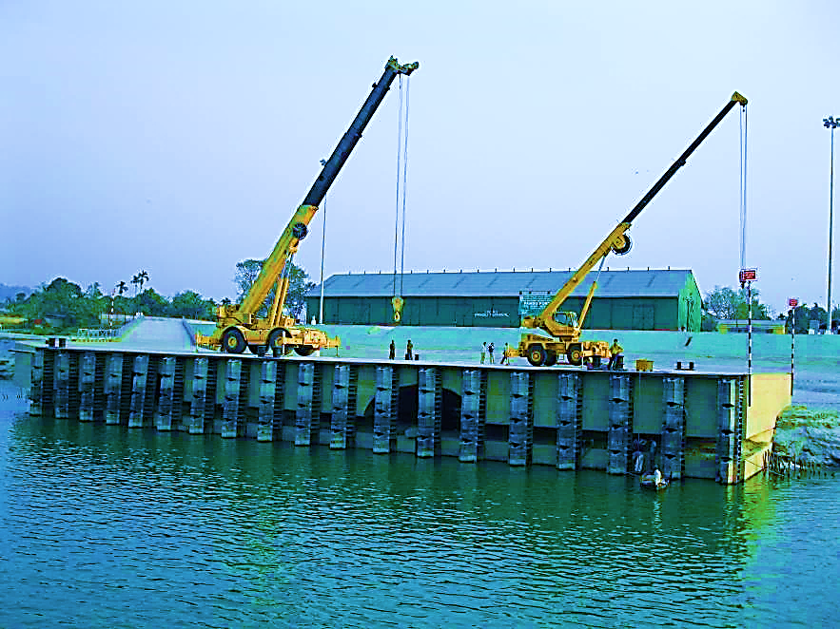
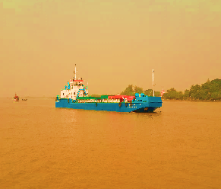
Business Opportunities – Inland Water Transport Sector
Inland Waterways Authority of India
NW1

Slide 2
Categorization of 111 National Waterways
Priority Projects
Category I
Existing five waterways : NW1 – NW5
Category II
New NWs – 8 viable waterways on which development activities have been initiated
Category III
New NWs – 24 waterways that have been shortlisted for DPR preparation after feasibility study
Category IV
IV A – New NWs – 4 waterways for which more information is sought from the 2 stage DPR consultants
Category V
New NWs – 52 waterways , reports being assessed, final call has to be taken regarding their viability
IV B – New NWs- 18 which are not viable technically and due to traffic issues identified during feasibility studies.
Subsequent Projects

Slide 3
Business Opportunities in IWT Sector
Fairway Development
Terminal Development
Fairway development & Maintenance – Dredging & River Training Works
Implementation & Maintenance of Navigational Aids (DGPS, RIS, Vessel Tracking System, etc.)
Development/Modifications of cross- structures, if required
Conducting Hydrographic Surveys
PMC & Consultancy Services
Construction, Operation & Maintenance of Terminals
Provision & Operation of Mechanized Cargo handling systems
Stevedoring & forwarding
Terminal Management
Vessel Construction, Manning & Operations
Vessel Construction (Barges, Ro-Ro, Survey vessels) & Operations
Training of Vessel crew
Tourism – Cruise Operations
Provision of Pilotage services

Slide 4
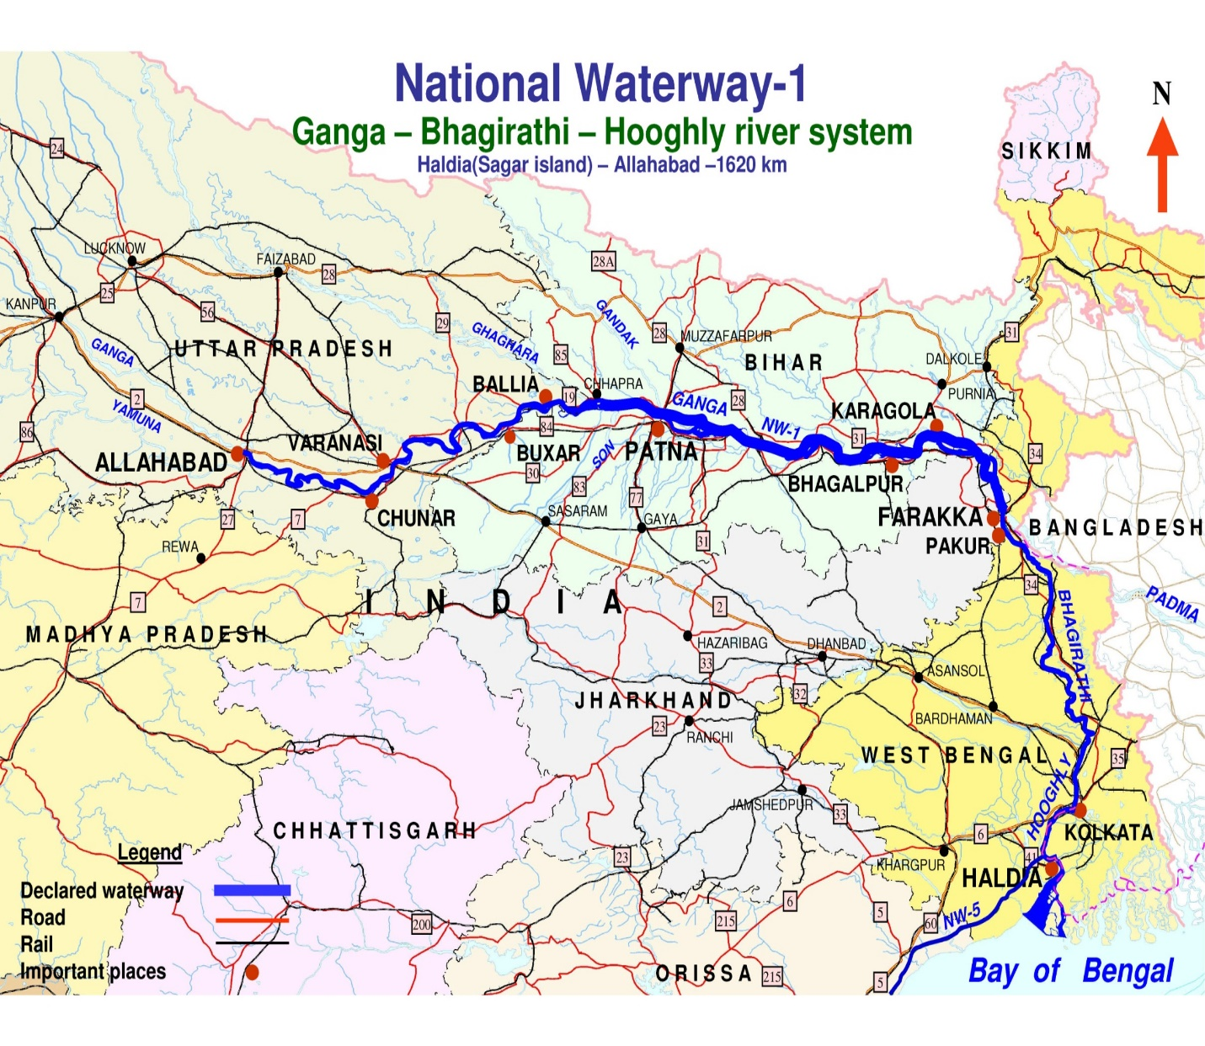
National Waterway – 1

Slide 5
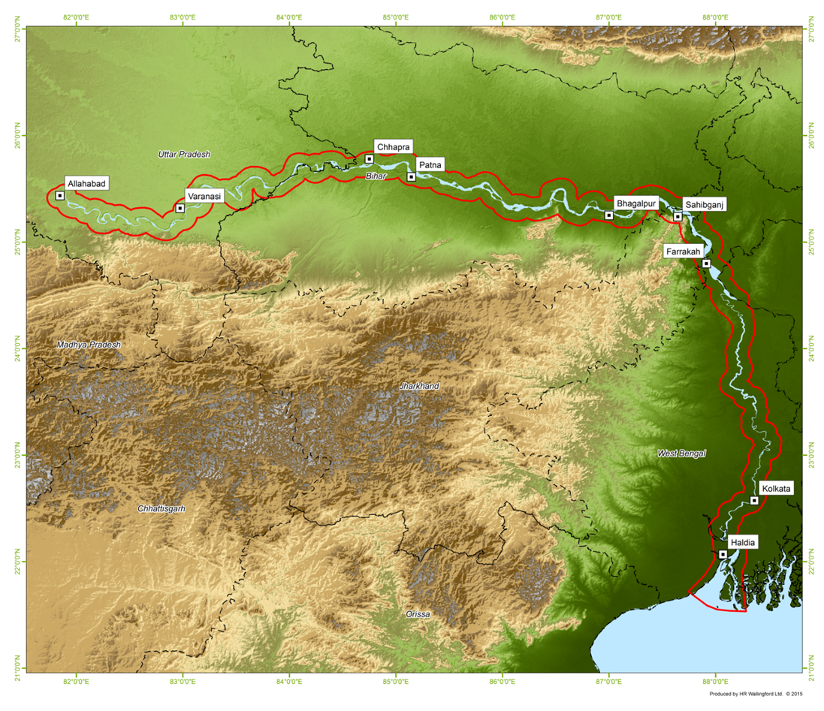
Projects Initiated Under Jal Marg Vikas Project (JMVP)
IMT Ghazipur
IMT Kalughat
MMT Varanasi
MMT Sahibganj
Assured Depth Contract
(Farakka to Kahalgaon)
New Navigational lock at Farakka
MMT Haldia

Slide 6
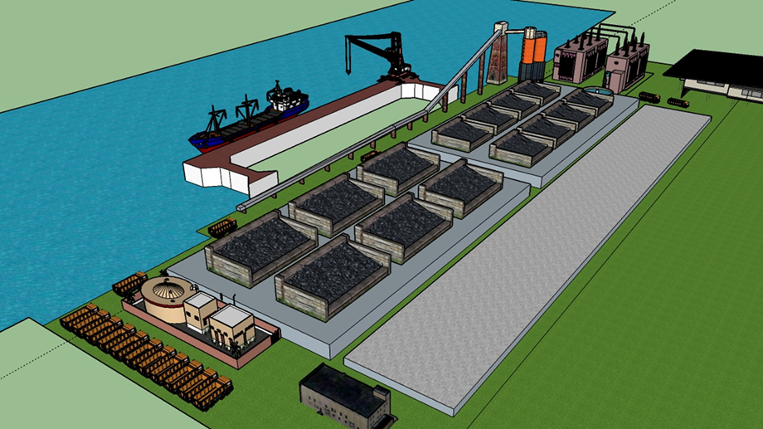
Status – JMVP Key Interventions
Varanasi multi-modal terminal (Phase 1 A) Cost : Rs. 169.7 cr Standing Finance Committee (SFC) appraised and recommended the proposal on 09.12.2015 Contract Awarded in May’2016 Work commenced
Sahibganj multi-modal terminal (Phase 1) Cost : Rs. 292.1 cr Standing Finance Committee (SFC) appraised and recommended the proposal on 30.06.2016 Contract awarded in Oct – 2016

Slide 7
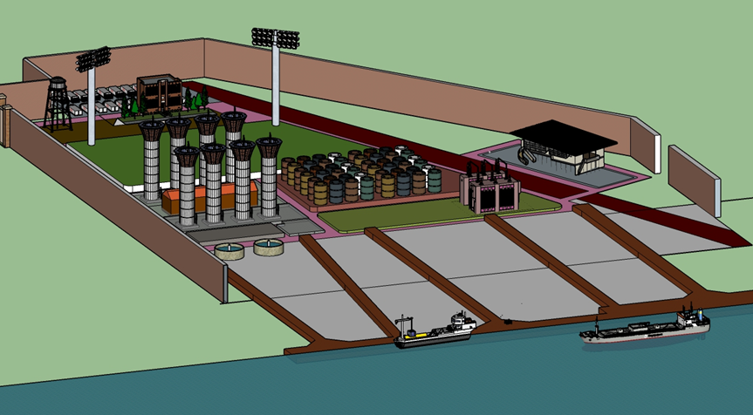
Status – JMVP Key Interventions
Haldia multi-modal terminal (Phase 1) Cost : Rs. 465 cr Standing Finance Committee (SFC) appraised the project on 17.08.2016 6 Bids received; evaluation completed & World Bank’s clearance awaited for award of work
New Navigational Lock at Farakka Cost : Rs. 380 cr Standing Finance Committee (SFC) appraised and recommended the proposal on 29.07.16 4 Bids received ; evaluation completed & World Bank’s clearance awaited for award of work

Slide 8
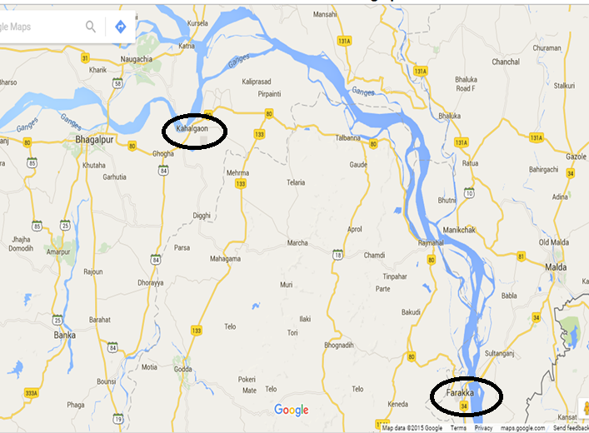
Status – JMVP Key Interventions
Assured Depth with Navigational Aids (Farakka-Kahalgaon Stretch – 146 km) Cost : Rs. 162.93 cr Standing Finance Committee (SFC) appraised the project and recommended the proposal on 30.06.2016. Tender issued after due Pre-Qualification process as required by World Bank 3 Bids received; evaluation completed & World Bank’s clearance awaited for award of work

Slide 9
JMVP – Upcoming Sub – Projects
Project | Details | Project Status | Target Milestone | Completion Date
Navigation aids | Estimated cost: Rs.48 crore | DPR study under progress; Tender to be floated in Feb, 2017 | Work expected to be awarded in June, 2017 | Dec, 2018
3 Additional (Smaller Size) Terminals | Kalughat, Ghazipur & Tribeni/ Kalyani Estimated Cost : Rs. 300 crore (approx.) | Terminals sites have been identified and preliminary feasibility study in progress. DPR is expected to be completed in March 2017 | Tender to be floated in June, 2017. | Nov, 2021
Ro-Ro Jetties (5 Nos.) | Estimated Cost : Rs.300 crore (approx.) | Location of 10 RO-RO jetties has been identified and feasibility study is in progress to finalize the 5 pair of locations. | DPR to be prepared by June 2017 & Tender between Sep, 17 – Dec 17 | Dec’ 2021
Bank Protection | 50 Kms at various locations Estimated cost Rs 100 cr. | Location of bank protection site in the feeder canal has been identified and feasibility study is in progress. | DPR to be prepared by February 2017 and tender in April 2017 | Dec’2022

Slide 10
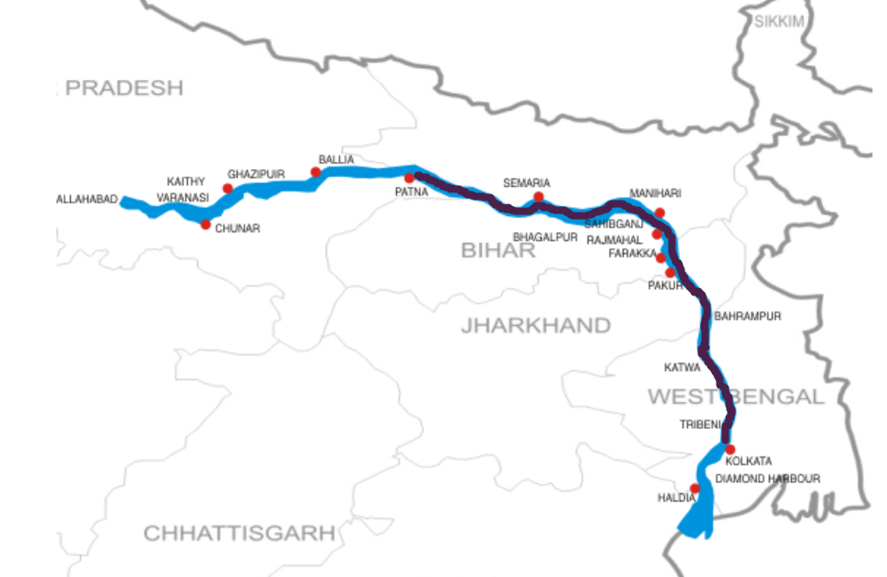
JMVP PPP Interventions – Kalughat & GR Jetty
Proposition: Development and operation of terminals in Kolkata and Patna for a period of 30 years.
IWAI has invited interested bidders to equip & operate the brownfield facility at Garden Reach Terminal, Kolkatta and existing Gaighat Terminal at Patna through a single stage two envelop bidding process for an agreement term of 30 Years.
Technically qualified Operator will be selected based on percentage revenue share, who will be responsible to meet minimum Functional guarantees agreed during signing of agreement
A total of 9 interested bidders participated in prebid meeting held on 19th of Aug., 2016, basis which a final bidding document was issued on 13th Sep., 2016.
Last date of submission is 30th Nov. 2016
Birganj
Nepal
Source of Base Map: Crisil Research
    Terminal in Patna
Garden Reach Terminal, Kolkata

Slide 11
Category II Waterways: Brief Overview
Covers 8 new most viable national waterways, currently under development stage. DPR has been completed and EPC tender documents for appointment of EPC contractor under progress.
The project development work on these 8 new waterways has been planned in phased manner.
Tendering for Barak, Ghaghra, Gandak & Kosi has already been initiated for appointment of EPC contractor for fairway development.
Tendering for terminal development work will be initiated from Dec. 2016 to match with the pace of Fairway development work
For Goa waterways, proposal received from Captain of Ports Goa for four jetties has been recommended by IWAI to Ministry of shipping.
The proposal received for provision of Navigational aids in Goa Waterways has been returned back to Captain of Ports seeking further techno-commercial details
Gandak (NW37)
Barak
(NW16)
Ghaghra (NW 40)
Kosi
(NW58)
Sunderbans
(NW97)
Goa Waterways:
Mandovi (NW68)
Zuari (NW111)
Cumbarjua (NW27)

Slide 12
Category II Waterways: Status Update
Waterway | Details | Activities | Timelines
Barak (NW 16) | Fairway development (including navigational aids) between Bhanga & Silchar & upgradation of terminals at Karimganj and Badarpur and new floating terminal at Silchar in Phase 1 | Fairway development Award of work Fairway Development (INR. 57 Cr.) | Nov, 2016 Mar, 2018
 |  | Terminal Development Award of work for upgradation of 2 terminals Award of work for new terminal Terminal development (INR 25.44 Cr.) Upgradation of 2 terminals New Terminal @ Silchar | Jan, 2017 May, 2017 Dec, 2017 Dec, 2018
Ghaghra (NW 40) | Fairway development (including navigational aids) between Dohrighat & Manjhighat (160 Km) and terminals at Dohrighat & Manjhighat in Phase 1 | Fairway development Tendering Fairway Development (INR 98.94 Cr.) | Oct, 2016 Jun, 2019
 |  | Terminal Development (floating) Tendering Terminal development (INR 33.5 Cr.) | Mar, 2018 Jun, 2019
Gandak (NW 38) | Fairway development (including navigational aids) between Dhumaria Ghat to Gaighat (160 Km) and terminal at Dhumaria ghat in Phase 1 | Fairway development Tendering Fairway Development (INR 36.5 Cr.) | Oct, 2016 May, 2018
 |  | Terminal Development (floating) Tendering Terminal development (INR. 20.7 Cr.) | Mar, 2017 May, 2018
Kosi (NW 58) | Fairway development (including navigational aids) between Dhamraghat and Kursela (95km) and terminal at Dhamraghat in Phase 1 | Fairway development Tendering Fairway Development (INR. 31.2 Cr.) | Nov, 2016 Jun, 2018
 |  | Terminal Development (floating) Tendering Terminal development (INR 7.25 Cr.) | Mar, 2017 Jun, 2018

Slide 13
Category II Waterways: Status Update
Waterway | Details | Activities | Timelines
Mandovi (NW 68) & Zuari (NW 111) | Upgradation of navigational aids Extension of CoP floating pontoon jetty at Panaji (Mandovi River) Construction of floating pontoon jetty at Dempo House, Panaji (Mandovi River) Extension of CoP floating pontoon jetty at Old Goa (Mandovi River) | Jetties development/ extension Tender for contractor’s appointment Jetties development/ extension | Case pending at MoS
 |  | Upgradation of navigational Aids Tender for contractor’s appointment Execution of works | Technical Details awaited from captain of Ports Goa
General notes
Construction/ extension of jetties are proposed by Captain of Ports, Goa based on feasibility report prepared by M/s Marinetek for them
50% cost by Gov. of Goa & remaining 50% by Central Sector Scheme post submission of DPR by Gov of Goa and approval by IWAI. Same has been recommended to MoS, by IWAI
DPR to be prepared by independent empaneled consultant of MoS
Apart from the abovementioned jetties, construction of floating pontoon jetty at Chapora river has also been proposed by Captain of Ports, Goa
Cumberjua Canal and Sundarbans waterways of category – II will be considered for development at a later stage

Slide 14
Yamuna Water Taxi Project
Yamuna Water Taxi project for operating tourist vessels / ferry services on Yamuna river from Wazirabad to Fatehpur Jat stretch (16 Km)
Actions Taken:
In view of the ban imposed on construction activities on Yamuna, IWAI has applied to NGT clearance. O/A filed in September, 2016, second hearing due on 19th October, 2016
DPR for the project received from M/s Kitco in September end.
NIT/ Tender issued for following works:
  a) Design & Construction of 3 no. passenger vessels
  b) Construction of floating jetties at terminal points
  c) Dredging and provision of Navigational Aids for fairway development
Due date of tender is 24th October, 2016.
EoI issued for operators to run vessels on Yamuna with IWAI financial assistance. 5 bids received and under evaluation.
Letter issued to Delhi Govt. for signing MoU for State Support Agreement.

Slide 15
JMVP Intervention – Vessel Operation & Management
–
Proposed Business Models:
Future Plan:
Procurement of 20 shallow draft (1.8m – 2m), self propelled barges and 2 LNG operated barges with a carrying capacity of 2000 tons.
Tendering works for sourcing of these vessels in progress.
Time Charter
Hiring of vessel for a specific period of time. Charterer to select the ports and direct the vessel.
IWAI to manage the vessel & charterer to pay for all fuel the vessel consumes, port charges, commissions, and a daily hire to IWAI.
2
1
Voyage Charter
Hiring of vessel and crew from IWAI for a voyage between load and discharge ports.
IWAI to manage the vessel.
Voyage charter to specify a time period for loading & unloading.
Bareboat Charter
Hiring of vessel from IWAI
No administration or technical maintenance is included as part of the agreement.
Charterer obtains possession and full control of the vessel along with the legal and financial responsibility.
Contract of Affreightment
Contract similar to a voyage charter
IWAI undertakes to carry a specified quantity within a specified period of time on a specified route.
3
4
39
Ro-Ro vessel

Slide 16
Investment Opportunities & Incentives for Investment
Investment opportunities exists in all segments of the IWT sector which include:
Greenfield ports
Modernization of existing ports
Development of new berths / terminals
Inland Water Transport
Maritime education & training
Shipbuilding & Ship repair
Dredging
–
Key Opportunities (Jal Marg Vikas Project):
Capacity Augmentation Projects of National Waterway – 1 to enable movement of 1500 – 2000 DWT vessels from Haldia to Varanasi:
Multi Modal Terminal Construction
Navigational Lock
Assured Depth Dredging
LNG Barges & Bunkering Facilities
Ferry Services
Opportunities in projects on PPP Mode:
Terminal operation & management
Development of entire waterway infrastructure in all respect for commercial navigation
Ship repair facilities
Vessel leasing / chartering
Passenger and captive cargo jetties
Incentive for Investment by GoI
Reduced service tax on coastal shipping
Viability gap funding for PPP projects
Infrastructure status and fiscal incentives for shipbuilding and ship repair
Income tax exemption for infrastructure development in ports.

Slide 17
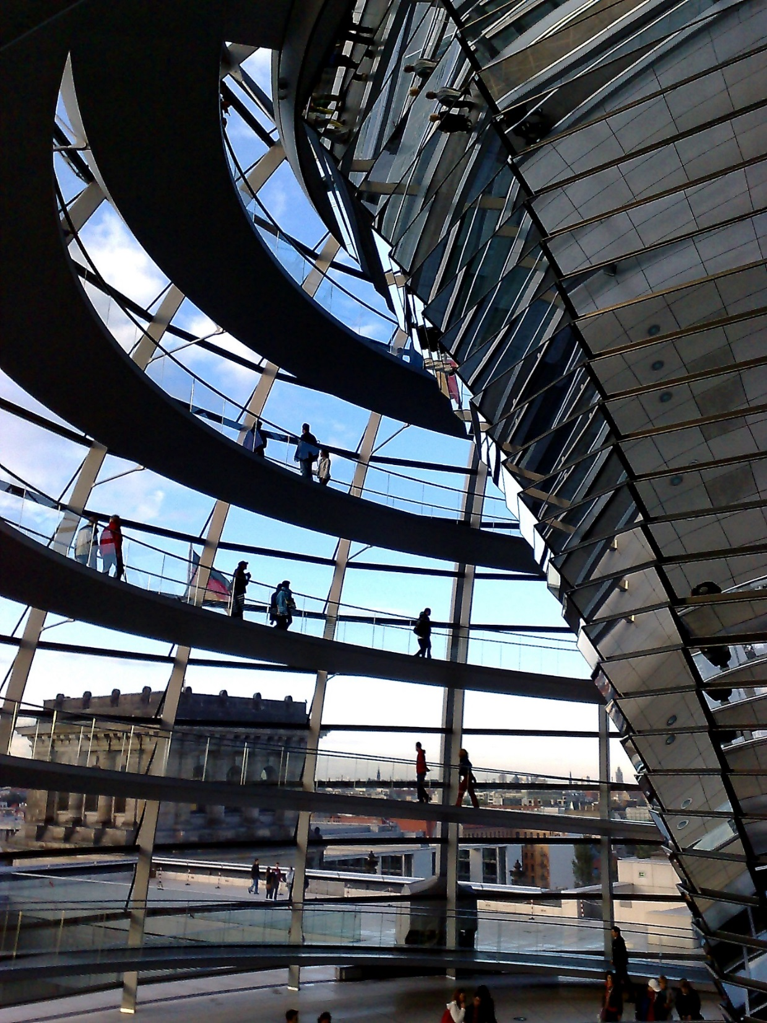

Reach us
-1 Tools, Templates & Key Trends
Inland Waterways Authority of India
A-13, Sector-1, Noida (UP),
PIN- 201301
e: vc.iwai@nic.in
Pravir Pandey
Vice Chairman, IWAI
Thank You !!

