Slide 1
Container Infrastructure and Logistics in India 2016
"The Emerging Trend - Economical Transportation of Goods in Containers using Coastal Shipping"
www.transworld.co/srs

Slide 2
ECONOMIC OUTLOOK
India has emerged as the fastest growing major economy in the world as per the
Central Statistics Organization (CSO) and International Monetary Fund (IMF).
www.transworld.co/srs

Slide 3
LOGISTICS OUTLOOK
In the ‘Indian Logistics Industry 2016 Outlook’: Frost & Sullivan finds that the industry is likely
to grow at a CAGR of 8.6% between 2015 and 2020; it grew at a CAGR of 9.7% during 2010-15.
Transportation and Communication accounted for 7% of the nation’s GDP in 2015, accounting for
around USD 130.4 billion. The key drivers of this growth are infrastructure investment associated
with ports, airports, and other logistics development plans, domestic demand growth, and increasing
trade.
The Government of India’s Foreign Trade Policy (2015-2020) aims to increase the value of trade to
USD 900 billion by 2020, by aligning with Government initiatives such as “Make in India”,
“Digital India”, and “Skills India” to promote growth of exports.
Containerized Cargo Tonnage is likely to cross 123 million ton in 2016 and is likely to grow by
4% driven by port modernization and expansion plans.
www.transworld.co/srs

Slide 4
TRANSPORT MODES
- Indian Scenario
Most commonly used transport modes in India are “Road and Rail Logistics”, which are
already overburdened and it is unlikely to keep up with the pace of our future growth
demands.
As an economically exploding nation, India should focus on encouraging Coastal
Shipping – not as nice extra, but as a logical and essential solution to meet our
growth demands and to reduce impact of Environmental Pollution.
www.transworld.co/srs

Slide 5
COASTAL SHIPPING
- World Scenario
There is strong positive correlation between use of coastal shipping and operations cost
contribution to GDP. For countries using coastal shipping operations cost to GDP is
approximately 9%, whereas for India it is 13%.
Globally seaborne trade is moving up by 4%. Indian economy is also on growth path, as a
result movement of cargo will increase.
Thus it is domestically, where we need to refocus our attentions. We all know how
important it is to be able to cost-effectively move freight internally around our nation with
available finite resources and infrastructure.
www.transworld.co/srs

Slide 6
MACRO LEVEL
Indian Logistics Industry is very fragmented, especially trucking.
Road movement across states are subject to checks enforced by various state jurisdictions.
Documentation Process.
Funding–Investment: Infrastructure should be programmed in anticipation of future demand.
Pricing.
Demography.
Information Technology.
Skills and Human Resource in Logistics.
Under Utilization of Coastal Shipping.
www.transworld.co/srs

Slide 7
CONTAINER COASTAL SHIPPING
- Why Use Container ?
Vessels: We do not require multiple types of vessels for different commodities.
Standardization: Standard transport product can move in containers in small quantities (max 28MT),
we no longer need to depend on bulk vessels. Each container has an unique identification number and a
size type code for ‘Track & Trace’.
Flexibility: Can be used to carry a wide variety of goods such as commodities (coal, wheat),
manufactured goods, cars, refrigerated (perishable) goods and liquids (oil and chemical products)
cargo. Most importantly, reuse container for next movement.
Costs: Lower transport costs due to the advantages of standardization.
Velocity: Transshipment operations are minimal and rapid. Port turnaround times reduced from 3
weeks to about 24 hours.
Warehousing: The container is its own warehouse; Simpler and less expensive packaging. Stacking
capacity on ships and on the ground (container yards).
Security and Safety: Contents of the container is unknown to carriers. Can only be opened at the
origin (seller), at customs and at the destination (buyer). Reduced spoilage and losses (theft).
www.transworld.co/srs

Slide 8
CONTAINER USAGE TRENDS
www.transworld.co/srs

Slide 9
CONTAINERIZED
COASTAL SHIPPING TRENDS
Container Coastal Shipping Trade: Improved by 276% over last 6 years.
Tiles Industry (Morbi Cluster): In present, 70% volume is moving through this mode.
Cotton Industry: From 1,000 containers per season, now they are moving 1,000 container per week
in a peak season.
www.transworld.co/srs

Slide 10
COASTAL CONTAINER SERVICE
- Commodities
www.transworld.com/srs

Slide 11
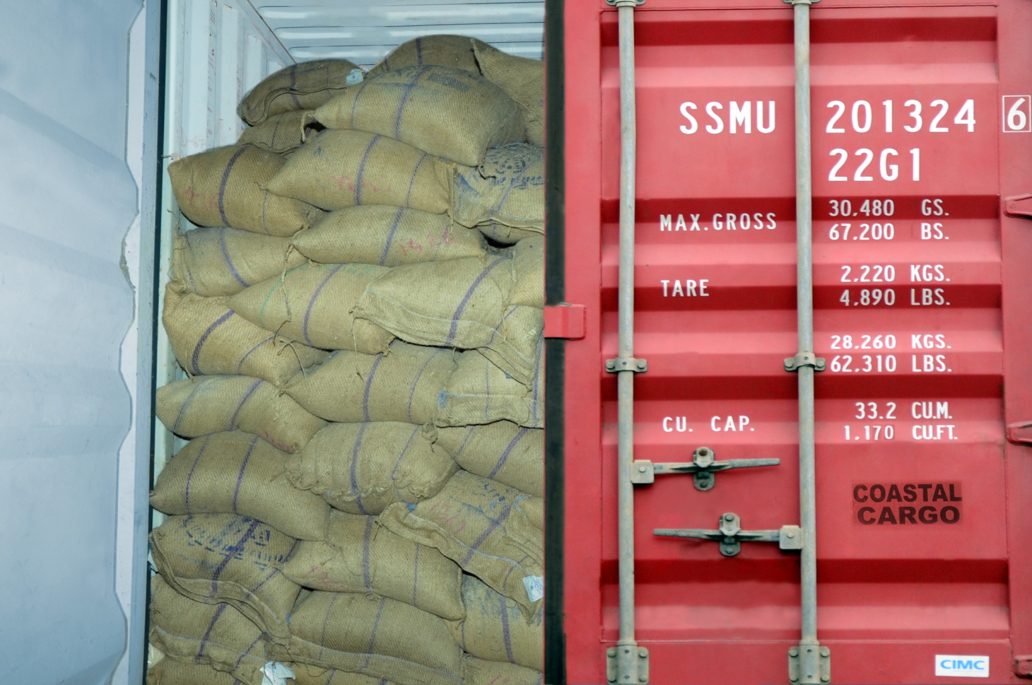
RICE
www.transworld.co/srs

Slide 12
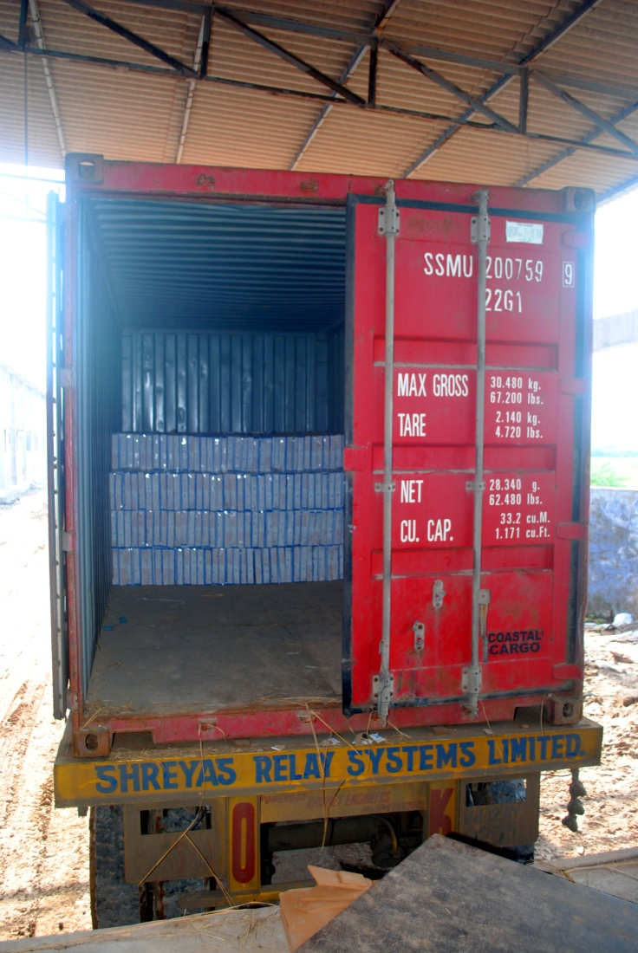
TILES
www.transworld.co/srs

Slide 13
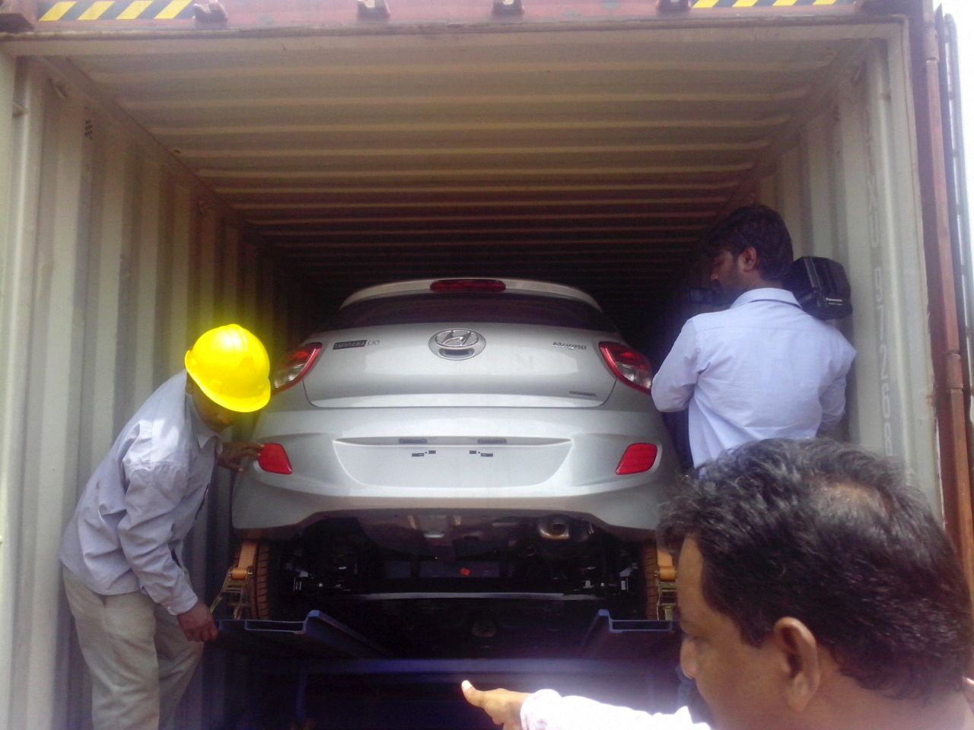
CAR
www.transworld.co/srs

Slide 14
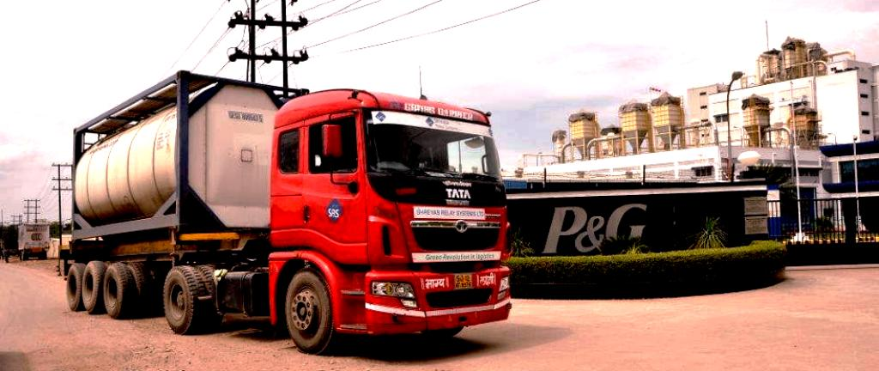
LIQUID CARGO
www.transworld.co/srs

Slide 15
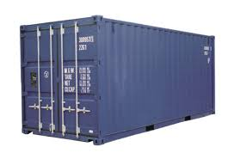
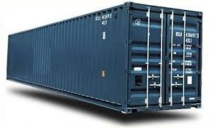
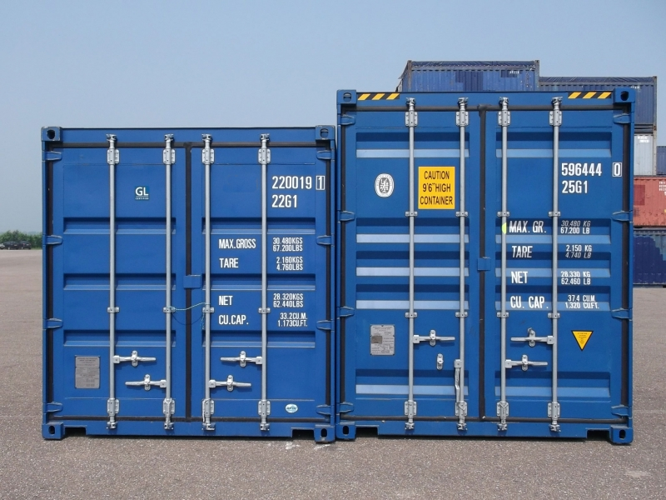
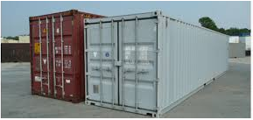
CONTAINER
- Standard Steel Container
20” Standard Steel Container
40” Standard Steel Container
20” High Cube Container
40” High Cube Container
www.transworld.co/srs

Slide 16
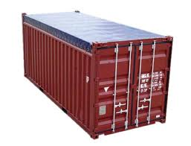
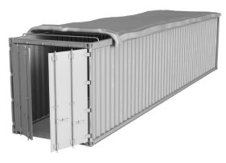
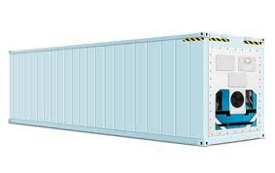
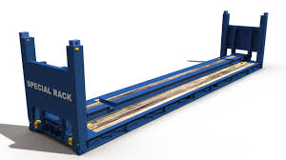
CONTAINER
- Open Top Container
20” Open Top Container
40” Open Top Container
40” High Cube Reefer Container
40” Flat Rack Container
www.transworld.co/srs

Slide 17
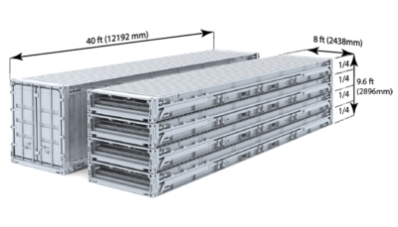
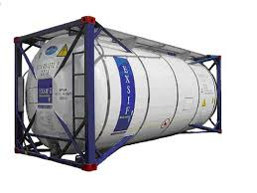
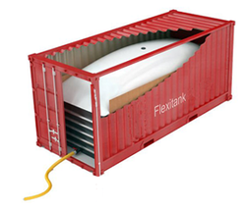
CONTAINER
- Others
20” Tank
40” Foldable Containers
20” & 40” Flexi Bags
www.transworld.co/srs

Slide 18
KEY FOCUS AREAS
Logistics Cost
User Innovation
Environment
Logistics Partnership
Network Optimization
Economy
www.transworld.co/srs

Slide 19
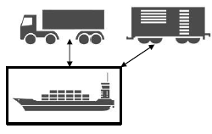
KEY FOCUS AREAS
Logistics Cost
User Innovation
Environment
Logistics Partnership
Network Optimization
www.transworld.co/srs

Slide 20
NETWORK OPTIMIZATION
- Present State
Unfavorable Model Mix, which is skewed towards road – as a major mode of transport
followed by rail and under utilization of modes such as Coastal shipping and Inland
Waterways.
Developing countries are able to reduce unit cost of production by as much as 20% by
optimizing their networks – “Just in Time”.
Previous research suggests “optimizing Indian logistics network can give 11% cost
benefit”.
www.transworld.co/srs

Slide 21
KEY FOCUS AREAS
Logistics Cost
User Innovation
Environment
Logistics Partnership
Network Optimization
www.transworld.co/srs

Slide 22
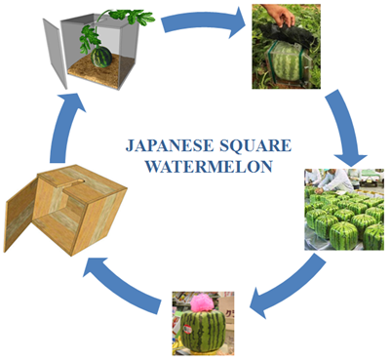
JAPANESE SQUARE WATERMELON
Watermelons are big and round, waste lot of space. It wasn’t long before they invented the square watermelon – grew them in square box. It was much easier and cost effective to ship the watermelons.
www.transworld.co/srs

Slide 23
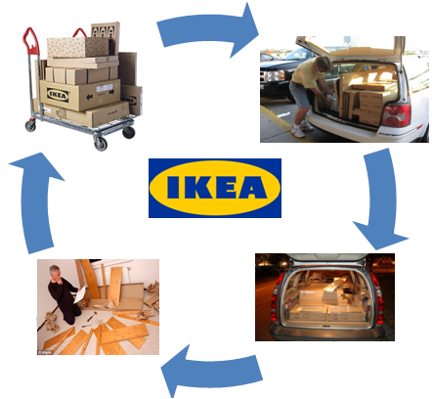
IKEA
IKEA stores got massive product line (9,500) and involves with lot of transportation activities, therefore transportation costs form a large part of their total cost. To reduce cost and improve transportation efficiency, IKEA reengineered their products and optimized their package techniques. As a result, dramatic savings in costs, they have realized a savings of $200 to $300 and 15% more loading per container.
www.transworld.co/srs

Slide 24
KEY FOCUS AREAS
Logistics Cost
User Innovation
Environment
Logistics Partnership
Network Optimization
www.transworld.co/srs

Slide 25
ENVIRONMENT
The transport sector plays a crucial role in world energy use and carbon emissions.
Transport energy use amounted to 26% of total world energy use (EPA).
Transport sector was responsible for about 23% of world carbon emissions (IPCC).
Indian transport industry increased its carbon emission by 17% over last 20 years (ITF).
Data suggests, today the “Carbon Emission Norms” for shipping is almost five times
less as compared to the highest emission by other modes.
Previous research suggests “Optimizing our network can give 11% cost benefit and
reduction of carbon emission by 10%”.
Mode of Transport | Latest contribution composition | Carbon Emission** (Grams of Carbon for 1 ton of cargo per KM)
Road | 83% | 62
Rail | 5% | 22
Air | 9% | 602
Sea | 3% | 16
** Source: Guidelines for Measuring and Managing CO2 Emission from Freight Transport Operations.
www.transworld.co/srs

Slide 26
ENVIRONMENT
www.transworld.co/srs

Slide 27
KEY FOCUS AREAS
Logistics Cost
User Innovation
Environment
Logistics Partnership
Network Optimization
www.transworld.co/srs

Slide 28
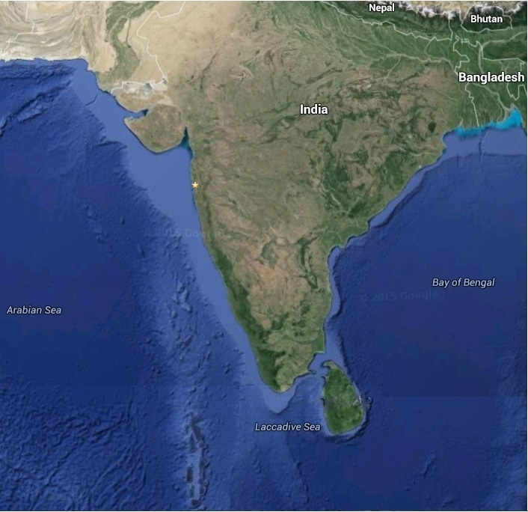
PORTS CONNECTIVITY
●
●
KOLKATA
MUNDRA
●
●
●
HALDIA
PIPAVAV
HAZIRA
MUMBAI (JNPT)
●
●
VIZAG
●
KAKINADA
●
GOA
MANGALURU
●
●
CHENNAI
KOCHI
●
TUTICORIN
●
www.transworld.co/srs

Slide 29
COASTAL CONTAINER SERVICE
- Highlights
First Indian Logistic Company to provide Coastal Container Service.
Certified by DNV Quality Registrar in accordance with ISO 9001:2008.
Cost effective.
Capacity to Handle Large Volumes.
Better Cargo Safety.
Energy Efficient and Environmental Friendly.
Protects National Highways.
www.transworld.com/srs

Slide 30
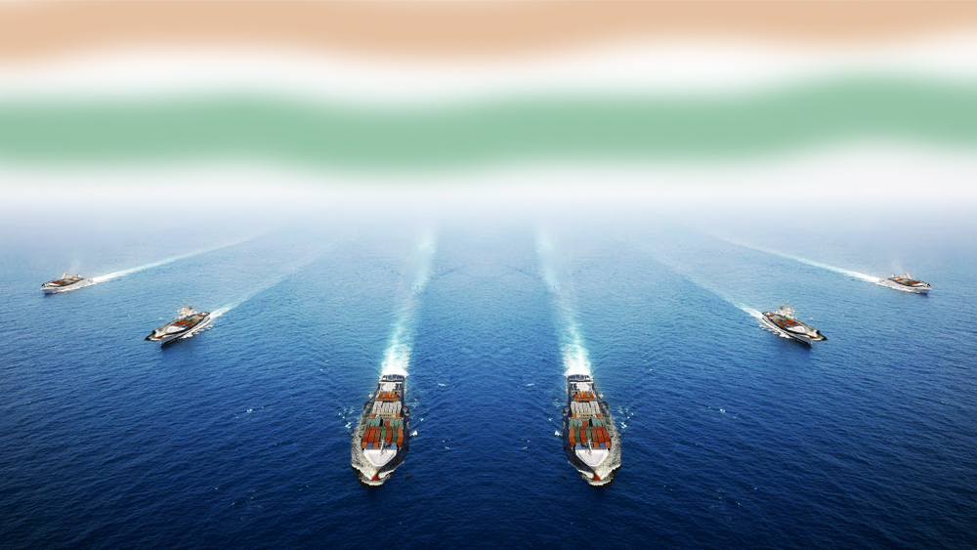
Fleet of 9 Indian Flag vessels

Slide 31
VESSEL DETAILS
NAME | CAPACITY | GRT
 | (In TEUs)
M.V. SSL BHARAT | 2,959 | 29,383
M.V. SSL Trust | 1,050 | 11,872
M.V. SSL Sagarmala | 569 | 6,942
M.V. SSL Mumbai | 1,645 | 18,602
M.V. SSL Kochi | 1,725 | 21,339
M.V. SSL Kutch | 1,725 | 21,339
M.V. SSL Gujarat | 1,613 | 18,602
M.V. SSL Chennai | 700 | 8,214
M.V. SSL Vishakhapatnam | 1,613 | 18,602

Slide 32
FIRST time in India
Shreyas opens
East - West corridor
for containerized trade link

Slide 33
Pan India Express - 1
Current Services
M.V. SSL Kochi & M.V. SSL Kutch
Weekly Service
Mundra Hazira Cochin
Tuticorin Mangalore Goa Mundra
PIX 1

Slide 34
Pan India Express - 2
Current Services
M.V. SSL Bharat, M.V. L.B Shashtri , M.V SSL Gujarat and M.V SSL Vishakapatnam
Weekly Service
Mundra Katupalli Krishnapatnam
Chennai Tuticorin Cochin Jebel Ali Mundra
J
PIX 2

Slide 35
ECS Services
Current Services
M.V. SSL Trust, M.V. Sagarmala & M.V SSL Chenani
Weekly Twice
Krishnapatnam Vizag Kolkata
Haldia Vizag Krishnapatnam
ECS

Slide 36
SMILE SERVCIE
Current Services
M.V. SSL Mumbai & Rajeev Gandhi
Weekly Service
Mundra Pipavav Cochin
Tuticorin Mundra
SMILE

Slide 37
ECONOMY
 | Price Per MT (Coastal ) | Price Per MT (Other Modes)
Gujarat to Cochin | 1250 | 4000
Gujarat to Chennai | 2000 | 4200
Gujarat to Kolkata | 2350 | 5500

Slide 38
ECONOMY

Slide 39
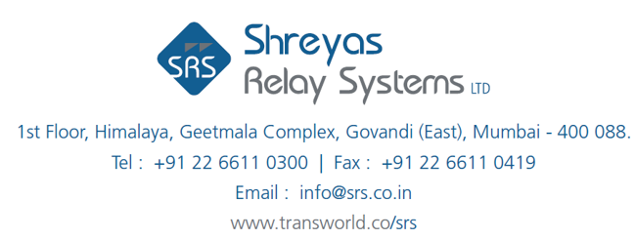
THANK YOU
www.transworld.co/srs

