Slide 1
HYDRAULIC AND COMMERCIAL CONSIDERATIONS OF Development of national waterways of india
BY
Prof.Somenath Ghosh,
Retd Professor of Civil Engineering,
IIT Kharagpur and Ex-Chief Hydraulic Engineer, Kolkata Port Trust.

Slide 2
It is very interesting to note that in India inspite of having huge potential for transportation by inland navigation through the river Ganges and Brhmaputra it has only received marginal considerations compared to rail and road transport. There exists lots of information as to why the inland navigation has not received its due importance inspite of the Govt of India notifying the creation of National Waterway one and two for the economic development of India. I shall not go into them but will try to point out some issues regarding the development from hydraulic and water availability and commercial point of view

Slide 4
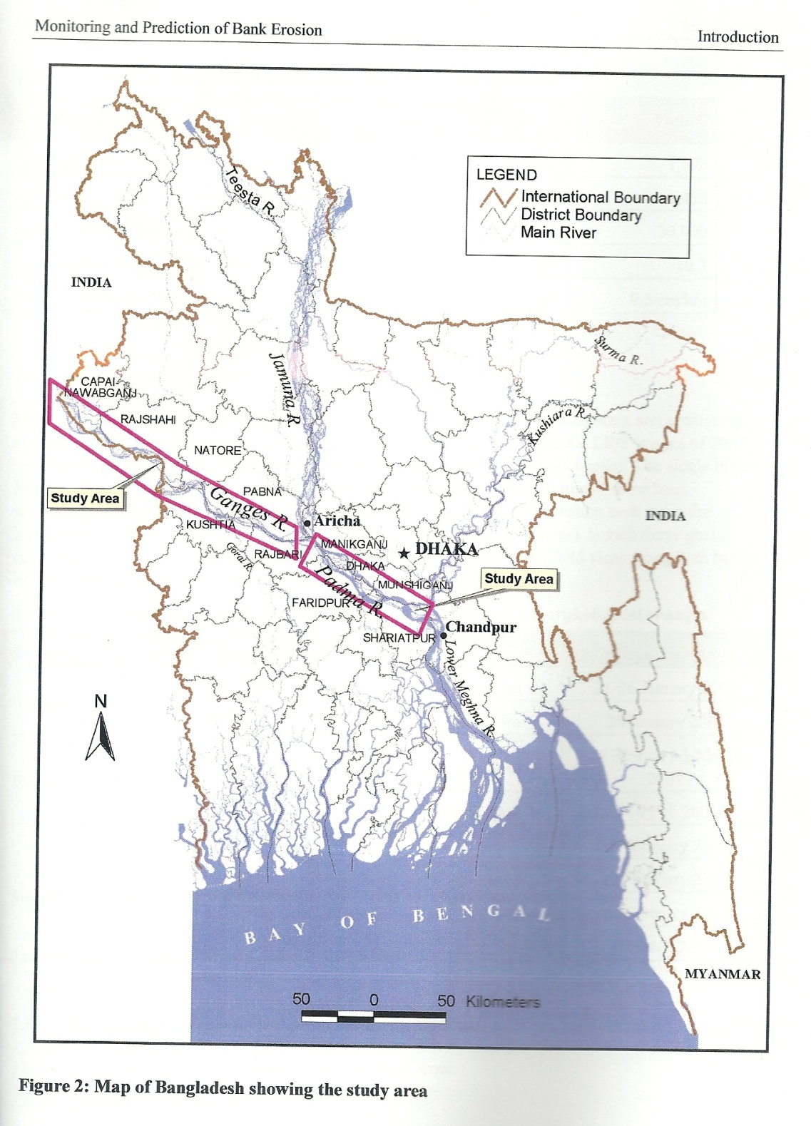

Slide 5
Water transport is relatively inexpensive and has hence been developed on a large scale in many countries. The importance of inland navigation is continuously growing on account of the rising cost of petroleum products and the emphasis on control and abatement of pollution. Rivers such as Danube, the Rhine and the Volga in Europe have been regulated and developed for Navigation. For a river to be navigable, its low water discharge and cross section must be such so that the minimum depth required for navigation is always available. In some cases low flow has to be supplemented from outside sources to attain such a depth. Other measures to obtain adequate depth at low flows include dredging the shallow patches in the river and using spurs or jetties to narrow the stream thereby increasing the depth. In addition any sharp curves along the river reach must be eliminated so that ships can turn fairly easily. After rectification in this way certain reaches may require stabilization of the banks.

Slide 6
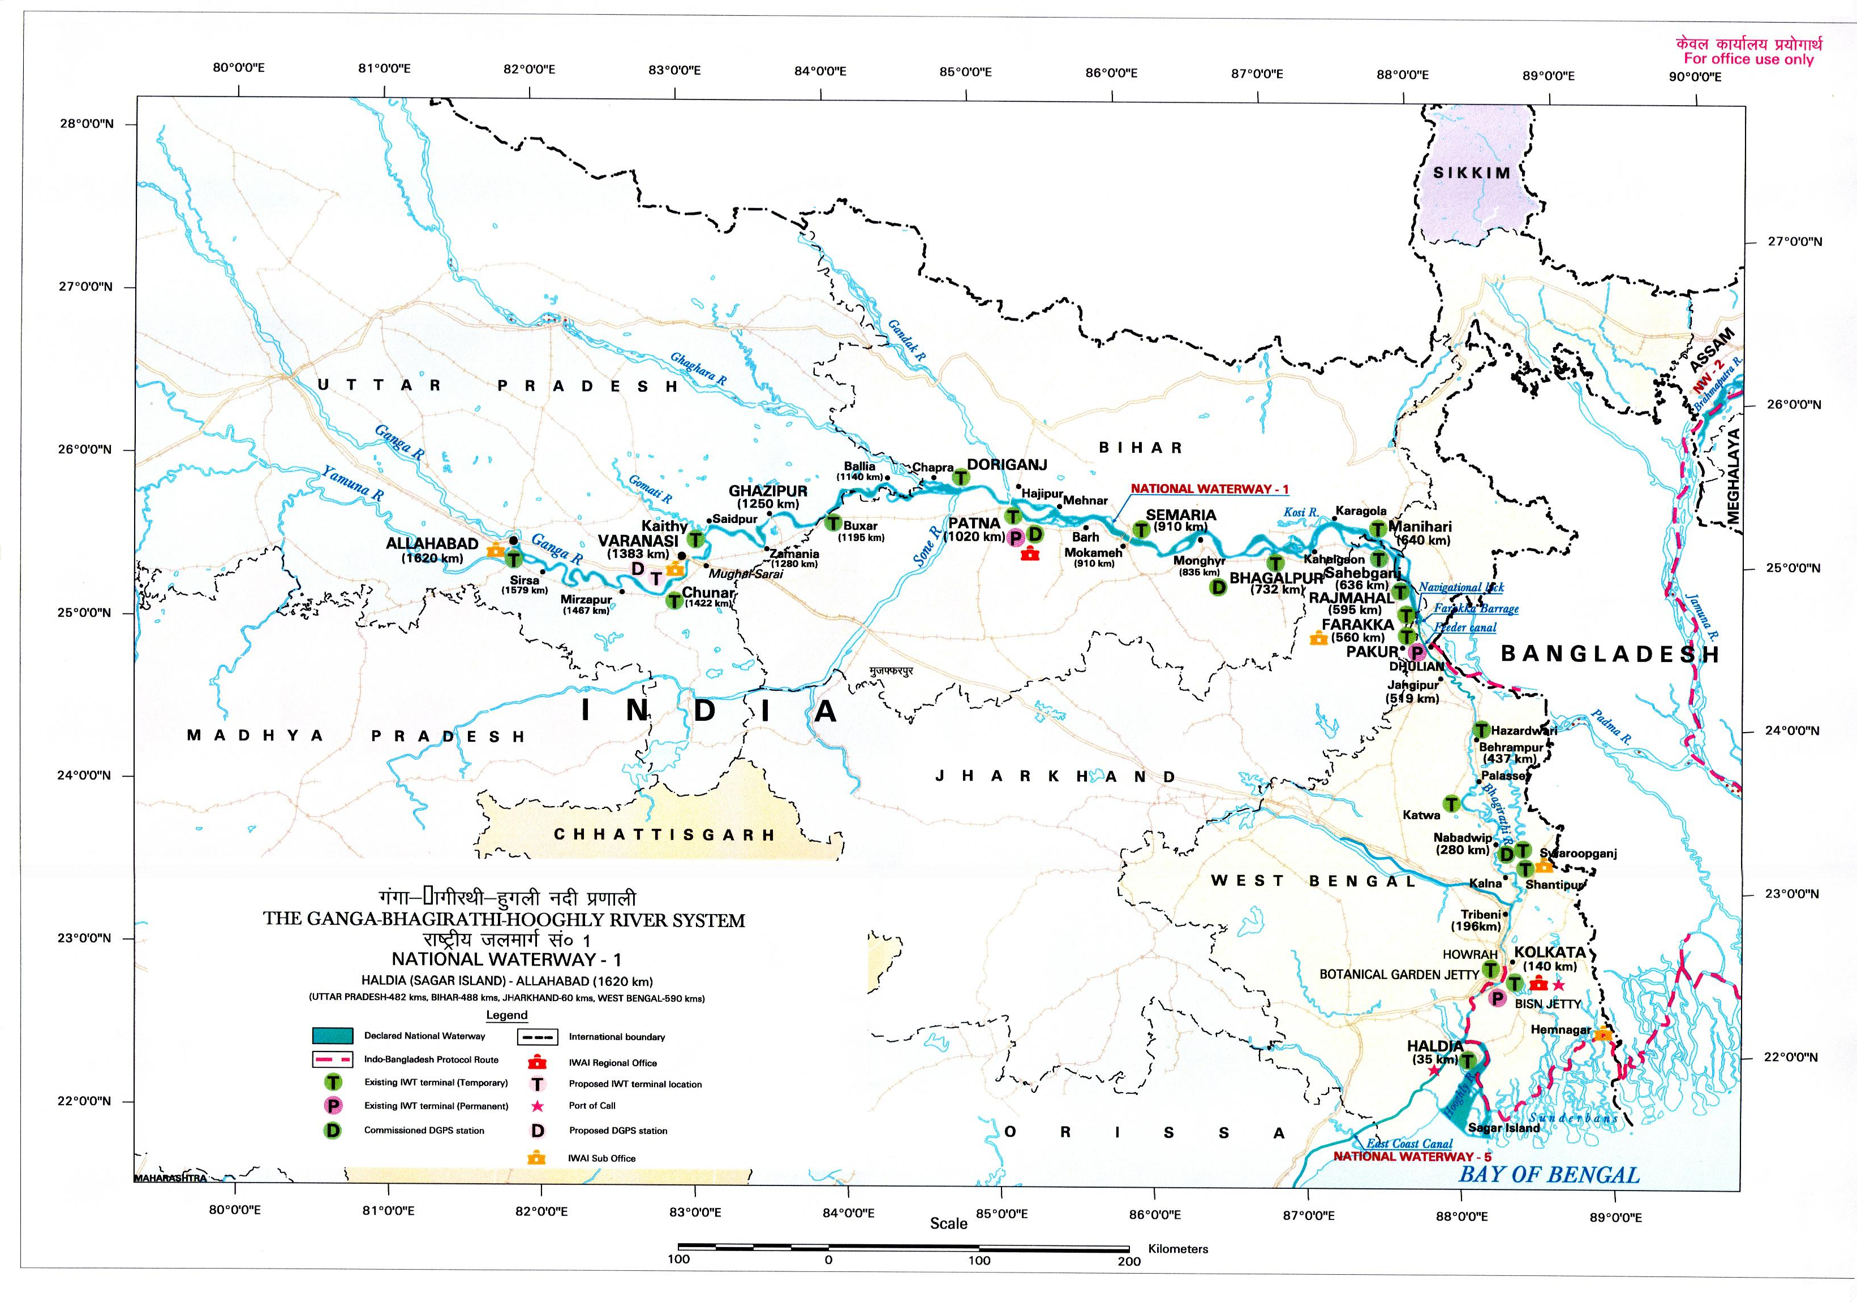

Slide 7
I shall now briefly touch upon some features of Ganga Brhmaputra basin. The combined flow of the Bhagirathi and Alkananda forms the Ganges. The Bhagirathi originates from the Gangotri glacier and the Alkananda rises in the Anzkar range in the west of Nandadevi. Fig1. The length of the Ganges from the west of the Nanda Devi to the confluence of the Jamuna River at Aricha is about 2200Km. Several tributaries have merged to form the main flow of Ganga. Three trans- Himalyan distributaries the Karnail, Gandak and Sapt Kosi originating in Nepal contribute about 41% of the total annual flow of the Ganges system. The river enters Bangladesh through the Chapai Nawabganj District and flows about 110 km along the international border of Bangladesh and India Fig2. occupying the territories of both the countries. From the offtake of the Mathabhanga River, the Ganges enters completely into the territory of Bangladesh.

Slide 8
The length of this reach upto the confluence of Jamuna river is 120km. The average width of this reach of the river is 5.3 km but varies from 1.5km to 14 km. The annual average flow as measured at Hardinge Bridge since mid 1930 is about 11000 cubic meters per second.
The Brhmaputra (Tsangpo) originates in the vicinity of Mount Kailas and Manossarovar Lake and drains the Northern face of the Tibetian Himayays and the southern slopes of the Kailas, Aling Kangri and Nyenchenthangla Ranges.The river traverses the Tibetian plateau, east west and then take hairpin bend between the lofty Namche Barwa and Gyala Peri peaks.before entering Arunachal Pradesh of India and subsequently flowing west words before making a complete turn east word to join Ganga and the combined flow is taken care of by Meghna near Goalanda before debouching into the Bay of Bengal.

Slide 9
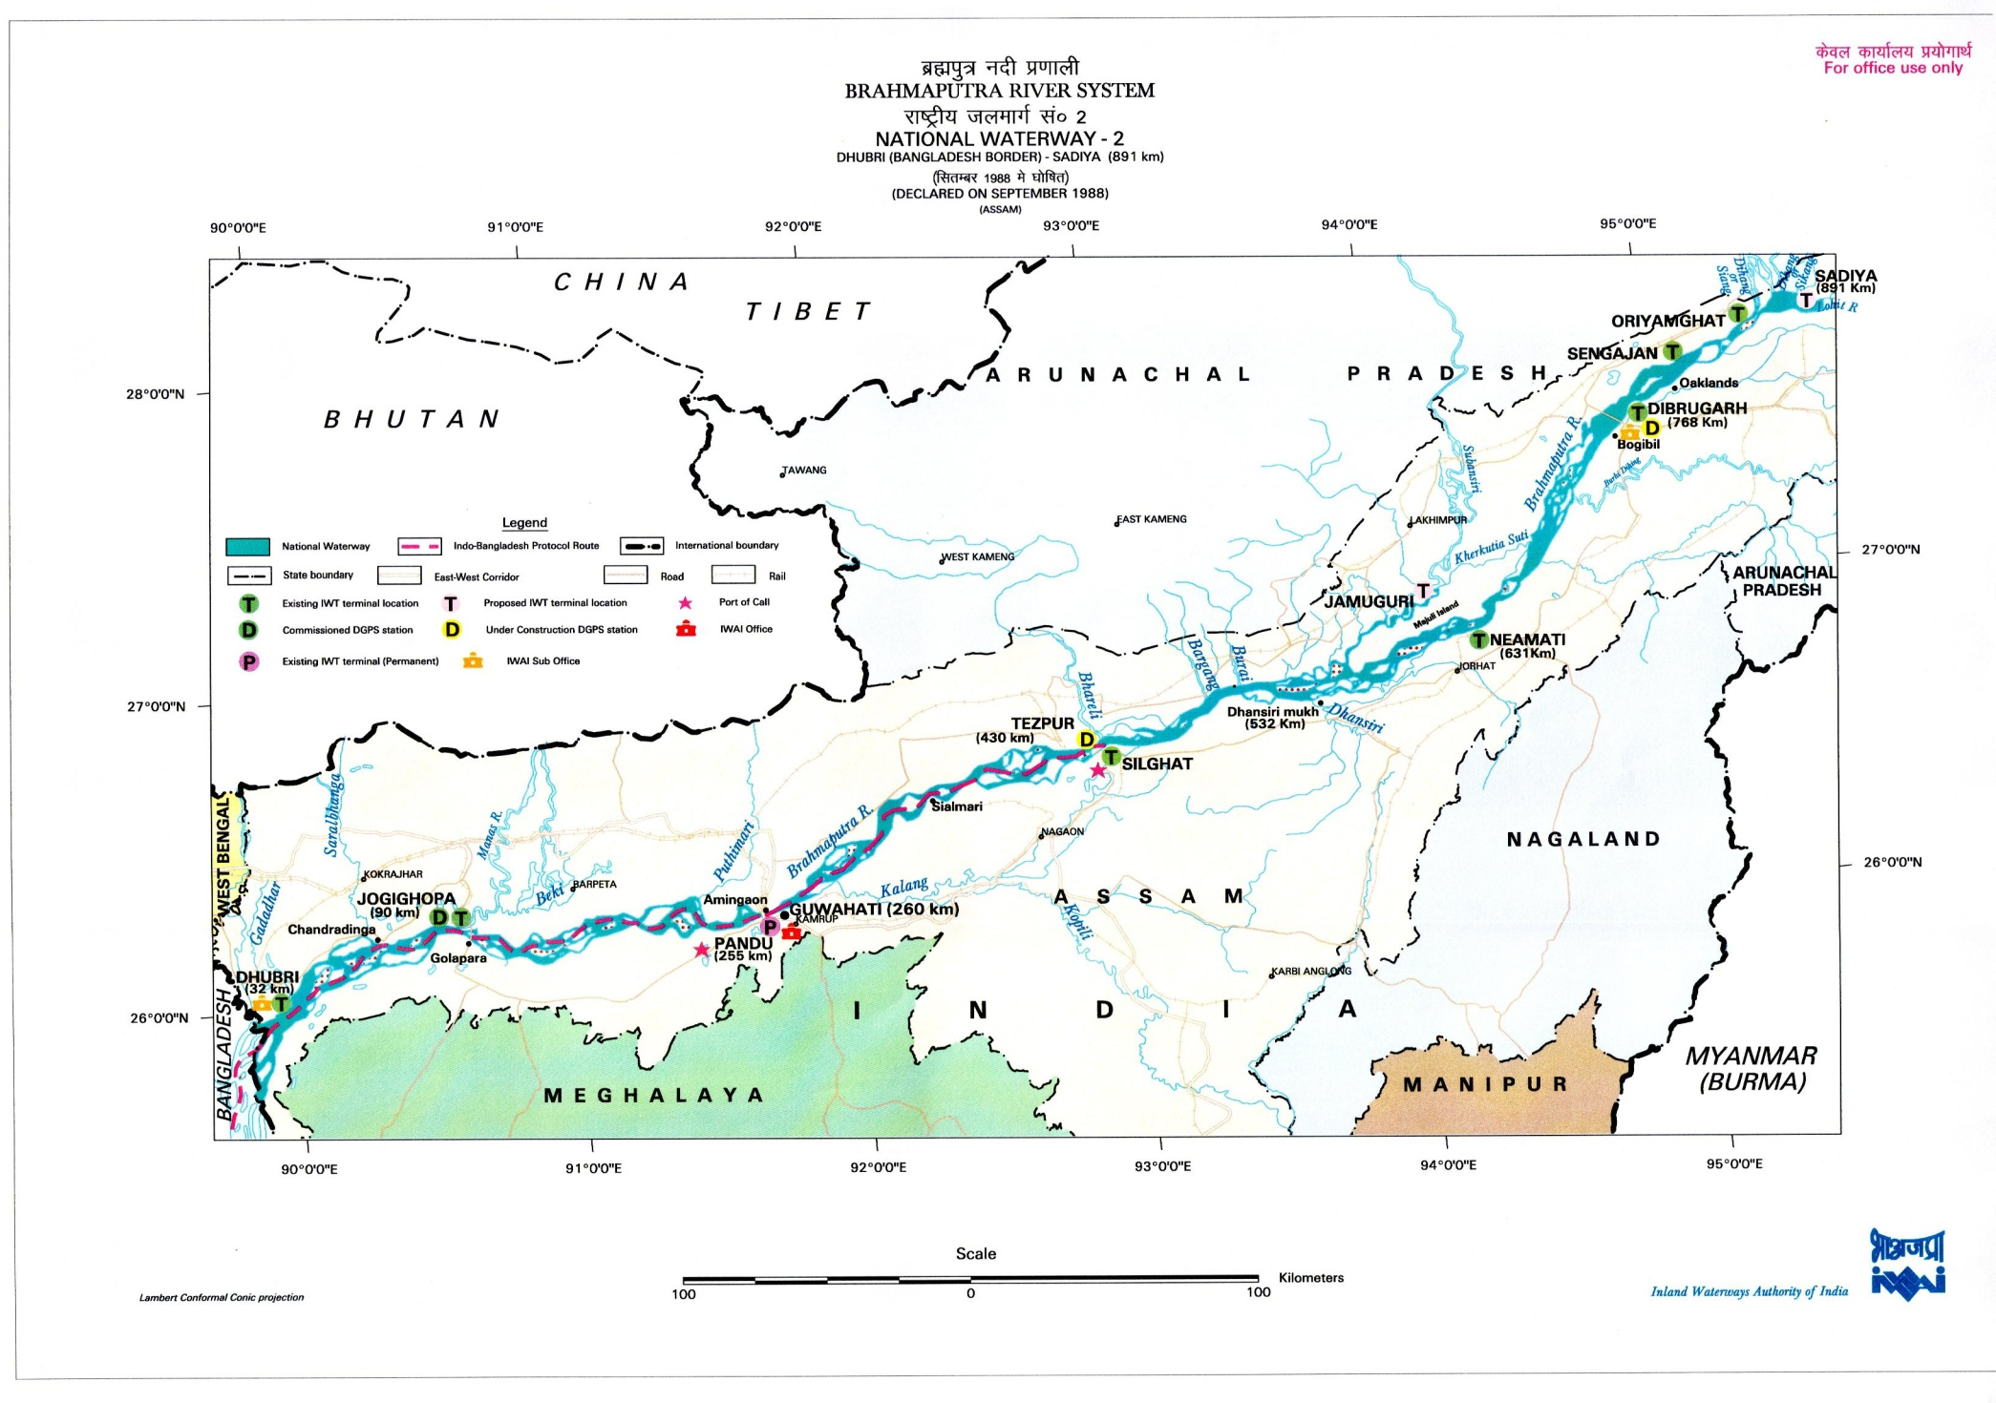

Slide 10
Fig. shows the National Waterway one. It falls under three sectors, Haldia to Farrkka 500 km, Farrakka Patna 480 km and Patna Allahbad 600km. The lowest 100 kms of thw waterway between Haldia and Nabadwip located above Kolkata is a tidal reach and presents no problems for barges which do not require a draft of more than 1.5m. Between Nabadwip and Farrkka however dredging or cother conservation measures may be necessary at locations depending on hydrographic surveys . Farrakka lock is part of the National waterway, but was still being probably operated by the Water Resources Ministry of the Govt. Of India. Farrakka complex Fig. consists of a 2245 km long Barrage across the Ganga, designed with a surplussing capacity of 76500 cumecs, a 38.3 km long feeder canal diverting upto 40000 cusecs of water to Jangipur where the Bhagirathi takes off from the Ganges.The Bhagirathi off take is chocked with silt and the head water supplies from the Ganga only enters during the monsoon months.

Slide 11
A barrage on the bhagirathi at Jangipur prevents the waters fed into the feeder canal at Farrakka flowing back into the Ganges. A lock has been built at this point to provide a navigation link from the Hooghly Bhagirathy into the Ganga Padma into Bangladesh. The Frrakka lock bridges the difference between the bed level of the Ganga and the Pond level of the Farrakka reservoir. The lock has two chambers each 25.15m wide and 180.7 m long sufficient to pass a craft or a barge train upto 1500 tonnes Provision has been made for adding a second lock at a future stage.The feeder canal has minimum draft of 4 m.The navigational lock at Frrakka facilitates navigation of vessels from Ganga into Bhagirathi via feeder canal. Studies have indicated that the optimum of head water discharge for the improvement of 17 bars and crossings in the river Hooghly and its estuary is of the order of 40 000 cusecs. Farrakka barrage started operation from 1975. Most of the 12 bars and crossings from kolkata to DH showed noticeable gain in navigable depth due to fresh water intrusion into the Bhagirathi Hooghly.

Slide 12
The other benefits included reduction of salinity intrusion, incidence of tidal bore and quantam dredging from Kolkata Port to hooghly point. The effect of Farrakka discharge on Bhagirathi resulted in increasing capacity of the river as well as bank erosion. The upper tidal compartment of the Hooghly river from Nabadwip to Mograkhal got silted up considerably.However during lean season Jan-May due low arrival of Ganga waters upstream of Farrakka low flows of the order of 36000 cusecs to as low as 14000 cusecs were diverted through feeder canal. Lean season flow of the order of 50000 cusec in the river between Rajmahal to Farrakka on Ganga that has a maximum capacity of 2.7 million cusecs caused great difficulties in maintaing the requisite draft in the navigational channel leading to feeder canal. Under the treaty of mutual sharing of water between India and Bangladesh for arrivals at Farrakka of 75000 cusecs or more India would draw 40 000 cusec and the balance will go to BD.Between 75 to 70 thousand cusec BD will get 35000 cusec and the rest to India.

Slide 13
For less than 70000 the sharing will be equal between the two countries. There is a guarantee clause that would enable both countries to receive 35000 cusecs in alternate three 10 day period during March 11 to May 10 starting BD. There are other clauses in the treaty notably the following that there is need in finding a solution on long term for augmenting the lean water flow, which means creation of storage facilities on Sarada, Ghagra, Gandak and Kosi then more water will flow in the NW 1 between Allahabad and Kolkata which will ensure a better draft at Kolkata.
5.The hydrographic survey of the middle sector between Farrakka and Patna has been completed and conservancy works have probably been undertaken with bandalling to divert river flows to scour a deep channel to provide freeway with the requisite 2m depth and 45 m width. There is upto a 9 m level difference in river levels between the lean season and floods and the deep channel keeps changing course. The challenge is to moderate the channel fluctuations and to maintain a fairly constant fairway, which needs to marked appropriately for safe.

Slide 15
The 600 km sector between Patna and Allahabad have several navigational problems. Above Patna the lean season draft in the Ganga varies between 1.2 to 1.5 m and more than 20 shoals are there out of which some will reqire dredging and others may be overcome by Bandalling For this one would require dredgers, survey vessels, instruments and other marine facilities are needed
6. The National Waterway two covers the distance from Dhubri ( Bangladesh border to Sadiya a distance covering 891 Km along the mighty Brhmaputra river.The Indian vessels are cleared to operate in the transit waterways in Bangladesh while moving from Kolkata to Dhubri. The route take vessels from Kolkata to Sundarbans and into Bangladesh waters at Raimangal and then on to Khulna and Chandpur at the confluence of Padma and Meghna. From here barges bound for Guwahati move up the Brhmaputra ( Jamuna in BD) to Bahadurabad-Chilmiri and on to Dhubri. From Dhubri to Sadiya. The Brhamaputra has sufficient draft year round though some conservancy works may be required to canalize the lean season flows of this largely braided river.

Slide 16
With storage on the Brhmaputra system in Arunachal Pradesh a stable deep water fairway
could be available along the entire length of assam Valley and into Bangladesh The Farrakka Padma link would also provide a shorter and better navigation route between Kolkata and Guwahati. With the declaration of Dhubri Sadiya reach as National waterway terminal facilities are being planned or under execution at Jogighopa, Guwahati, Silghat, Tejpur and Neamati. A terminal is also propsed at Karimganj.

Slide 17
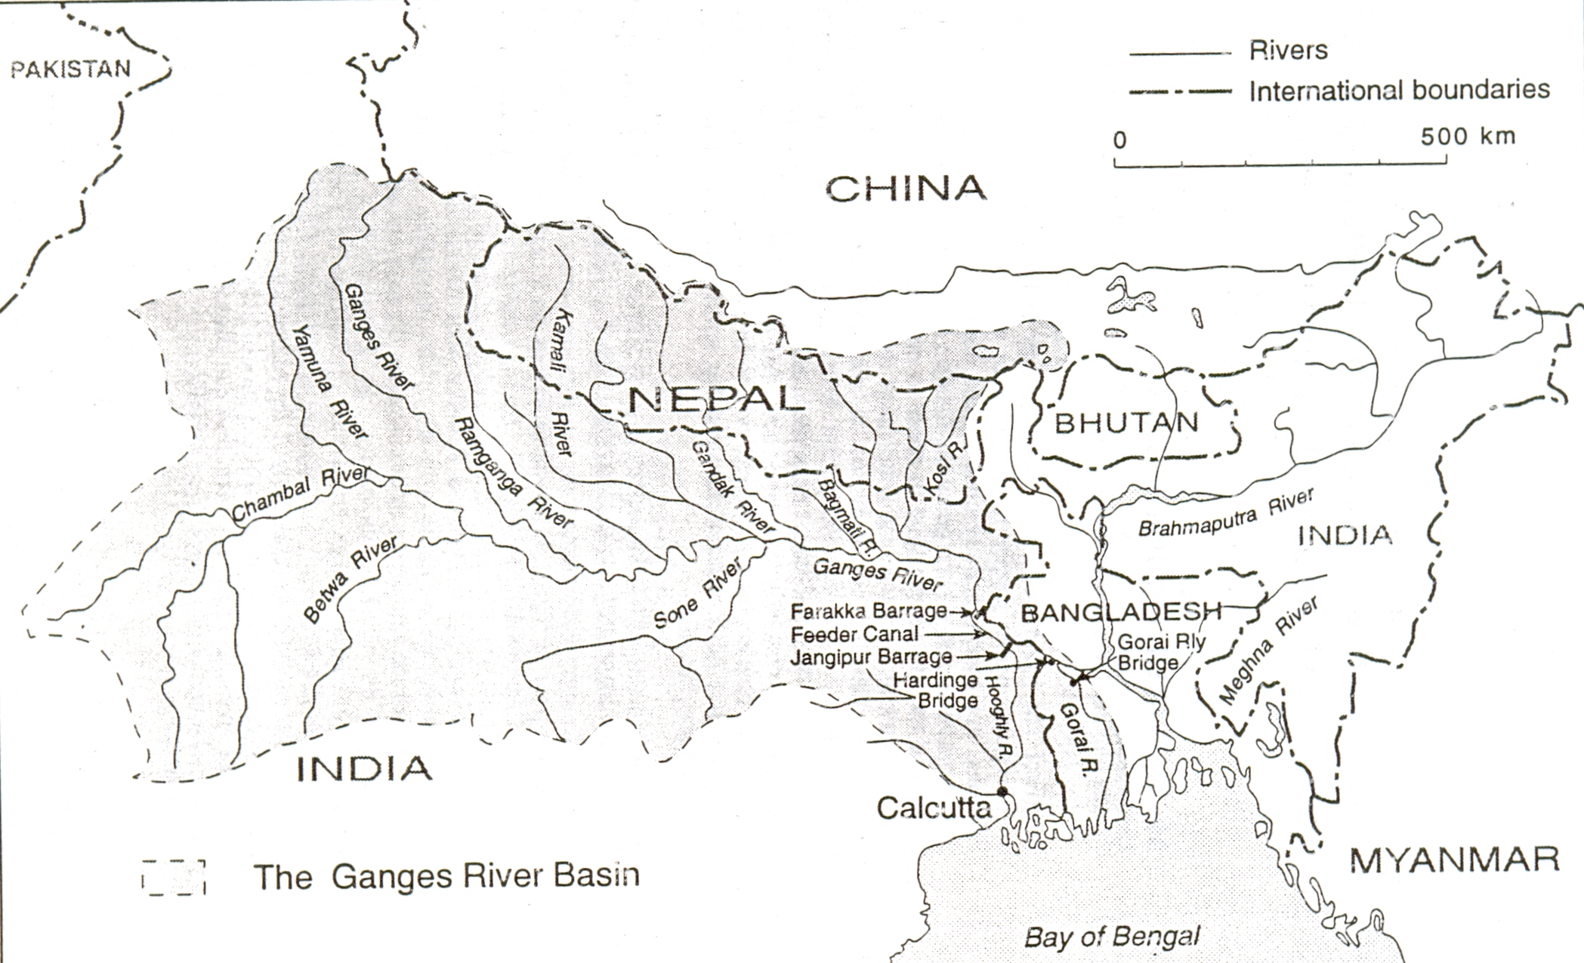

Slide 18
7. So far we have discussed hydraulic considerations involved for maintaining suitable draft during lean season flows so as to make possible inland navigation of crafts to take place and for this it is essential to have adequate facilities like survey vessels, dredge equipments, marking of shipping lanes especially night navigation, jetties and other infrastructural facilities that will be necessary for proper maintenance. So it requires a good deal of capital investments and inorder to be financially viable the revenue earning potential from the cargoes have to be assessed. Besides there is the question of proper type and mix of craft that should be used have to be given careful consideration. As it affects the cost overrun. Push towing has an advantage in so far as the prime mover is in constant use and can be employed to move a large number of dumb barges in trains of 125 tones each. A self propelled barge of say 600 tonnes with 460 HP engine can move independently. Modular sized deck loading barges or flats could carry containers while with holds may be required for certain types of cargos that require safe handling.

Slide 19
Here it may be mentioned that after creating an expensive infratstructure and then have no adequate traffic to move will be wasteful. Going by the consideration of energy efficiency IWT is at a considerable advantage as one HP of energy moves 150 Kg by roads, 500kg by rail and 4000kg by river To conclude it may be said although inland water transport has immence potential we hear about it occasionally during some impulsive jerk from someone in authority and later on everything goes into hibernation, this is basically because of the absence of a strong lobby both from key industries involved in bulk transport and political parties. For example Farrakka barrage was completed in 1971, the feeder canal in 1975 but the navigational lock was operational in 1987.

Slide 21
It is therefore important to lay down a policy frame work including studies regarding financial viability of different sectors of the waterway for developing and attracting riverine and coastal traffic by providing locational and other benefits as has been done during the last several decades in the case of roads and railways. With more emphasis on environment Globally it would seem desireable to support IWT and coastal shipping for expansion to reduce the pressure on freight corridors as also to reduce carbon emission which is responsible for Global Warming and resulting detrimental effects on floods, droughts, cyclones, sea level rise etc.

Slide 22
Thank You

