Slide 1
Best Practices on Industrial Production & Processes
Shri A K Agarwal
Deputy General Manager, IndianOil
(Haldia Refinery)

Slide 2
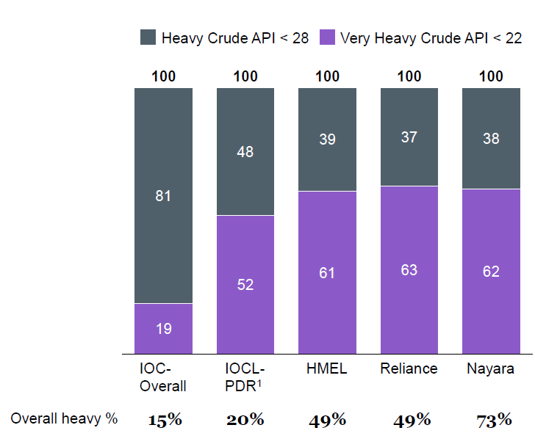
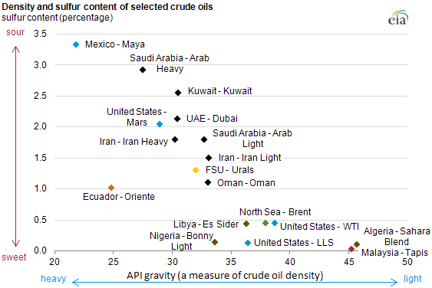
Crude Oil Import- 2018-19
Best Practices– Processing Cheaper Heavy Crudes
Heavy crude can give additional 1.5 $/bbl benefit to refiners
Globally diverse market for raw material
MARPOL had an impact on crude pricing, with sweet crudes such as Bonny Lt seeing a boost in 2020 relative to Brent but stabilizing after 2022.
Widening crude oil basket
Processing cheaper & heavy crude oils based on differentials

Slide 3
Supply chain optimization to achieve Resource Efficiency
Manage demand disruptions/Tankages lfexibility
Inventory Management
Avoid any criss- cross movement
Minimum Logistic Cost
Nil Dry Out at any location
Complete Customer satisfaction
Optimization of secondary intermediate feed for right product mix/ Refinery stream sharing
Refinery secondary products

Slide 4
Best Practices: Supply Chain through Cross Country Pipelines
Lower cost of transportation
~ 30-50% of the railway freight and 20-25% cheaper than road transportation
Lower transit losses
PL- 0.05% Max.,
Railway- 0.25%,
Road- 0.5%
Energy efficient
Railway mode consumes 3-4 times & road mode about 20 times more energy than Pipeline mode
Safety and Reliability
Minimum disruptions
Environment friendly
3-4 times lesser Carbon emissions than Railway mode

Slide 5
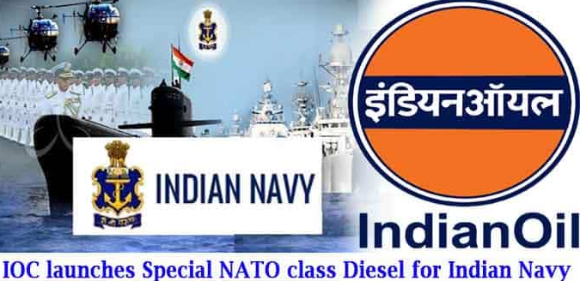
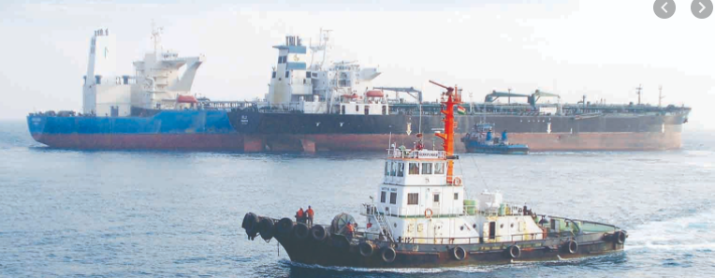
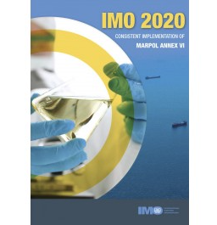
Expanding wings…a step towards Atmanirbhar Bharat
Haldia Refinery supplied NATO (North Atlantic Treaty Organization) Grade HFHSD
IMO 2020 : MARPOL FO production to cut down GHG emissions
……. Journey from 3.5% S to <0.5% S Fuel Oil

Slide 6
Best Practices: Process
Tube inserts for HEs in CDU-II for pre heat sustenance: Improve Turbulence & Tube side heat transfer coefficient
Operation of TC Vessels : IOCL has 24 TC Vessels -4 (crude oil), 8 (LPG) and 12 (product) tankers for which Bunkering is done by IOCL
Use of spent De-waxing catalyst in Idle Lube oil Hydro finishing unit: For production of LOBS & Winter grade Diesel
Indian Ship Owners are reluctant to fit scrubbers in their existing fleet. Adopting wait & watch approach, but prefers use of low Sulphur FO.
Enhancing LPG Yield through modern Zeolite Socony Mobil–5: Converting light gasoline range olefins (C6-C9) to LPG (C3 and C4 olefins)
Ensuring availability of compliant bunker fuel for coastal TC vessels before the 2020 regulations
Production of high class Gr-III Lube Oil Base Stocks from OHCU unconverted Oil
Identify suitable bunkering ports for foreign TC vessels – possible need to sign up long term contracts with single suppliers, for compatible fuels
Rigorous Online Modeling and Equation Based Optimization in RFCC Unit for improved yield of LPG, Gasoline
Cope up with possible spike in freight rates due to mass scrapping of old vessels, high cost of compliant fuel or vessel fitted with scrubber
Improvement in DCU skin temperature through pigging
Cope up with initial transition phase of uncertainties immediately after 1st Jan, 2020
Wet Gas Sulphuric Acid Production exporting 40 TPH HP steam to Refinery
Possible distortions in markets and conventional trade routes

Slide 7
Best Practices: Energy Conservation(Road towards net zero journey)
Advance Process Control ( APC) implemented in all major units of Refinery
Operation of TC Vessels : IOCL has 24 TC Vessels -4 (crude oil), 8 (LPG) and 12 (product) tankers for which Bunkering is done by IOCL
H2 Recovery from Refinery off-gases
Indian Ship Owners are reluctant to fit scrubbers in their existing fleet. Adopting wait & watch approach, but prefers use of low Sulphur FO.
Commissioning of Pressure recovery turbine in DHDT
Ensuring availability of compliant bunker fuel for coastal TC vessels before the 2020 regulations
Process optimization and steam network reduction
Cope up with possible spike in freight rates due to mass scrapping of old vessels, high cost of compliant fuel or vessel fitted with scrubber
Ejector steam Reduction in vacuum systems
Cope up with initial transition phase of uncertainties immediately after 1st Jan, 2020
Stripping steam reduction in fractionator columns
Possible distortions in markets and conventional trade routes

Slide 8
Best Practices: Energy Conservation
Flare monitoring through dashboard
Operation of TC Vessels : IOCL has 24 TC Vessels -4 (crude oil), 8 (LPG) and 12 (product) tankers for which Bunkering is done by IOCL
Waste heat and flash steam recovery from HRSG blow down
Indian Ship Owners are reluctant to fit scrubbers in their existing fleet. Adopting wait & watch approach, but prefers use of low Sulphur FO.
Replacing MAB & WGC Condensing Turbine Drive with Motor Drive
Ensuring availability of compliant bunker fuel for coastal TC vessels before the 2020 regulations
Hot stream feeding to Units
Identify suitable bunkering ports for foreign TC vessels – possible need to sign up long term contracts with single suppliers, for compatible fuels
Emissivity coating of major furnaces CDU,VDU & DCU
Cope up with possible spike in freight rates due to mass scrapping of old vessels, high cost of compliant fuel or vessel fitted with scrubber
Stoppage of cooling water pump by reorganizing CTs
Cope up with initial transition phase of uncertainties immediately after 1st Jan, 2020
Conversion of steam Re-boiler to Electrical Re-boiler
Possible distortions in markets and conventional trade routes

Slide 9
Best Practices: Safety
Intrinsically safe portable camera & tab has been built and configured to control portable camera mounted on fire tender with 360°view from incident location
Operation of TC Vessels : IOCL has 24 TC Vessels -4 (crude oil), 8 (LPG) and 12 (product) tankers for which Bunkering is done by IOCL
Critical job monitoring done during shutdown using portable CCTVs/wireless cameras on helmet
Indian Ship Owners are reluctant to fit scrubbers in their existing fleet. Adopting wait & watch approach, but prefers use of low Sulphur FO.
Biometric Based Entry System in Plant Area
Ensuring availability of compliant bunker fuel for coastal TC vessels before the 2020 regulations
Green signage on 150 nos. Safety Showers
Identify suitable bunkering ports for foreign TC vessels – possible need to sign up long term contracts with single suppliers, for compatible fuels
AI based PPE compliance system, Mobile detection system
Safety surveillance by drones during unit turndown period

Slide 10
Best Practices: Technology Transformation
“Laboratory Information System” – reduction of lead time
“Mobile Phone Detection system” – Enhanced Safety & Security
Data Reconciliation and Yield Accounting
ML Based Real time Yield optimization analytics
“Real Time Solution for Critical Alarms”
Vehicle speed detection system
Robotic Ultrasonic Crawler – more efficient & safe
Digitalization
Digitalization
Real time optimization- rigorous first principle model in RFCC

Slide 11
Best Practices Environment : Fresh water reduction
Parameter | 2020-21 | 2021-22 | 2022-23
Specific water consumption (m³/MT of crude) | 1.45 | 1.08 | 1.07
Fresh water consumption (m³/hr) | 1169 | 936 | 897
ETP Recycle Utilization (%) | 89.7 | 90 | 90.7
Water consumption reduced after taking various measures in CTs, ETP treated water quality improvement, steam consumption reduction, CW/FW/drinking water loss reduction
Total Industrial water consumption FY 22-23 : 31,652 m³/day
45% of total water consumption is CT make up water

Slide 12
Thank You

