Slide 1
Ecological Sustainability in the Industrial region

Slide 2
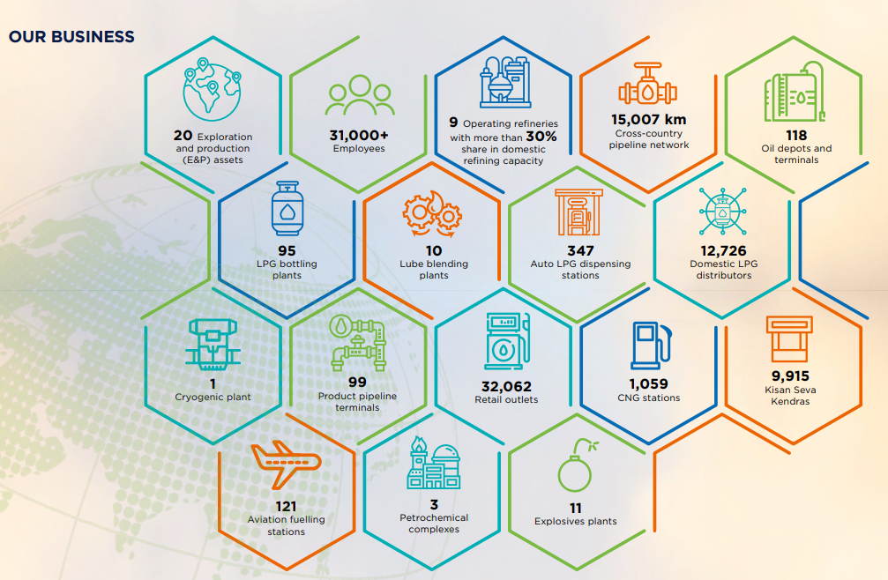

Slide 3
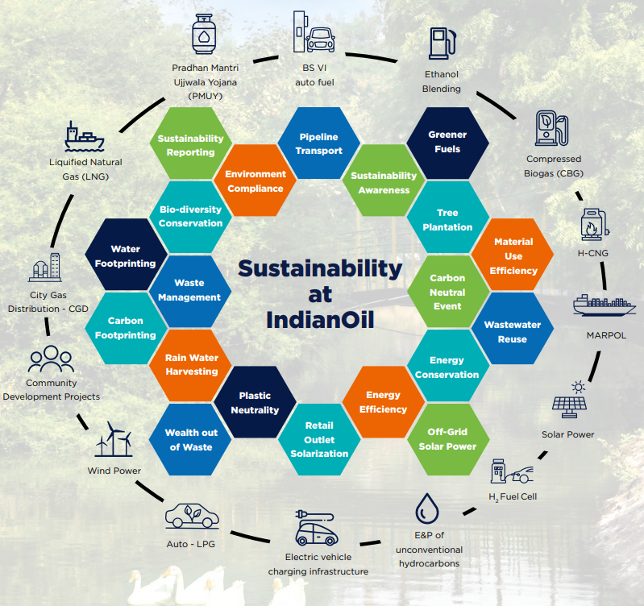
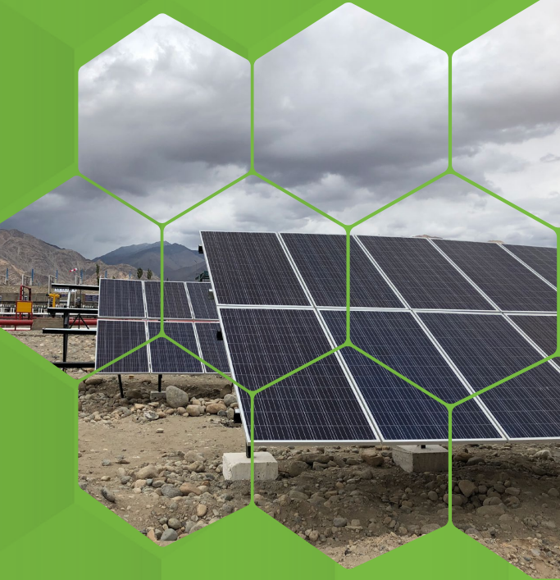

Slide 5
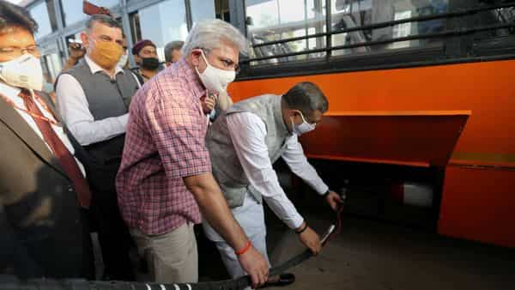
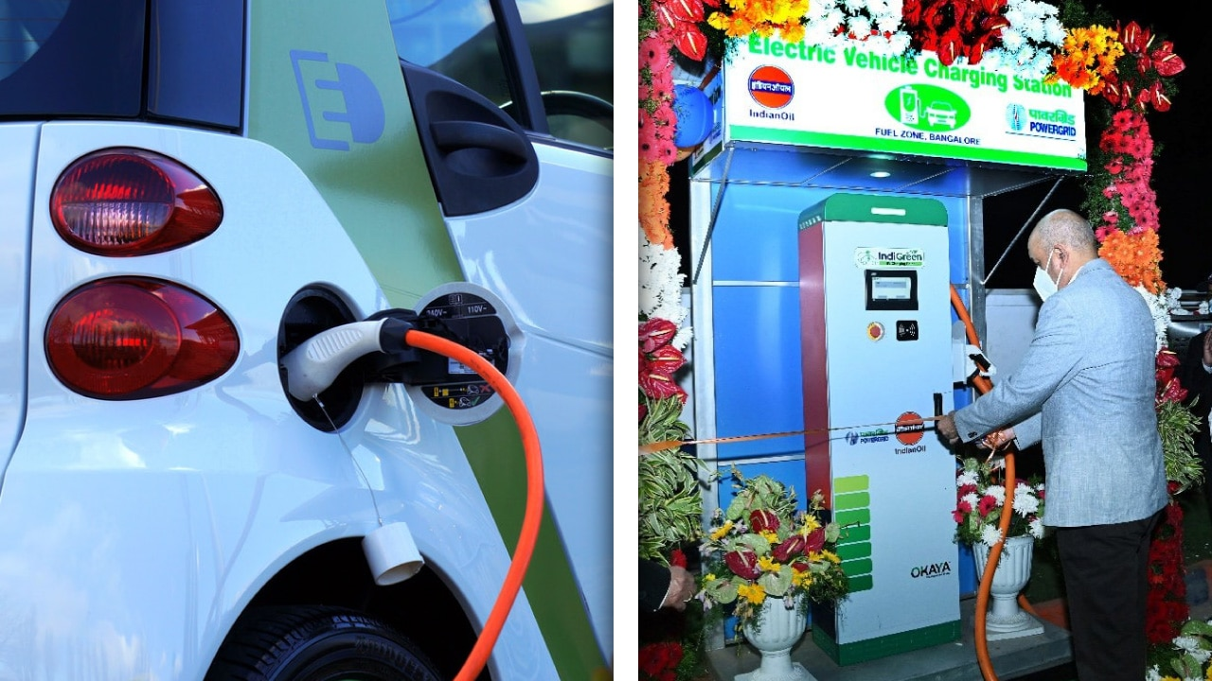
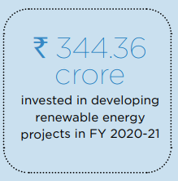
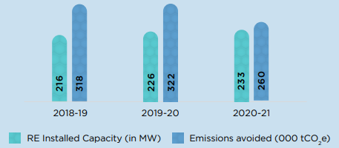
H2 CNG buses at Delhi - powered by a blend of hydrogen and compressed natural gas
IndiGreen EV Charging Station retail outlet in Bengaluru

Slide 6
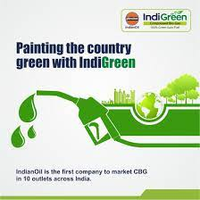
Organic waste to energy is a key focus area
Bioethanol.
Biodiesel from Used Cooking Oil (UCO)
Compressed Biogas: CBG is produced from organic waste and is an alternative to compressed natural gas (CNG).

Slide 7
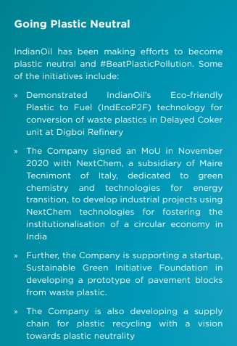
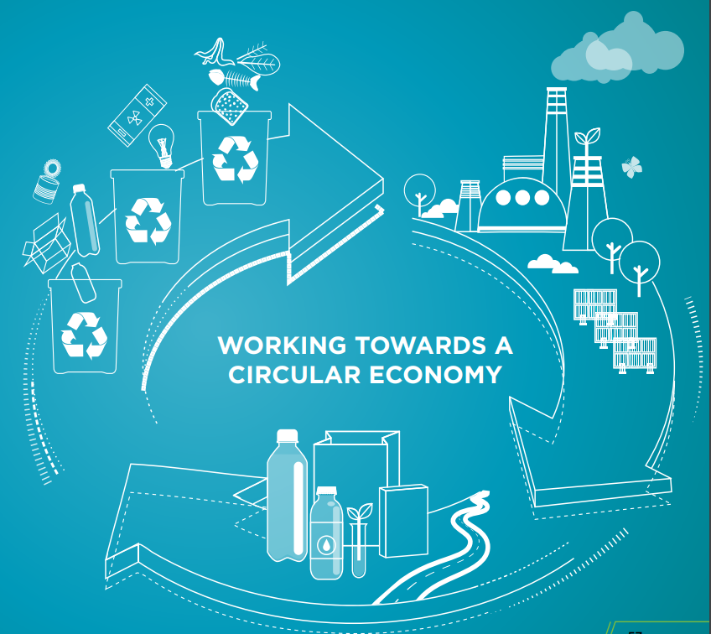

Slide 8
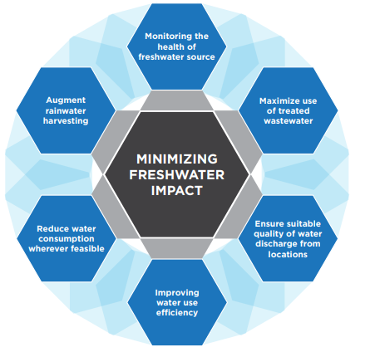

Slide 9
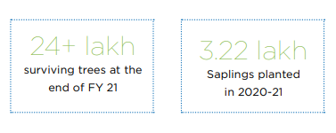
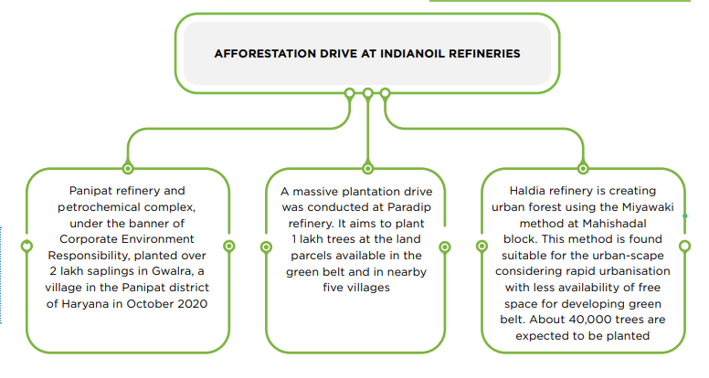

Slide 10
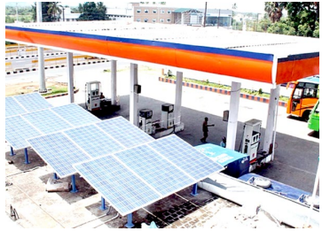
SOLARISATION OF RETAIL OUTLETS

Slide 12
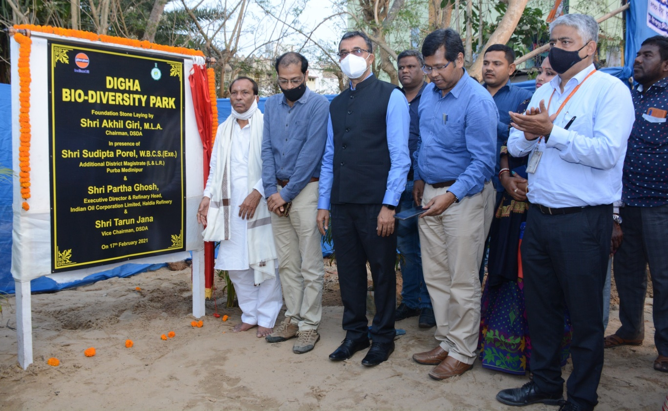
Bio Diversity Park at Digha
Foundation Stone of “Digha bio-Diversity Park” on Feb 2021
The ceremony was held in the august presence of Mr. Akhil Giri, M.L.A and Chairman- Digha Sankarpur Development Authority (DSDA),Mr Parth Ghosh, ED&RH, Mr. Sudipta Porel, Additional District Magistrate (L & LR)-Purba Medinipur & other senior officials

Slide 13
Coastal Shelter Belt Plantation
Massive plantation of approximately 35000 plants covering approx. 22 ha land at Balughata & Royraynachak Mouza

Slide 14
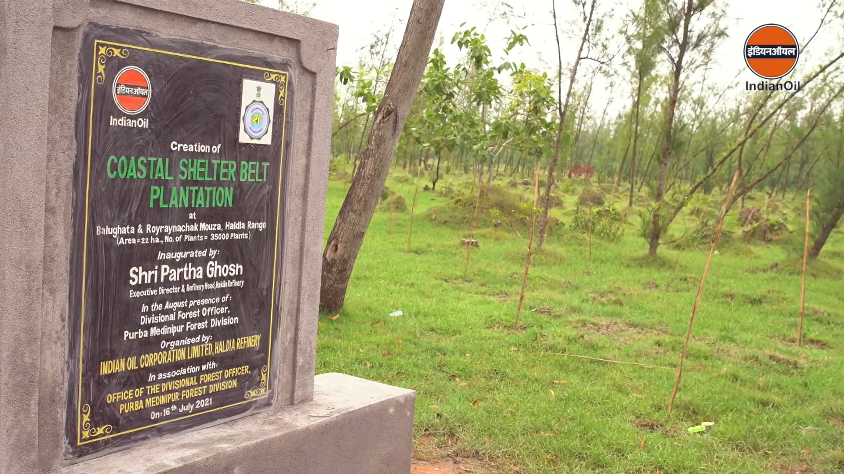
Coastal Shelter Belt plantation
massive plantation of approximately 35000 plants covering approx. 22 ha land at Balughata & Royraynachak Mouza

Slide 15
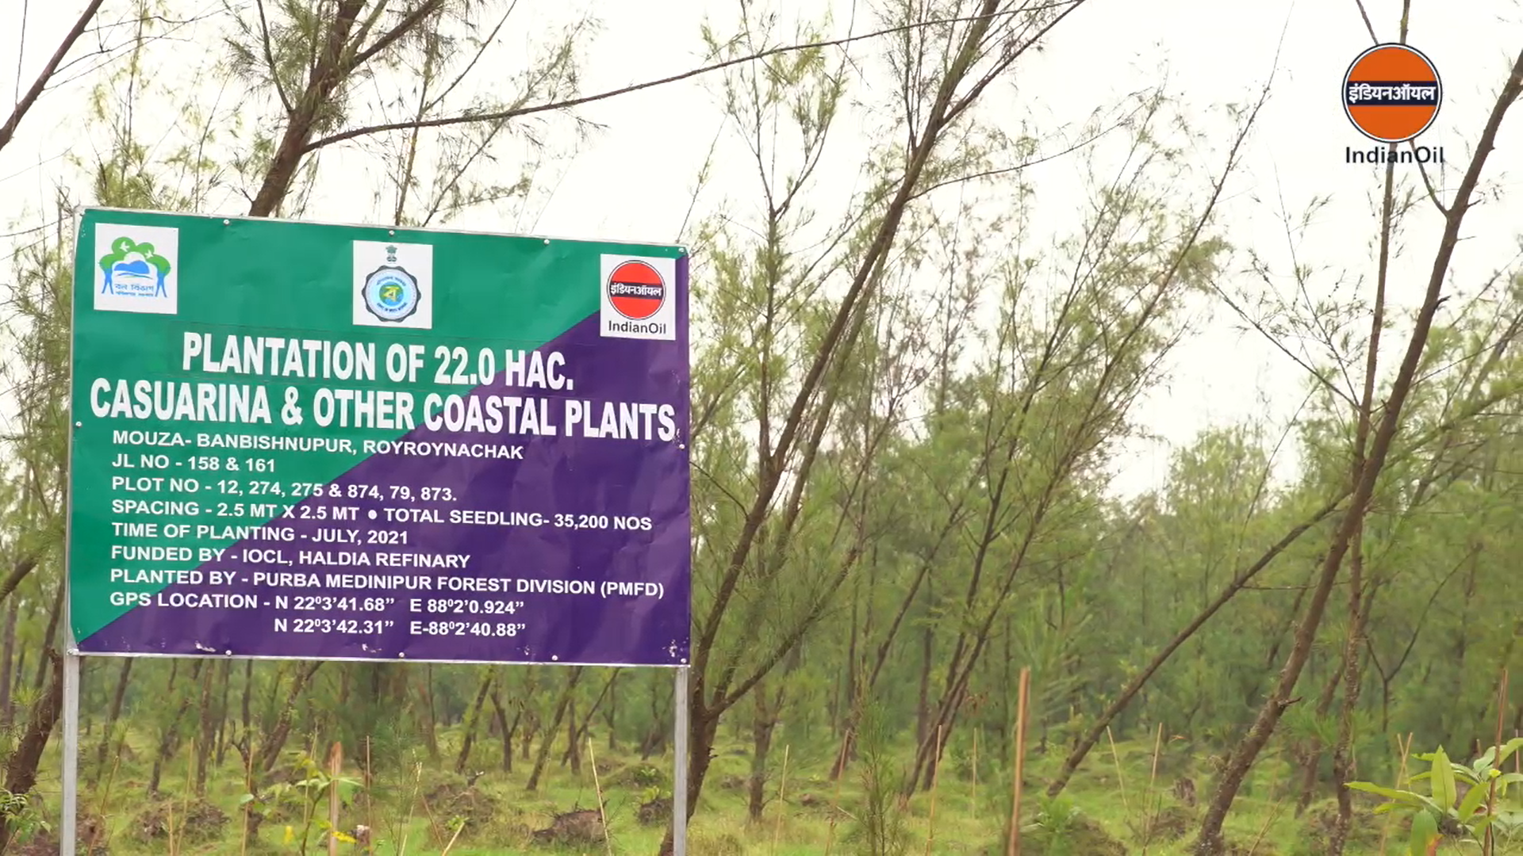
Coastal Shelter Belt plantation

Slide 16
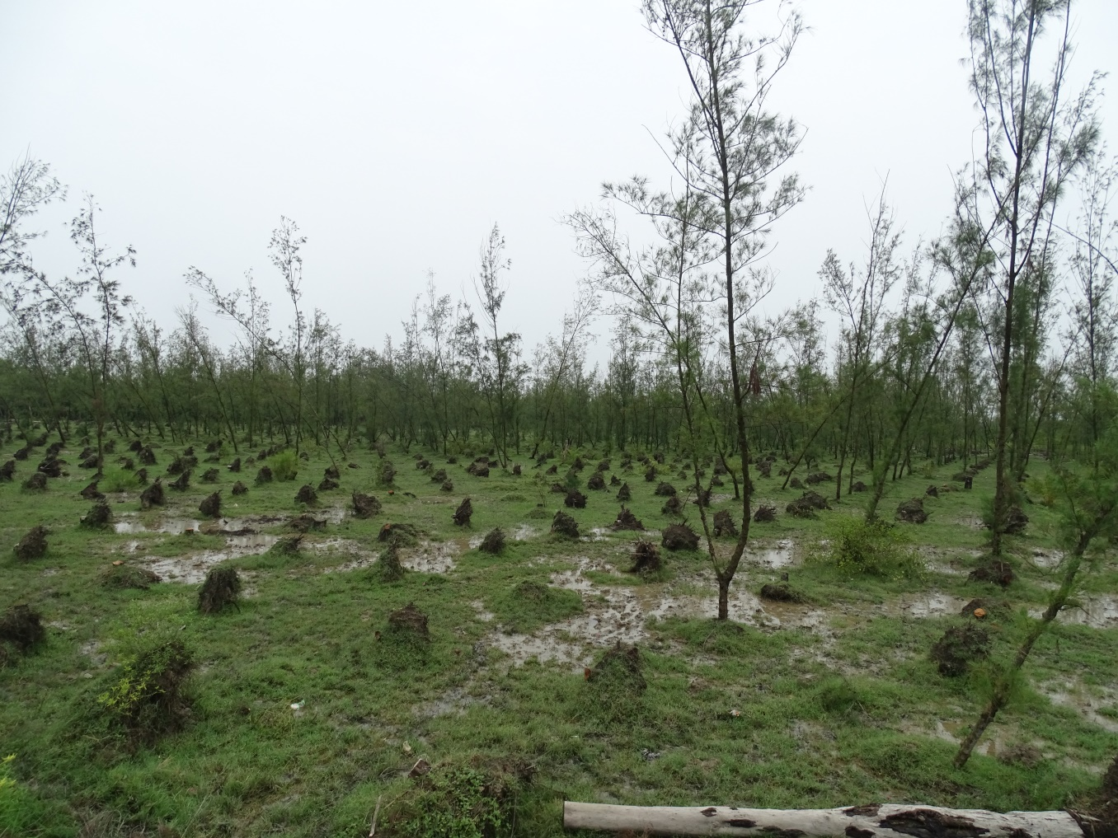
Coastal Shelter Belt plantation
massive plantation of approximately 35000 plants covering approx. 22 ha land at Balughata & Royraynachak Mouza

Slide 17
Miyawaki at Mahishadal

Slide 18
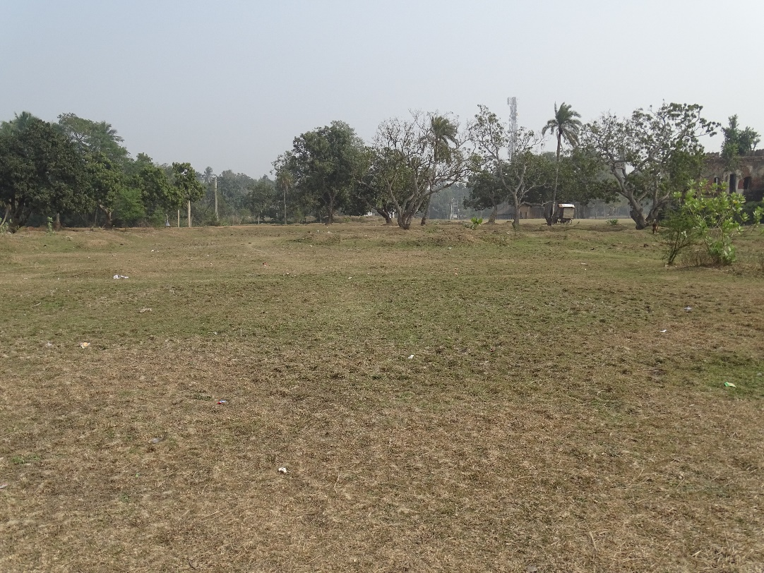
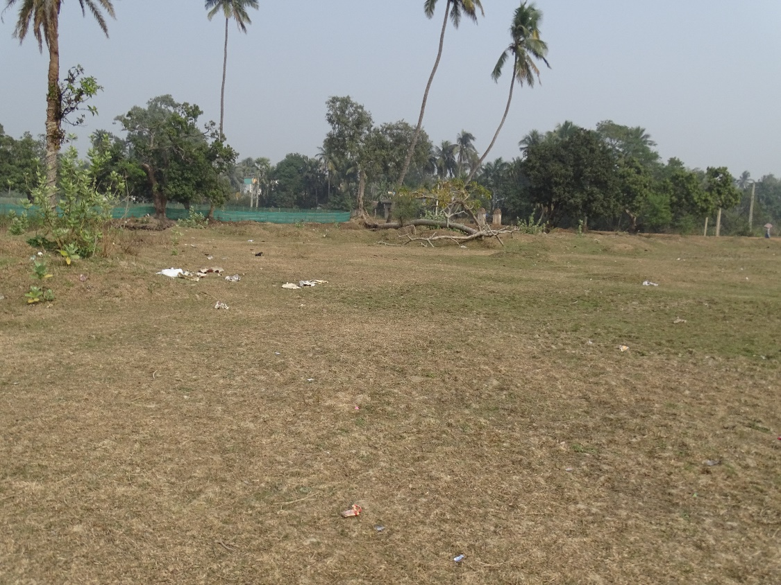
Miyawaki at Mahishadal
Before pictures

Slide 19
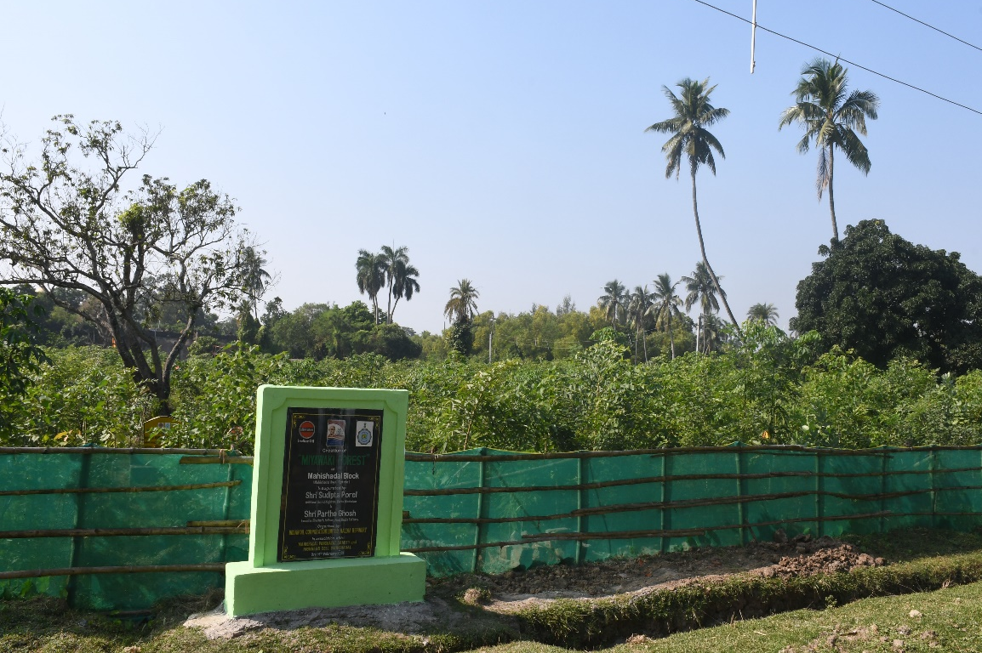
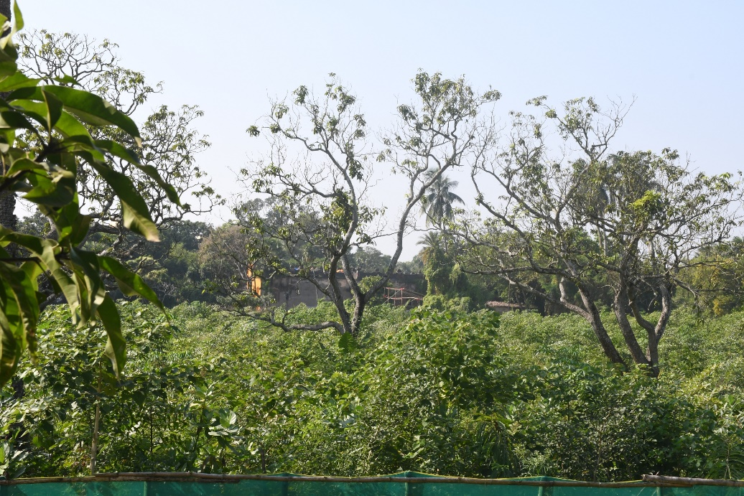
Miyawaki at Mahishadal
After pictures

Slide 20
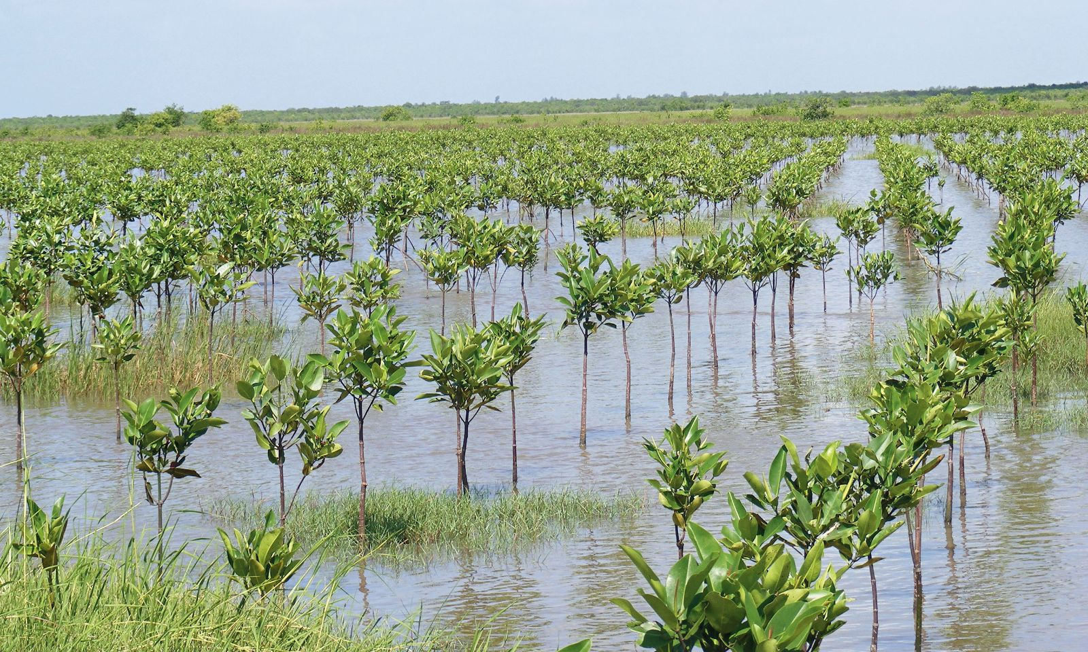
Mangrove Plantation

Slide 21
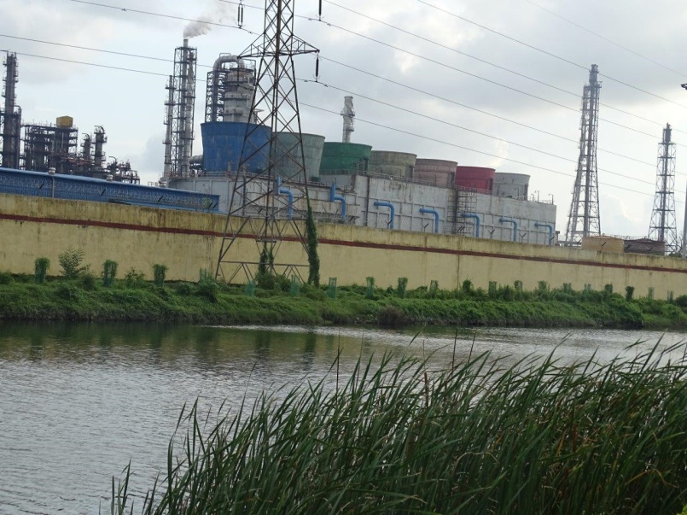
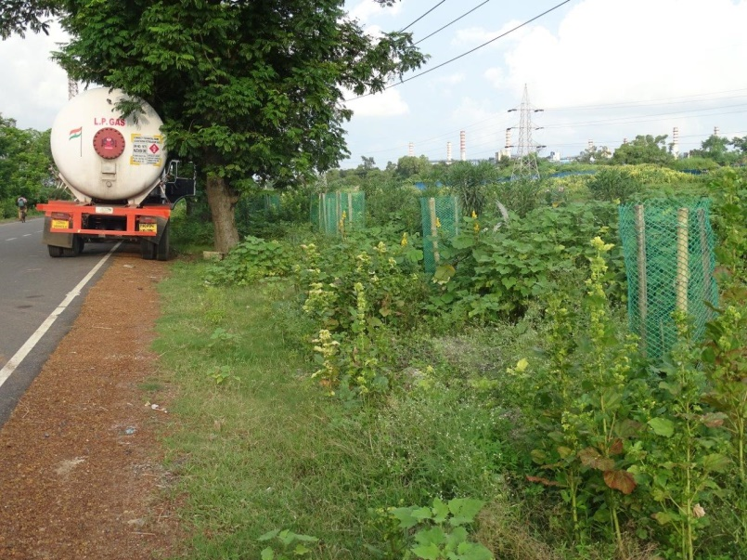
Green Belt Channel- Haldia Refinery

Slide 22
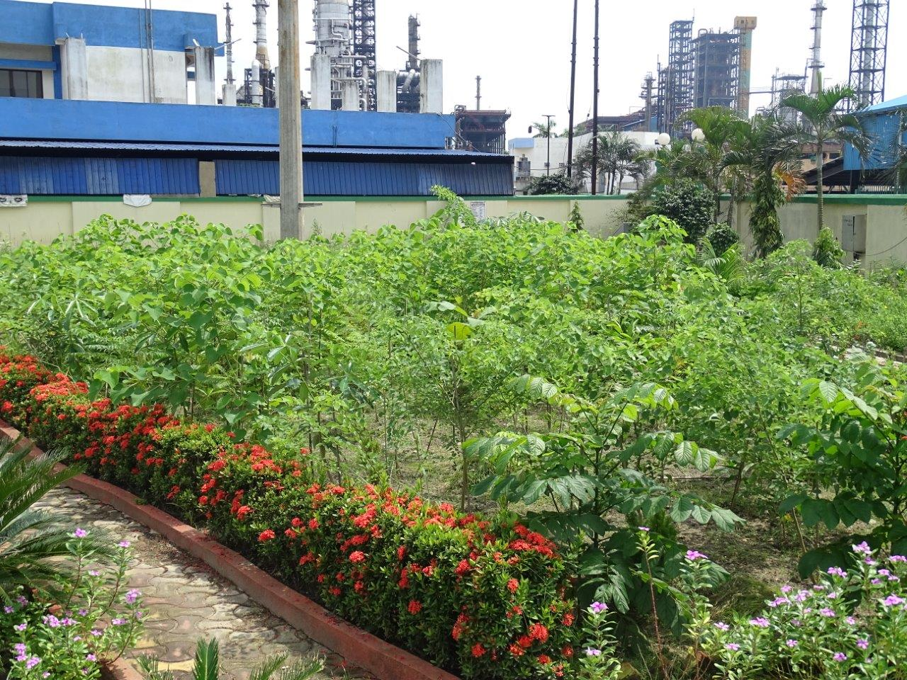
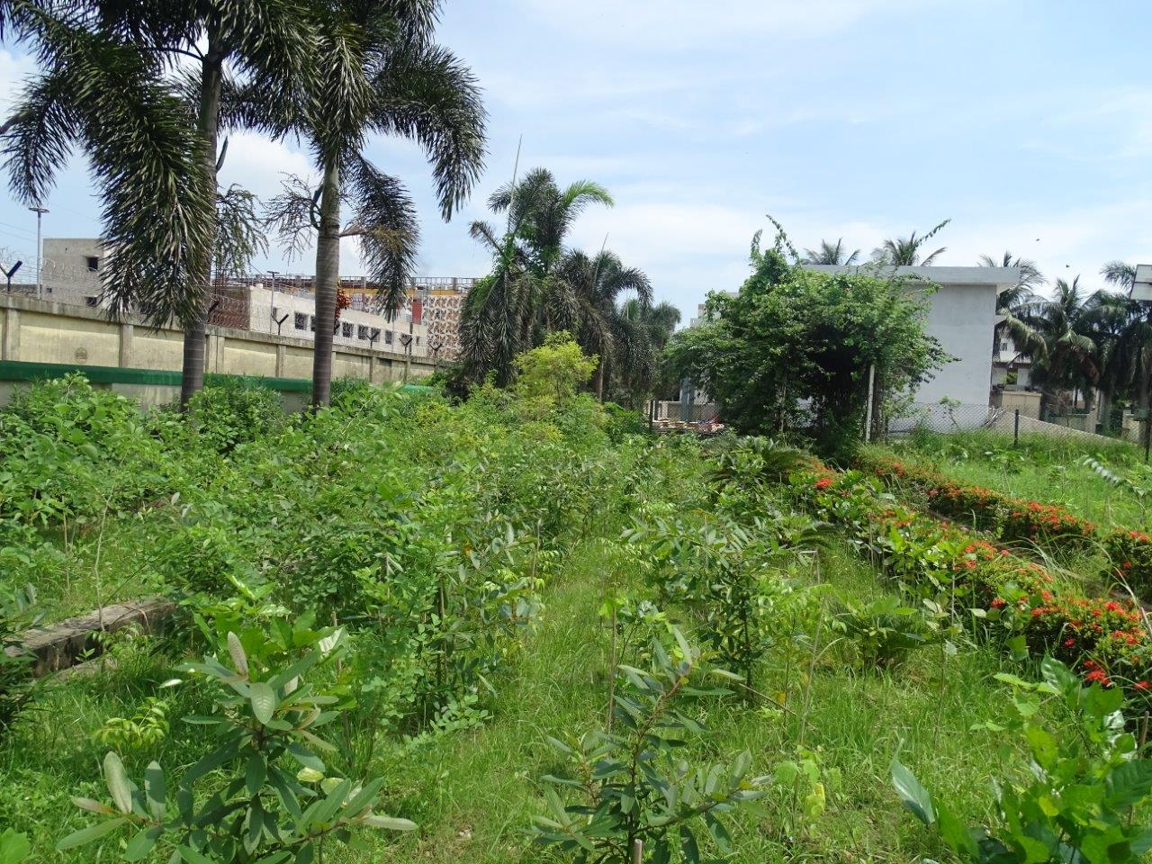
Miyawaki at Haldia Refinery(Ecological Park)

Slide 23
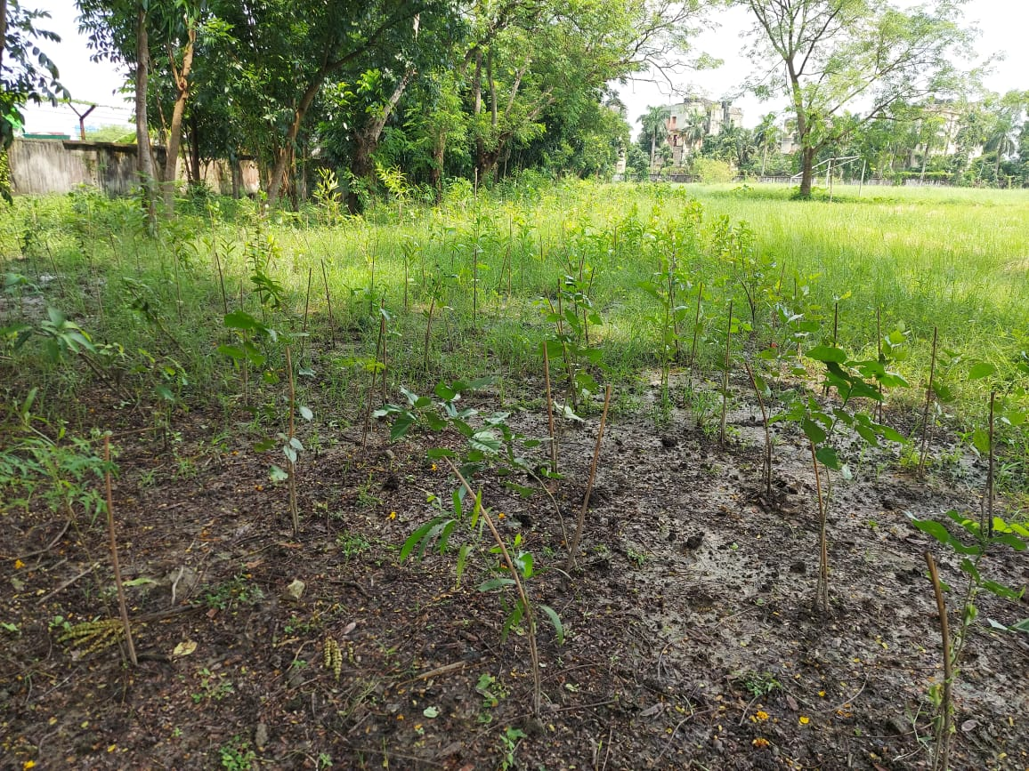
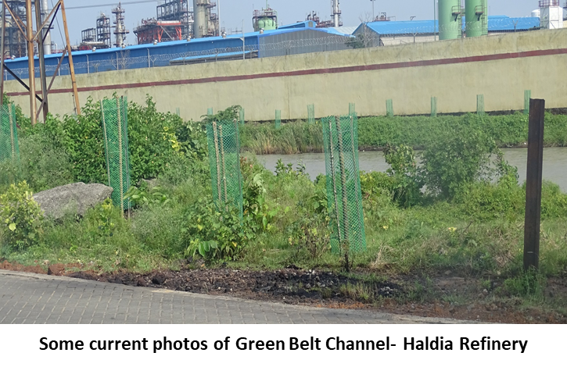
Miyawaki at Haldia Refinery(KV –Haldia)

Slide 24
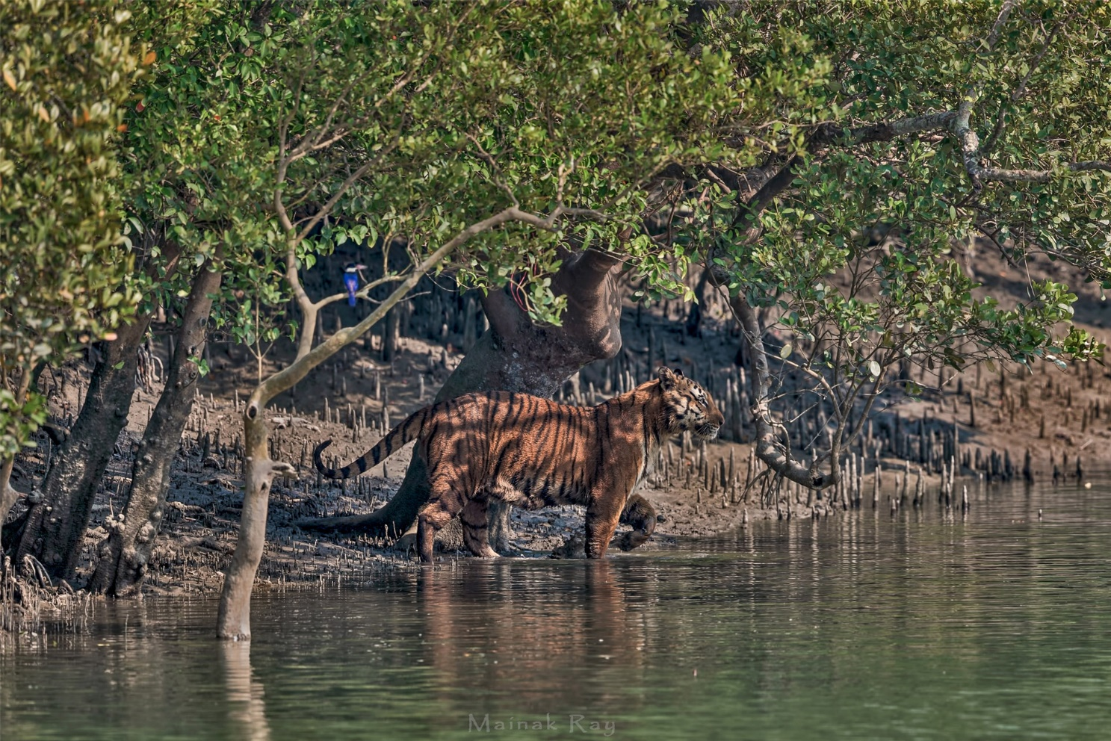
Tiger Conservation at Sundarban Tiger Reserve

Slide 25
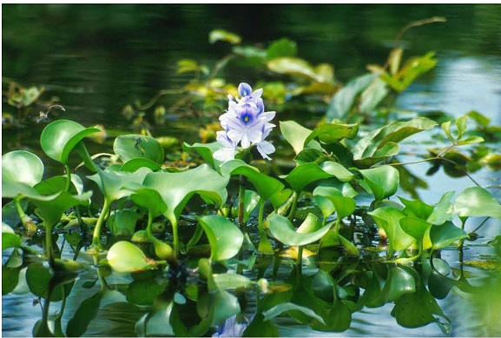
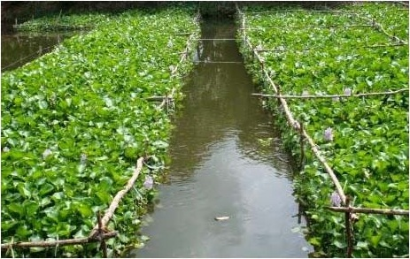
Water Hyacinth Project

Slide 26
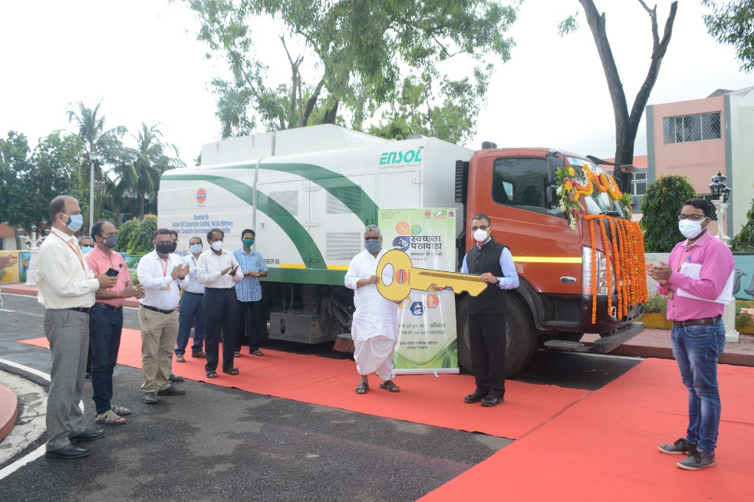
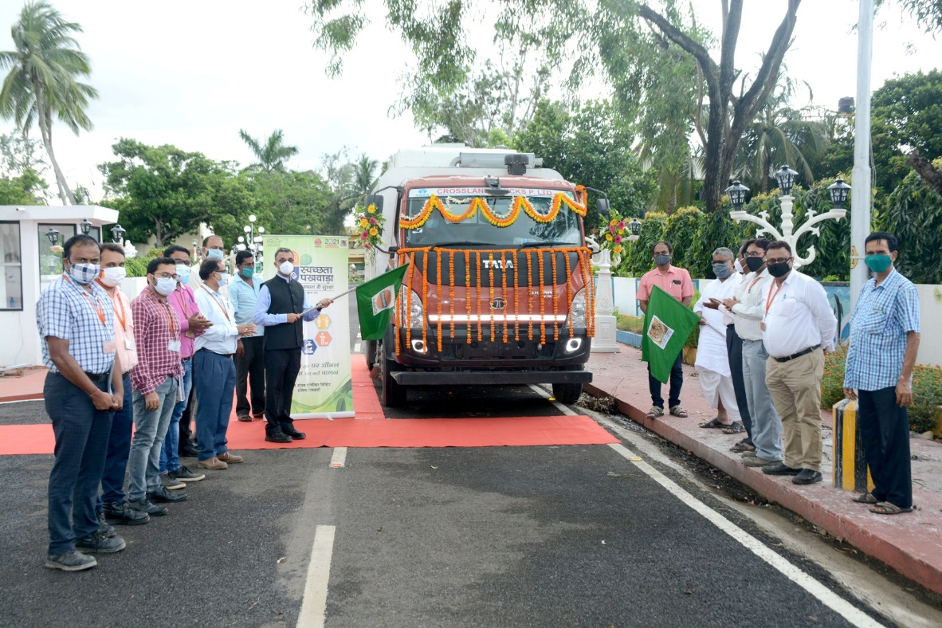
Mobile Sweeping Machine for Use of Haldia Municipality

Slide 27
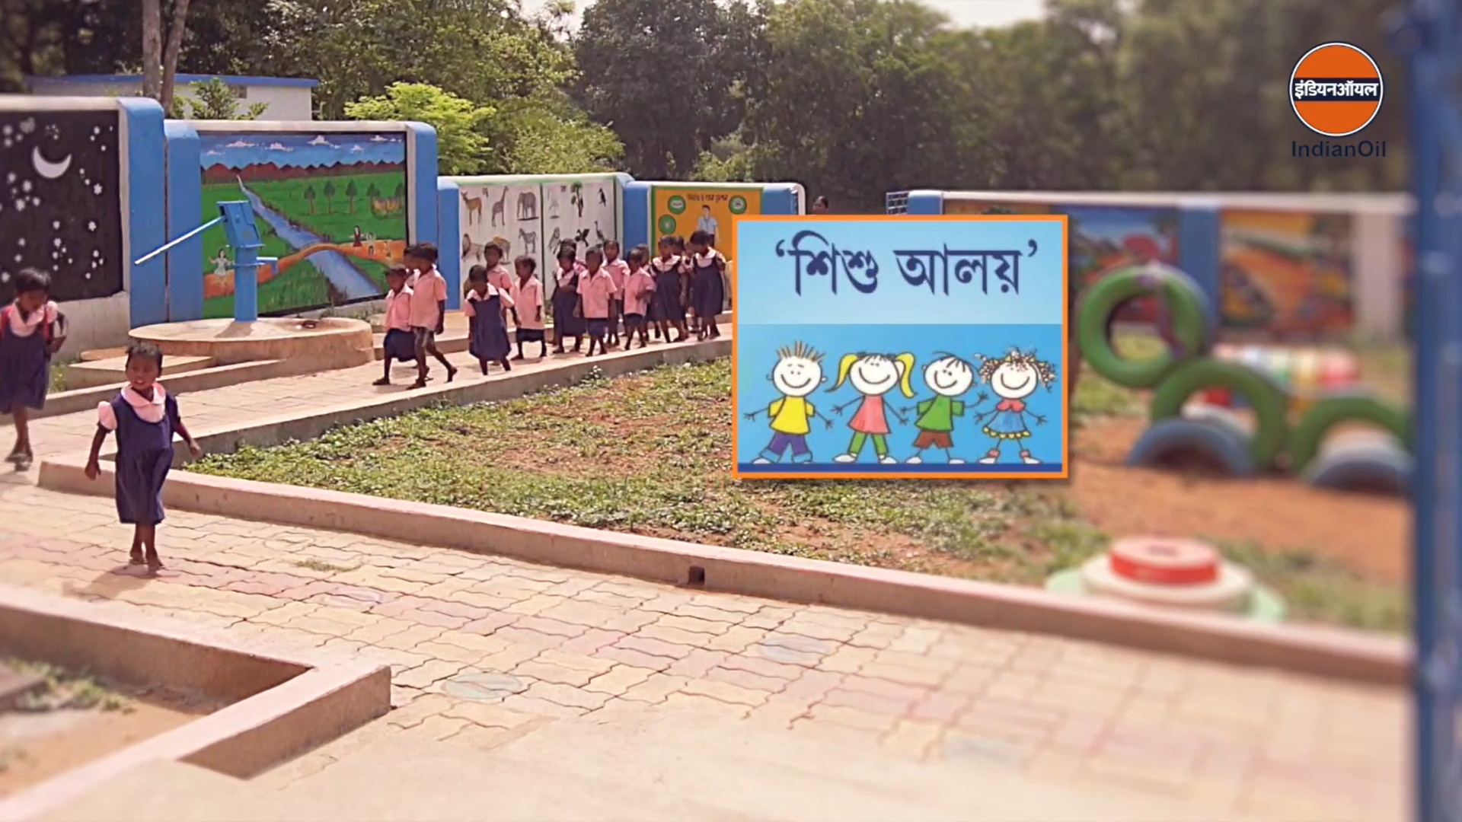
5 Nos. of ‘Shishu Aloy’ under various ICDS Centre running at Purba Medinipur

Slide 28
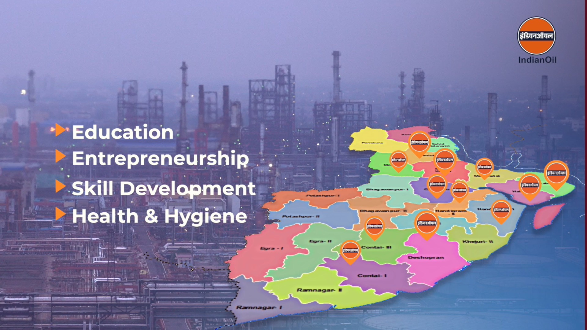
Modernization of Government ITI- Durgachak

Slide 29
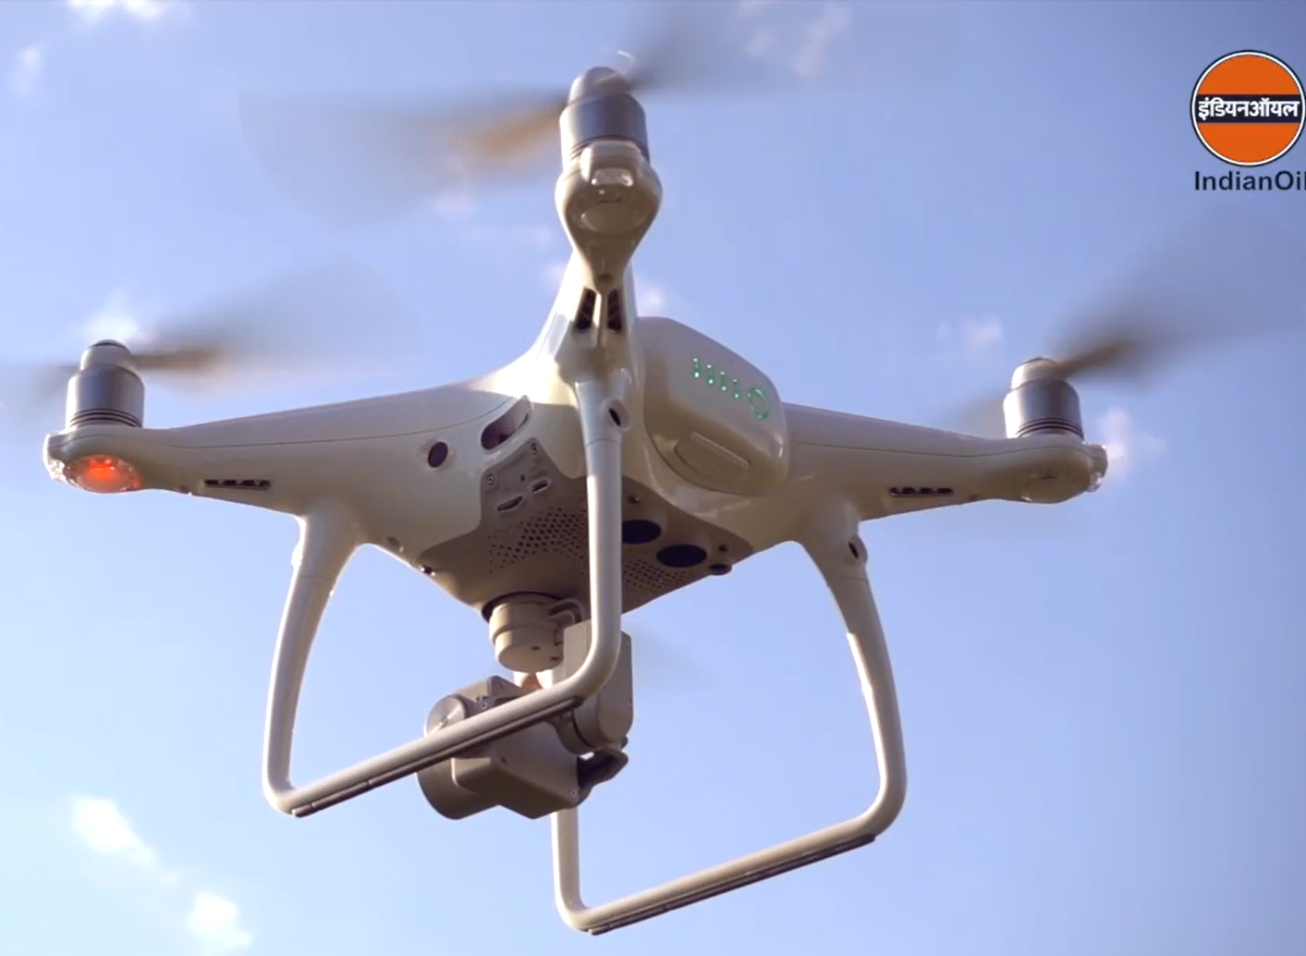
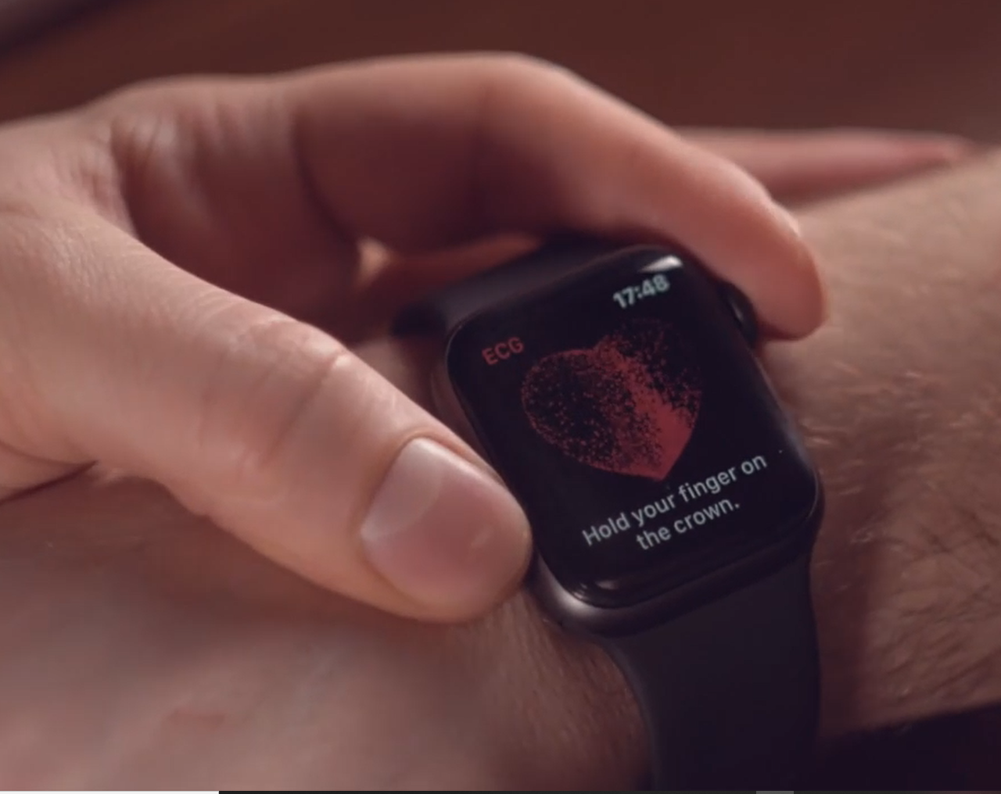
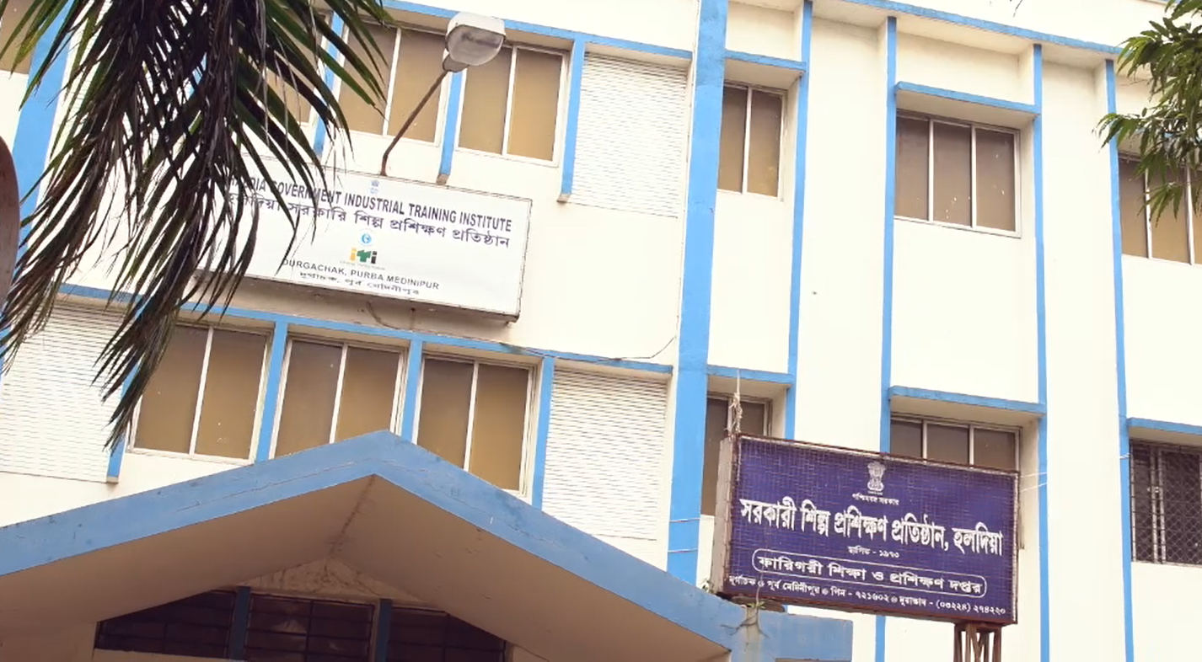
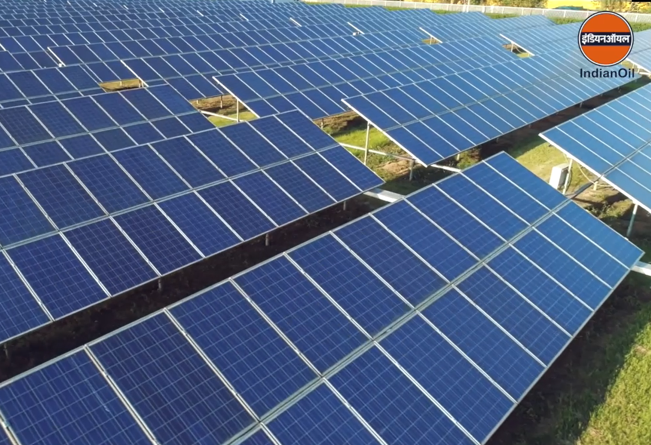
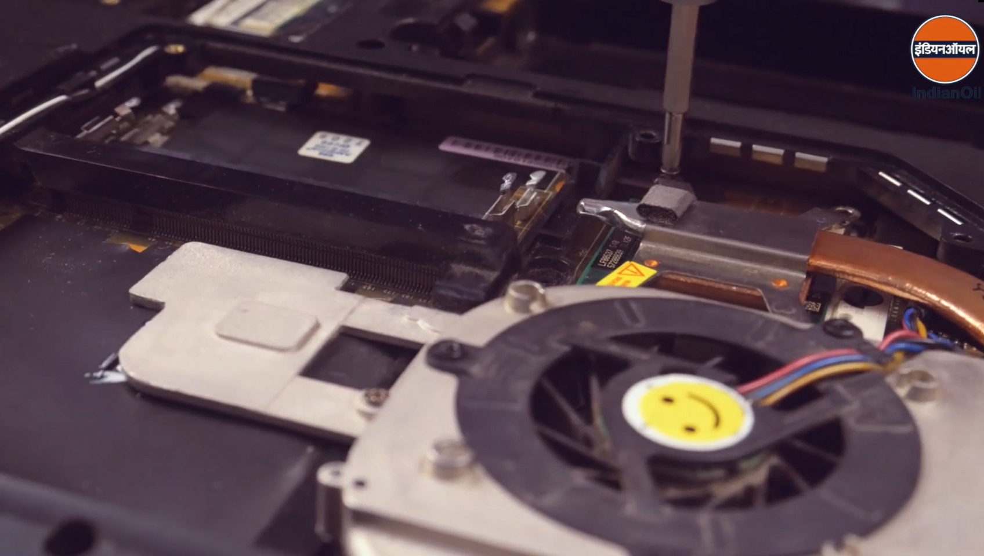
Modernization of Government ITI- Durgachak

Slide 30
THANK YOU

