Slide 1
INITIATVES FOR MSMEs

Slide 2
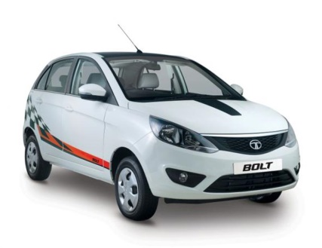
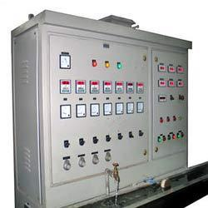
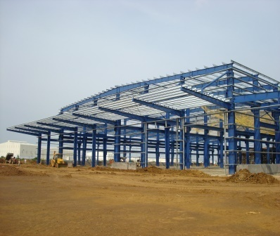
Brand offerings: Catering to a multitude of segments
Touch around 10,000 SMEs
Cumulative sales of more than 1.6 MT in FY’16
Applications in various segments
Auto
Yellow goods
White goods
Solar
Panels
PEB
But, we are just not a product brand!

Slide 3
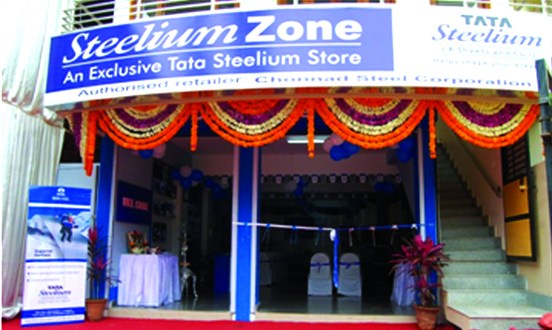
Our brands over the years have focused upon product and service innovation to differentiate in the marketplace
2002
2003
2004
2005
2006
2007
2008
2009
2010
2011
2012
2013
2014
2015
2016
2017
Product Marking
Tata Steel - Kalinganagar
Product innovation/ Introduction
TSCR
CAPL
GP Brand Launch
HR Brand Launch
Service innovation
Service Centre
TOC
Steelium Zone
Suraksha
astrum Retail
Customer Intimacy
Service Centre
VIU
Launch of Qualithon
Channel partner
Emergency Supply
TDC-TPR
Customer relationship
Launch of webinars
Loyalty progam

Slide 4
Our Mission: Making customers competitive by resolving their issues
Limited knowledge of selecting the
right inputs for product
Dedicated Product Application Engineers group to understand and then suggest the right input
Limited knowledge of selecting the right inputs for product
Dearth of easy finance and credit instruments
Working with Credit Rating agencies for ease of financing through Financial institutions/ channel partners
Limited knowledge of modern, affordable technology
Web based Knowledge sharing sessions conducted
every fortnight

Slide 5
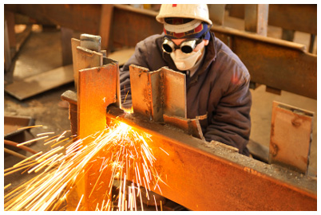
Making customers competitive by resolving their issues
Unavailability of affordable skilled labour
Technical training sessions to improve labour productivity at customer’s premises
Limited knowledge of selecting the right inputs for product
Customer pressure for quality and delivery
Conclaves/ Clinics to sensitize and equip
customers with the latest tools of quality
Occupational hazards and safety at workplace
Safety programs to educate customers on improving their workplace safety

Slide 6
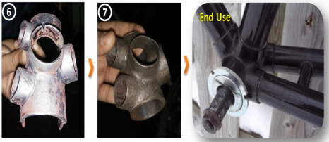
Value in Use – Hot forming to cold forming
Customer Stated Problem
Concerns over workers safety due to hot forming thru furnace accompanied with requirement of skilled labour
Alternate
Suggested
Usage of AU03 CR for Cold Forming in place of HR Grade 1 which employed Hot Forming
Benefits realised
Improved Safety
Requires less Skilled Labour
Eliminates furnace heating cost
Eliminates shot blast cost
Improved prductivity

Slide 7
Customer Engagement Journey So far…..
1,000+ Customers touched
8,000+ touch-points made
18,000+ (~700+ man-days)
man-hours engaged
For FY’17 till January

Slide 8
Thank You

