Slide 1
Zensar Technologies | RPG Group
Competitive Strategies in
Digital Disruption

Slide 2
38% of TV consumption happen through streaming
40% of urban travelers in India use ridesharing apps
20.3% global retail sales occur online
Digital Payments
UK - 82%
US – 84.5%
India -75%
Remote/Hybrid work
UK - 44%
US – 26%
90% reduction in newspaper sales globally
18.57% projected growth in eLearning
25% YoY growth in Telemedicine
NLP
IoT
AI
ML
Blockchain
Robotics
Deep Learning
Computer Vision
PRIVATE AND CONFIDENTIAL

Slide 3
Zensar Technologies | RPG Group
Does not matter what it is, today, we “humans”, have to have everything digitally…..period.

Slide 4
Zensar Technologies | RPG Group
Every business in every industry segment is trying to punch above their weight & create impact digitally and hence the wave of “Digital Disruption”

Slide 5
Zensar Technologies | RPG Group
In summary.....
What are the drivers of digital disruption?

Slide 6
Zensar Technologies | RPG Group
1. Consumer Behavior
2. Technology Advancements
3. Business Model Shifts
4. Democratization
Across every industry
And a lot more

Slide 7
Zensar Technologies | RPG Group
Let's do a little deep dive at this.....
1. Consumer Behaviors
Self-service
Personalization
“Always On”
2. Technology Advancements
Digital Technologies
Growth of AI
New Paradigms (Web3, Blockchain XR,,IoT, etc)
3. Business Model Shifts
Top-down / Bottom-up Disruption
Networks & Ecosystems
4. Democratization
Digital Tools
Empowerment | Accessibility

Slide 8
Zensar Technologies | RPG Group
Now in the attempt –
enterprises are biting into more than what they can chew….
… and also often faced with headwinds/challenges, right?

Slide 9
Zensar Technologies | RPG Group
Let’s talk a little bit about what we are doing and the outcome we are delivering ?

Slide 10
Zensar Technologies | RPG Group
125X
Leveraging Digital technologies (GenAI) for innovative solution
90+%
End-to-end transformation of human-centric operations
Higher customer satisfaction and business growth
Efficiency gain and enhanced accuracy
High impact
Customer Experience
Faster Processing
International Center
for Dispute Resolution
Leading Utility
Servicing Company
Leading Broadcaster & Telecommunications Group
Digital Engineering
Hyper-automation
Hyper-automation
Process Automation
Co-innovation Partner
Co-innovation Partner
User Experience
Digital Transformation
Digital Transformation

Slide 11
Zensar Technologies | RPG Group
Through these numerous experiences we have built a repeatable process and approach to successfully digitally innovate and digitally transform…

Slide 12
Zensar Technologies | RPG Group
Human Experience Design
Components
Services
Data
Analytics
Cloud Enablement

Slide 13
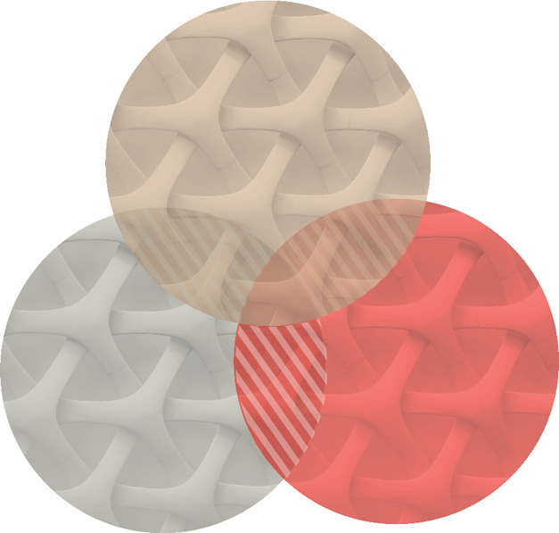
Zensar Technologies | RPG Group
Our “mantra” to solve this….
Experience
Engineering
Engagement
Help understand users & hyper personalize
Discover, build & launch new products
Brand stand out through content
Experience
Technology & platform relevancy
Manage critical infrastructure & platforms
Communicate with simplicity
Engineering
Engagement
Make partner ecosystem work through enablement
IT from a cost center to a value driver
Maximize internal & external investment

Slide 14
Zensar Technologies | RPG Group
So What’s next?

Slide 15
Zensar Technologies | RPG Group
Can we shift our paradigm from a “human centric” approach to a “humanity centric” approach?

Slide 16
Zensar Technologies | RPG Group
Well…
We believe so and we are working hard towards that.

Slide 17
Zensar Technologies | RPG Group
Thank you

