Slide 1
Energy and Environment
Striking Balance : The CESC Experience
Kushal Bhowmick
Dy. General Manager ( Environment)

Slide 2
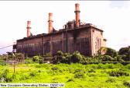
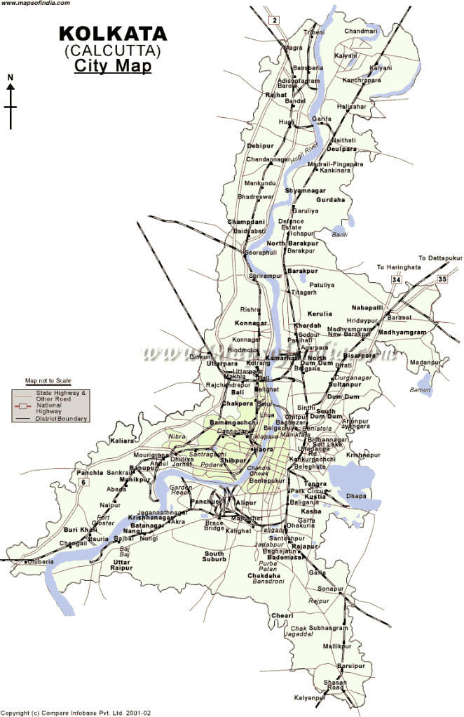
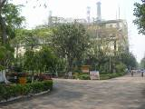
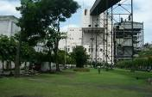
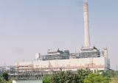
is a century old company and
currently is a flagship company of
New Cossipore 1949
Today CESC is serving 2.6 million consumers across its licensed area, spread over 567 sq. km. in and around the city of Kolkata.
Titagarh
1982
Southern
1990
CESC has 4 Coal based Thermal Power Generating Stations with a total capacity of 1225 MW.
Budge Budge
1997

Slide 3
Energy & Environment Model of CESC Limited
1
CESC’s business objective is to produce maximum uninterrupted cost effective power in environment friendly way
2
Our Environment Policy states that “Protection of the environment is integral with CESC’s power generation and distribution processes”
3
Since all the power plants of CESC are city based, the company has taken various proactive measurers in various areas of environment management and pollution control like emission and effluent management, hazardous and solid waste management etc.
4
Another key objective of CESC is to conserve energy at the maximum possible way through “Energy efficiency and conservation ” efforts

Slide 4
Energy & Environment Model of CESC Limited
For Energy saving and Environment protection CESC has two straight forward approaches
Reduce coal and oil consumption so that lesser amount of fuel is required to produce same amount of energy which in turn will produce lesser amount of CO₂
1
Reduce the environmental impact from the unavoidable pollutants produced by power generation process
2

Slide 5
Energy & Environment Model of CESC Limited
Understanding the Basic Model
Input
Air
Water
Coal
Output
Electricity

Slide 6
Energy & Environment Model of CESC Limited
Understanding the Basic Model
Input
Air
Water
Coal
OBJECTIVE
Reduce Coal Consumption
BENEFIT
Reduction in CO₂
Output
Electricity

Slide 7
Reduction in Coal Consumption by Heat Rate Improvement
Energy & Environment Model of CESC Limited
1
Improvement of Heat Rate means improvement in efficiency which reduces coal consumption and benefits environment
2
Major areas of losses have been identified and corrective actions implemented like
Proper blending of coal to achieve close adherence to design coal
Regular and time bound checking of unburnt carbon and excess air
Thermographic monitoring of insulations and drain lines to detect heat loss and steam leaks.
Time bound replacement of turbine internal seals to maintain turbine efficiency

Slide 8
Reduction in Coal Consumption by Heat Rate Improvement
Energy & Environment Model of CESC Limited
2
Major areas of losses have been identified and corrective actions implemented like ( contd…)
Continuous monitoring of any deviation of critical parameters like steam pressure, steam temp, flue exit temp, condenser vacuum, oxygen & CO % .
Replacement of Phosphate Treatment by All Volatile Treatment of Boiler Feed Water.
Alteration of fuel oil atomizing media

Slide 9
Results Heat Rate Improvement
Energy & Environment Model of CESC Limited
1
In last 8 years the combined Heat Rate of CESC’s power plants has improved by around 10%
2
Considering our combined Generation is 8600 MU and average GCV of Coal is 4500 Kcal/Kg
Improvement in Heat Rate by 10% means
520, 735 Tons of Coal Saving ( Equivalent 147 Rakes )
Direct Reduction of CO₂ by 966,311 Tons
Along with substantial indirect reduction of CO₂ due to less rake movement and less coal handling.
Annual
Reduction
966,311
Ton

Slide 10
Energy & Environment Model of CESC Limited
Understanding the Basic Model
Input
Air
Water
Coal
Auxiliary Power is the part of generated power which is required for own consumption to run various pumps, motors, fans etc.
Auxiliary Power
Output
Electricity

Slide 11
Energy & Environment Model of CESC Limited
Understanding the Basic Model
Input
Air
Water
Coal
OBJECTIVE
Reduce Auxiliary Power
BENEFIT
Reduction in CO₂
Output
Electricity

Slide 12
Reduction of Auxiliary Power Consumption
Energy & Environment Model of CESC Limited
1
Improvement of Auxiliary means improvement in efficiency which reduces coal consumption and benefits environment
2
We have revisited and modified various processes
Operational optimisation of various high auxiliary consuming equipments like Feed Pumps, CW Pumps, Ash Water Handling Pumps etc.
Implementing Energy Efficiency Projects
Implementing Various Energy Saving Projects

Slide 13
Reduction of Auxiliary Power Consumption
Energy & Environment Model of CESC Limited
Few Actions
Stage Blinding of Condensate Extraction Pump
1
2
Incorporation of VFD in Induced & Forced Draught Fans
Installation of Micro Hydel Unit in CW Outfall
3

Slide 14
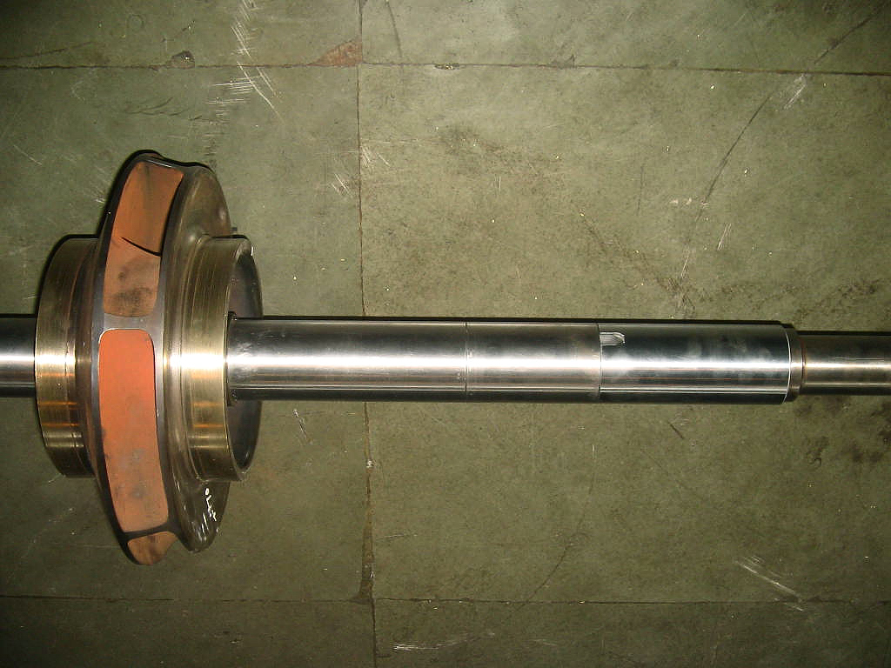
Stage Blinding of Condensate Extraction Pump
Energy & Environment Model of CESC Limited
1
5th STAGE REMOVED AND SLEEVE INSERTED
The bare pump rotor with 8 stages
4TH STAGE
5th stage removed, manufactured sleeved inserted

Slide 15
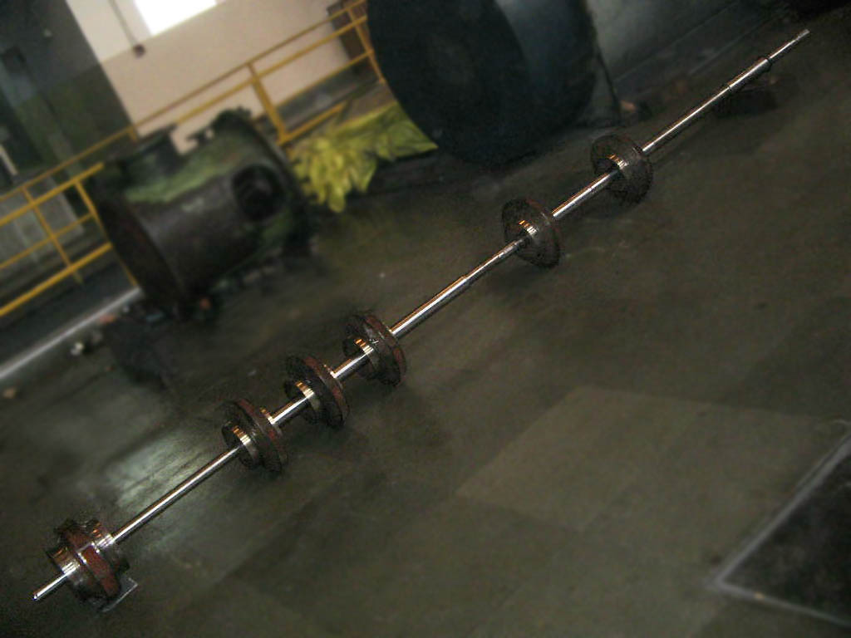
Stage Blinding of Condensate Extraction Pump
Energy & Environment Model of CESC Limited
1
7TH STAGE REMOVED AND SLEEVE INSERTED
5th and 7th stages removed
THE PUMP ROTOR : AFTER STAGE BLINDING (6 STAGES)
Annual
Reduction
Annual
0.9 MU
900
Ton
Savings

Slide 16
Incorporation of VFD in ID & FD Fans
Energy & Environment Model of CESC Limited
2
AC motor-driven applications that do not require full speed can save energy by controlling the motor with a variable speed drive. Energy cost saving with variable torque can be significant
Energy Saving 25-35%
CDM Benefits
We have installed VFD in ID and FD Fans.
In the modified system the furnace draft control will be carried out through a combination of fan speed control (through VFD) and inlet guide vane control.
Annual
Reduction
Annual
3.25 MU
3250
Ton
Savings
CDM
Project

Slide 17
Installation of Micro Hydel Unit in CW Outfall
Energy & Environment Model of CESC Limited
3
SGS utilises total cooling water (CW) flow to the tune of 17000 m³/hr to run the condensers of the two existing units.
This water is pumped into the condensers from Ganges and after cooling the steam in condenser, the same water flows out through open channel back to Ganges.
A project of installation of Micro Hydel unit in the outfall was devised to utilize the energy flowing back to Ganges -
3 x 15 KW – power utilization at one of the DM Plant Auxiliary board
This particular design, the first of its kind in India, was selected as the head was low.

Slide 18
Installation of Micro Hydel Unit in CW Outfall
Energy & Environment Model of CESC Limited
3
Timeline -
1st Hydel Unit commissioned in Mar 2011
2nd Unit commissioned in Dec 2011
3rd Unit planned for FY 2012-13
Upstream
Downstream
Annual
Reduction
250
Ton

Slide 19
Results : Auxiliary Improvement
Energy & Environment Model of CESC Limited
A
In last 8 years the combined Auxiliary Consumption of CESC’s power plants has improved by around 11%
2002-03
B
0.93% improvement in Auxiliary Consumption means
43, 498 Tons of Coal Saving ( Equivalent 12 Rakes )
Direct Reduction of CO₂ by 80,800 Tons.
Along with substantial indirect reduction of CO₂ due to less rake movement and less coal handling.
9.33%
8.40%
2011-12
Annual
Reduction
80,800
Ton

Slide 20
Energy & Environment Model of CESC Limited
Cdm Benefits
Project 1: Energy Efficiency thro’ change of Power Cycle Chemistry & Modification in Furnace Draft Control at Budge Budge Generating Station. Registered by UNFCCC (Registration No. 0479) Total CER issued till date : 29,913
Project 2: Energy Efficiency thro’ Alteration of Fuel Oil Atomizing Media at Titagarh Generating Station. Registered by UNFCCC (Registration No. 0987). Total CER issued till date : 1,87,745
Project 3: Optimization of Electrical Energy Consumption in Furnace Draft Control System thro’ installation of VFD and Installation of Cooling Tower for Auxiliary Cooling Water System at Titagarh Generating Station. Registered by UNFCCC (Registration No. 1087). Estimated CER 4046/Year
Budge Budge Generating Station is the first coal based thermal power station in the world to have registered a CDM project.

Slide 21
Energy & Environment Model of CESC Limited
Understanding the Basic Model
Input
Air
Water
Coal
Pollutants
Particulate Matter
CO₂
Solid Waste (Ash)
Output
Effluent
RIVER
Electricity

Slide 22
Energy & Environment Model of CESC Limited
Emission
Effluent
Solid
Waste
Plantation
Reduce pariculate emission by innovative technology & strict target and continuous monitoring
100% Recycling of effluent
Green Belt
Planted more than 1,15,000 Trees
100% Utilization of Ash
Increase Value added Utilization

Slide 23
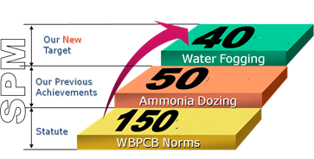
Reduce Particulate Matter
Energy & Environment Model of CESC Limited
1
CESC continuously explore ways and means by which pollutants like Suspended Particulate Matter (SPM) emission from the pulverised fuel stations can be reduced and maintained well below the statutory limits.
2
Actions
Our internal target is far below the statute.
Ammonia dozing ( innovative technology) brought down the figure to 50 mg/Nm³)
Stringent Target over years - now 40 mg/Nm³
24 x 7 monitoring through in- house integrated software and Company's Intranet
mg/Nm³
mg/Nm³
mg/Nm³

Slide 24
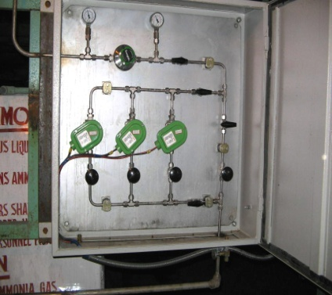
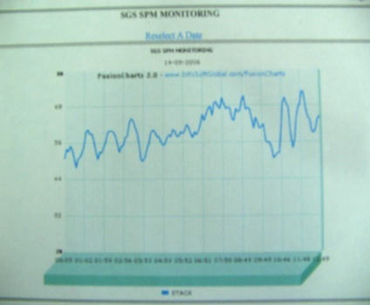
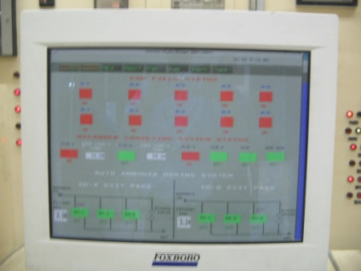
Ammonia Dozing
Energy & Environment Model of CESC Limited
Dozing
A
Ammonia helps to reduce resistivity of fly ash resulting better ionization of the particles
Thus it increase in collection efficiency of ESP fields.
B
Control
Effect
Monitoring

Slide 25
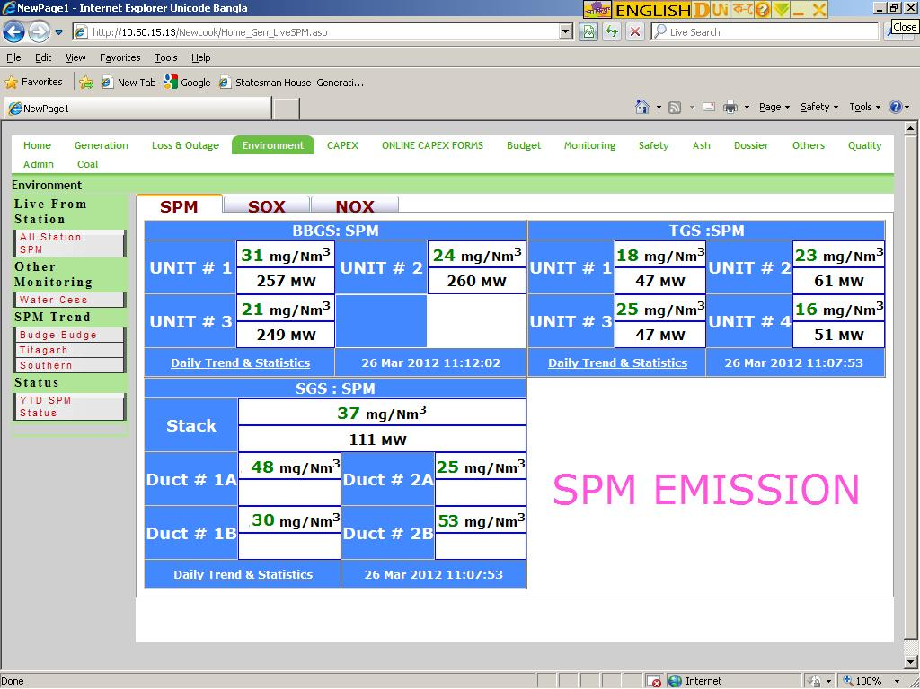
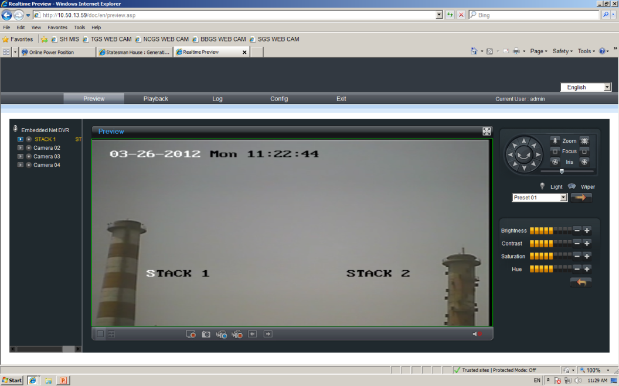
Reduce Particulate Matter
Energy & Environment Model of CESC Limited
Continuous Monitoring
Real-time values as seen through web pages
Live CAM view of stacks through web pages

Slide 26
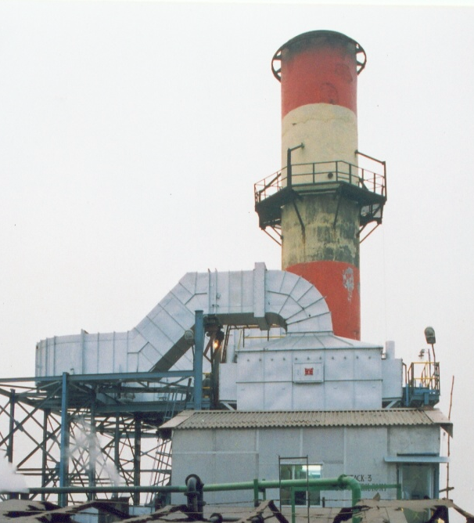
Reduce Particulate Matter (Wet ESP)
Energy & Environment Model of CESC Limited
3
In the age old New Cossipore Generating Station, to bring down the SPM level, Wet ESPs has been installed in the roof of the plant. Such installation is first of its kind in any power plant in the world

Slide 27
Reduce Particulate Matter (Wet ESP)
Energy & Environment Model of CESC Limited
New Cossipore is now our only non PF generating
station. It is also more than 60 years old. ( Commissioned in 1949 )
Derated Capacity : 100 MW
Battery of 8 Boilers delivers steam to a common range
Chain grates, Stroker fired boilers
Boilers completely enclosed in a house – No space to
change design or add implements

Slide 28
Reduce Particulate Matter (Wet ESP)
Energy & Environment Model of CESC Limited
ID Fans located on the roof of the boiler house
building pulls the flue
Stacks are also erected on the roof where ID fan
discharge is led into
Emission control equipment in the middle of 20th.
Century were rudimentary
Only a portion of flue would pass through static
cyclone grit arrestors
The power station need to generate around 40 ~ 80 MW in evenings to feed the command area

Slide 29
Reduce Particulate Matter (Wet ESP)
Energy & Environment Model of CESC Limited
Power station is situated very close to the congested
northern part of Kolkata
State pollution control board directed us to bring
down the SPM level from the stacks of New Cossipore
The hindrances of retrofitting of emission control
equipments were
Flue gas outlet at the top
Very old building making addition of structures at the
top difficult and risky
Workable option was to install WET ESP on the roof

Slide 30
Reduce Particulate Matter ( Wet ESP )
Energy & Environment Model of CESC Limited
The technology was provided by Beltran Associates Inc.,
New York, USA
A pilot plant brought from USA was tried with a portion of
flue shunted out from the main stream
Emission level of the representative gas was within 150
mg/Nm³
Subsequently five Wet ESPs were installed in phases during the period 2003 ~ 2006
Since then New Cossipore has always been compliant on the emission front.

Slide 31
Reduce Particulate Matter
Energy & Environment Model of CESC Limited
Where we are now
mg/nm³

Slide 32
100% Recycling
Energy & Environment Model of CESC Limited
1
One of the key mission of CESC in water management is
“Not A Single Drop of Effluent Will Flow Out of The Plant”
2
A task force comprising of engineers from all the stations made a detail study of all the types of effluents
Quantity of effluent ( Amount, flow rate etc.)
Quality of effluent ( chemical analysis etc. )
3
They also made a detail study about the intake water requirement of individual internal processes.

Slide 33
100% Recycling
Energy & Environment Model of CESC Limited
4
In the next step the water balance blue print was designed.
5
Treatment procedures of process effluents to suit the qualitative requirements for recycling were decided.

Slide 34
100% Recycling
Energy & Environment Model of CESC Limited
Our Station Effluent mainly consist of
Bottom Ash Handling Water
Process Effluents

Slide 35
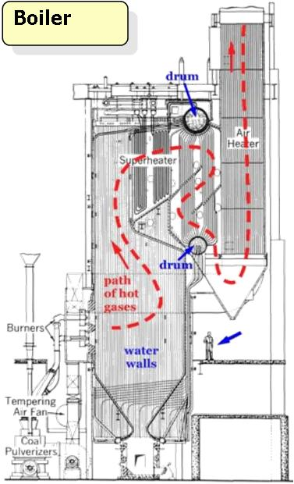
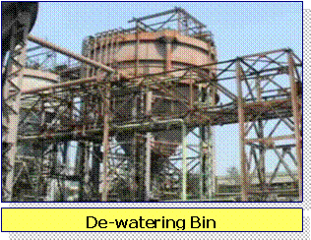
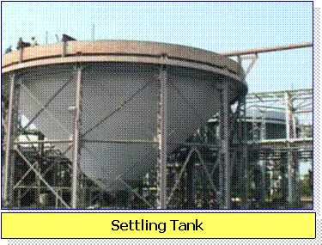
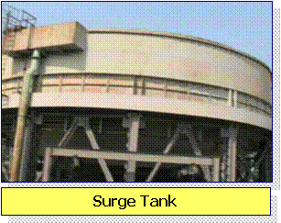
100% Recycling Of Bottom Ash Handling Water
Energy & Environment Model of CESC Limited
Bottom Ash
High Pressure Pump Transports the bottom Slurry to the Dewatering Bin

Slide 36
100% Recycling of Process Effluent
Energy & Environment Model of CESC Limited
The Real Scenario
Previous State
Power Plant Boundary
CTCW
Blow down
Toilet & Canteen Waste
RIVER HOOGLY
Neutralizing
Pit
Municipal Drain
Boiler
Blow down
Holding Pond

Slide 37
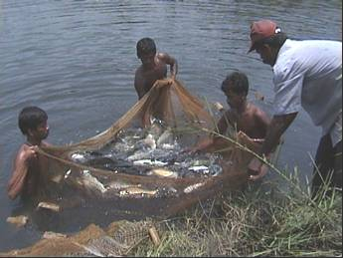
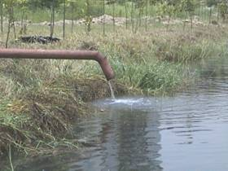
Energy & Environment Model of CESC Limited
100% Recycling of Process Effluent
The Real Scenario
Present State
Service Water Pump
Power Plant Boundary
CTCW
Blow down
X
Service
Toilet & Canteen Waste
X
RIVER HOOGLY
X
Neutralizing
Pit
Fish Pond
Municipal Drain
Raw Water Treatment Plant
Boiler
Blow down
X
Holding Pond

Slide 38
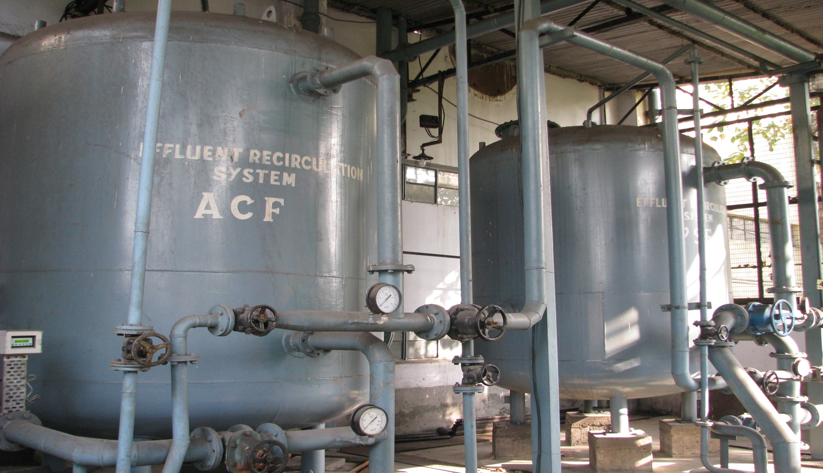
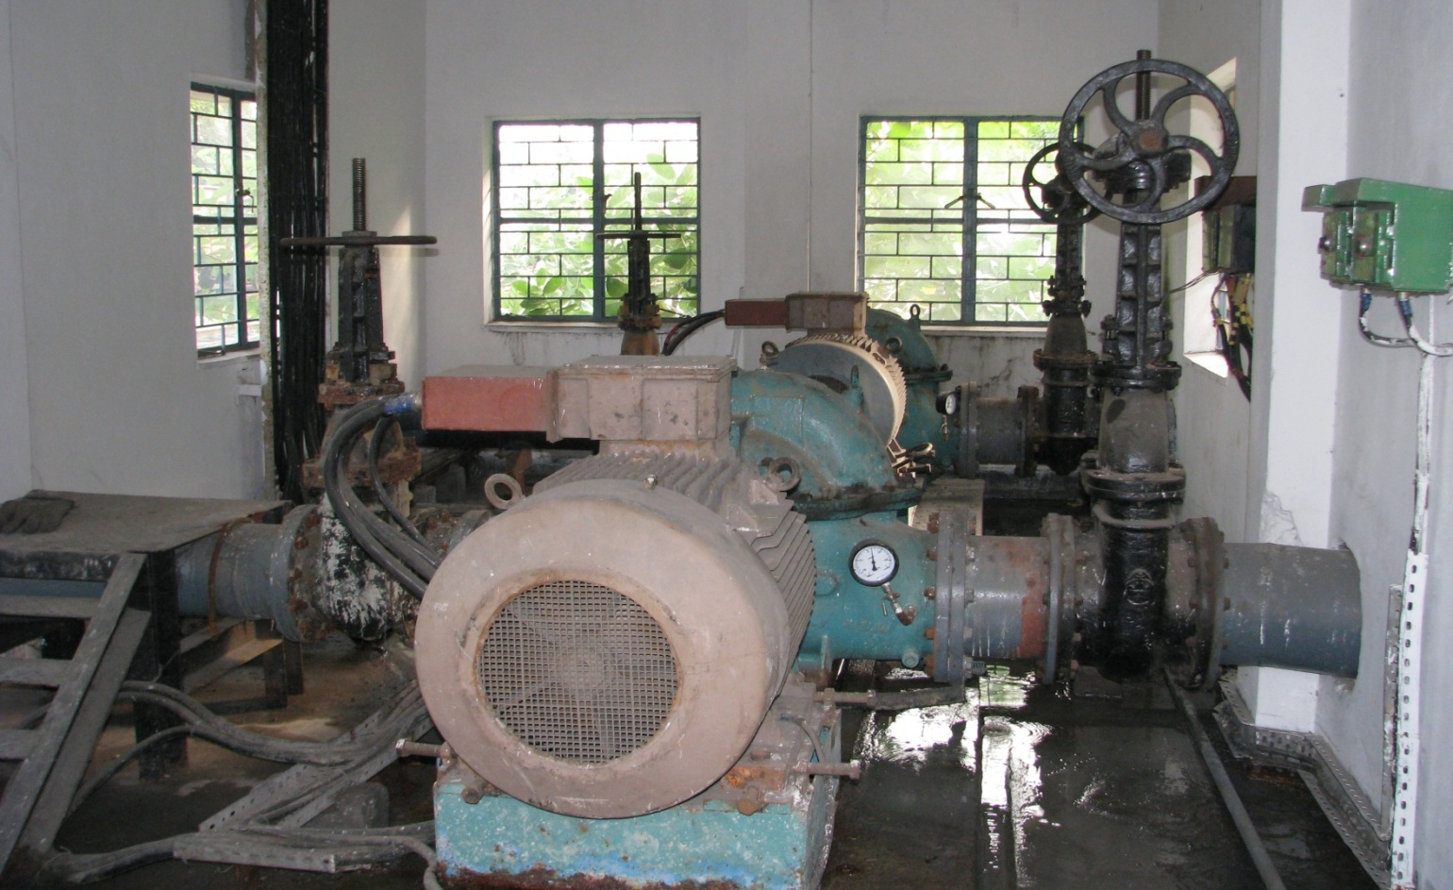
Energy & Environment Model of CESC Limited
100% Recycling of Process Effluent
Major Equipments Used
RECIRCULATION PUMPS for Bottom Ash Handling System
PSF & ACF for Process Water Recycling

Slide 39
100% Utilisation of Ash
Energy & Environment Model of CESC Limited
Policy
Ensure compliance with all applicable statutory and regulatory requirements
Utilize 100% ash to value added product by 2013-14.
No wetland filling
Major Actions Taken
Identification of probable value added utilization area
Selection of suitable entrepreneurs
Providing infrastructural and technical support.
Based on effectiveness, ash utilization areas have been prioritized and accordingly classified into four categories.
1
2
3

Slide 40
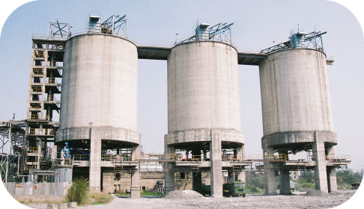
100% Utilisation of Ash
Energy & Environment Model of CESC Limited
Category # 1 : Fly Ash Bricks / Blocks / Tiles Portland Pozzolana Cement
Category # 2 : Road & Embankment
Category # 3 : Structural filling
Category # 4 : Land filling
CONSTANT EFFORT TO UTILISE MORE TOWARDS CATEGORY # 1

Slide 41
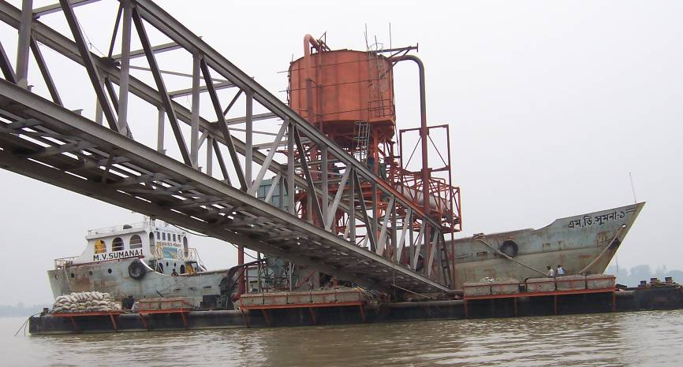
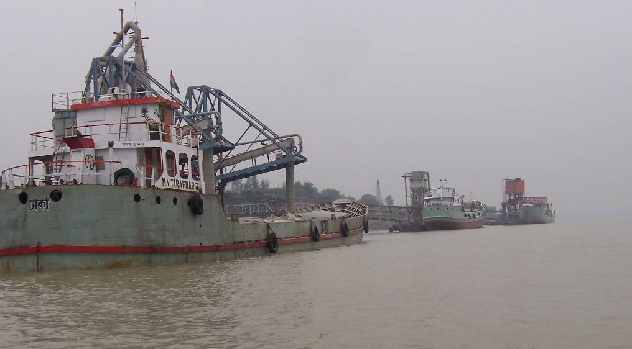
100% Utilisation of Ash
Energy & Environment Model of CESC Limited
Pontoon Jetty to Export Fly Ash

Slide 42
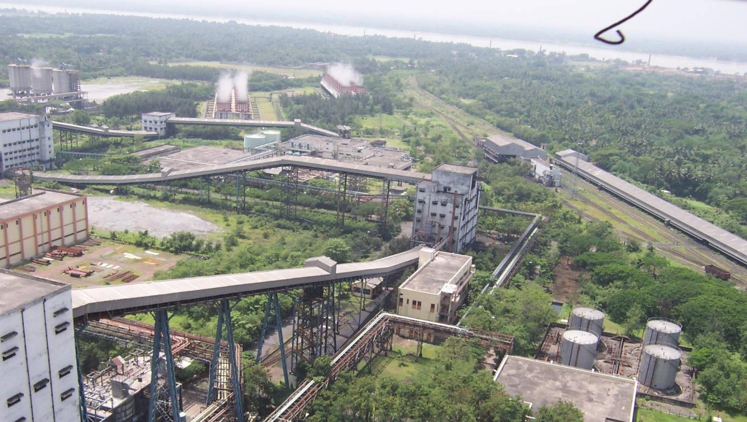
Green Belt Around Our Power Plant
Energy & Environment Model of CESC Limited
Green belt around Budge Budge Generating Station

Slide 43
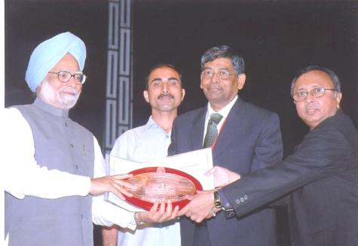
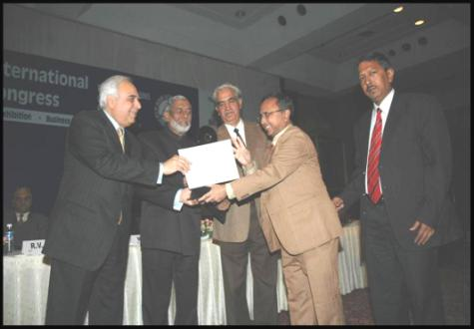
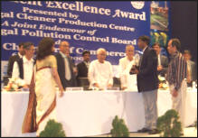
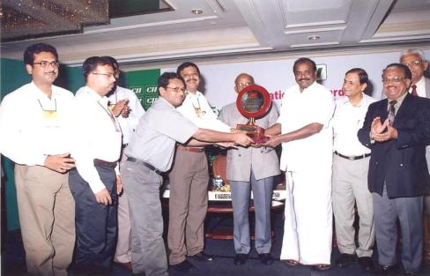
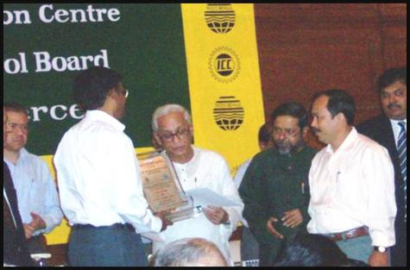
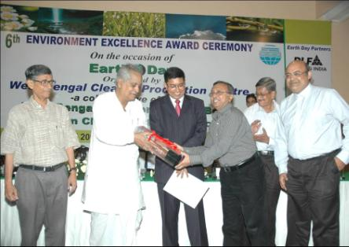
Awards & Accolades

Slide 44
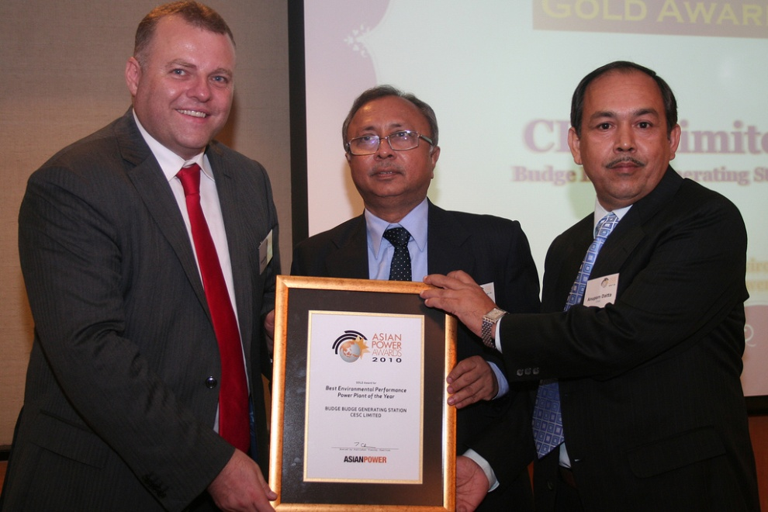
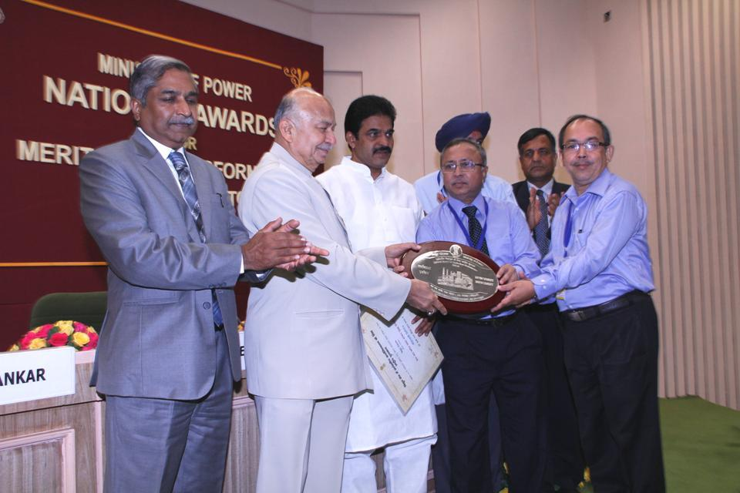
Awards & Accolades

Slide 45
Thank You !
The author may be contacted at : kushal.bhowmick@rp-sg.in
Please visit our website : www.cesc.co.in

