Slide 1
Cutting Edge technology
&
Quality Systems in
KK Singh

Slide 2
OUR VISION
To become a Global Power House respected by customers and preferred by investors, known for innovative products and solutions.
OUR MISSION
To outperform at market exceeding expectations of customers and shareholders through the accelerated evolution of people, processes and technologies in its journey towards excellence.
OUR CORE VALUES
These are the fundamental truths that the organization believes in and people respect and work towards, core values also set the tone of the organisation's culture. The core values of our organization are given below:
Leadership
Integrity
People Development and Involvement
Agility
Passion for Innovation and Technology
Channel Partner Relationship
Striving for Excellence
Customer Orientation
Management by Processes and Facts
Responsible Corporate Citizenship

Slide 3
OUTLINE OF HALDIA PLANT
(An ISO 9001 & ISO 14001 Accredited Factory)
OPERATION STARTED
MAR ’81
PLANT AREA
42.14 Acres
FLOOR SPACE
48530 M²
GREEN AREA 22626 M²
ROAD 22500 M²
OPEN AREA 66663 M²
NEW LAND 10275 M²
SUB UNITS (SBU)
A) AUTOMOTIVE
B) INDUSTRIAL
EMPLOYEES
721 (AS ON DATE)
EMPLOYEES FACILITIES
RECREATION CLUB, OHC, CANTEEN, LIBRARY, LOCKER, ROOM, TRANSPORT, INDOOR GAMES, INTERNET / INTRANET FACILITY ETC.
WATER SUPPLY
2 TUBEWELLS ( CAPACITY 1200 LPM )SUPPLY FROM PHE
WASTE WATER
TREATMENT
CAPACITY OF TREATMENT – 500 M³ / DAY
TYPE OF WASTE WATER – SEWAGE, LEADY & ACIDIC
NATURAL WATER
RESERVOIR
18000 M³

Slide 4
Strong Presence in Pan Indian with an Expanding Global Footprint
Delhi
Netherlands
Calcutta
UK
Mumbai
Turkey
Armenia
Korea
Kuwait
Dubai (UAE)
China
Japan
Bahrain
Bangladesh
Hong Kong
Taiwan
Ghana
Sudan
Qatar
Thailand
Cambodia
Srilanka
Brunei
Philippines
Chennai
Togo
Kenya
Indonesia
Zambia
Malaysia
Vietnam
Mauritius
Singapore
Australia
South Africa
New Zealand
Head Office
Regional Offices
Branch Offices
Automotive
Industrial
Pan-India sales & distribution network with an expanding global presence

Slide 5
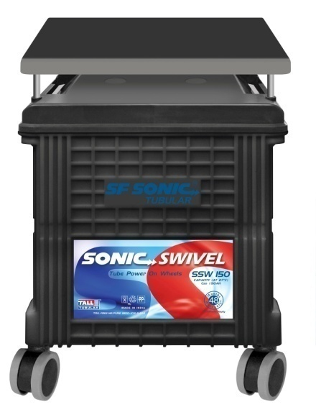
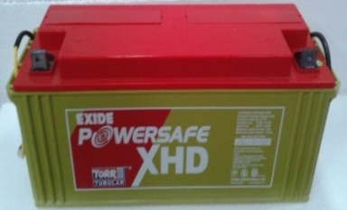
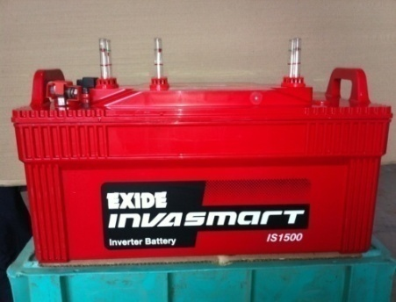
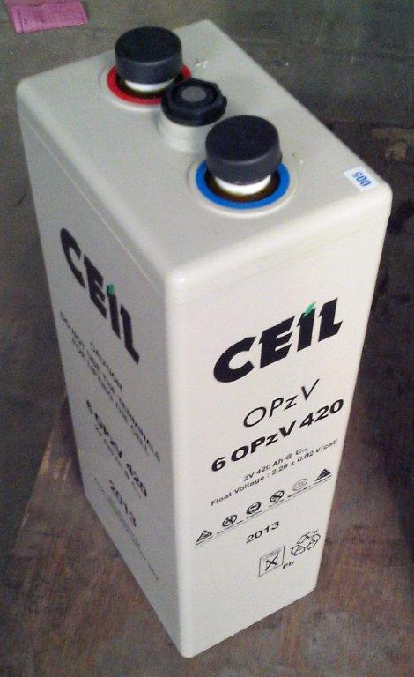
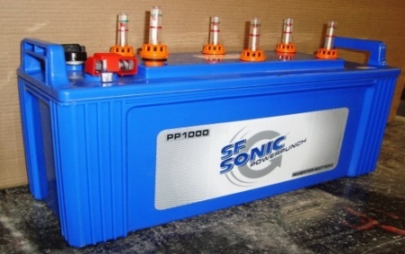
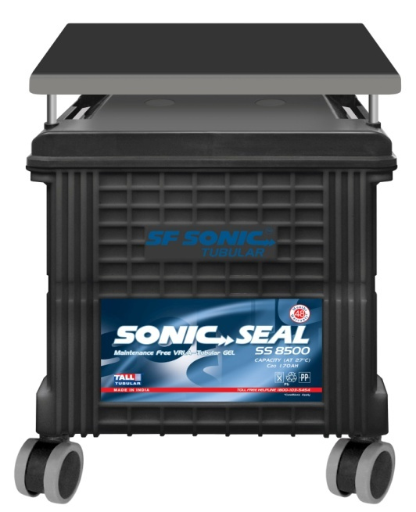
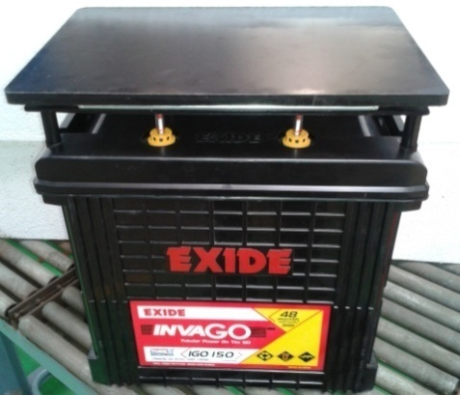
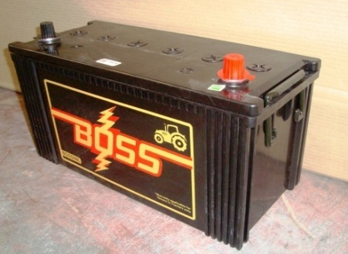
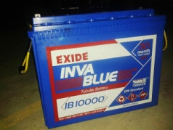
OUR PRODUCT RANGE
Automotive - 32 Ah to 200 Ah
Industrial
Standby - 15 Ah to 3000 Ah
Plante - 16 Ah to 2250 Ah
Motive Power - 64 Ah to 1550 Ah (BS & DIN Range)
VRLA - 4 Ah to 3500 Ah
Mono-block - 6V - 60 Ah to 225 Ah
- 12V - 39 Ah to 200 Ah
Cap Lamps - 4V - 9 Ah to 12 Ah
Submarine - 6700 Ah to 20200 Ah

Slide 6
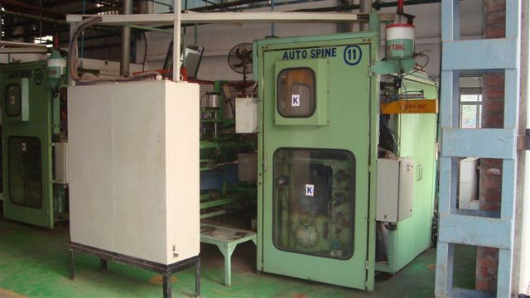
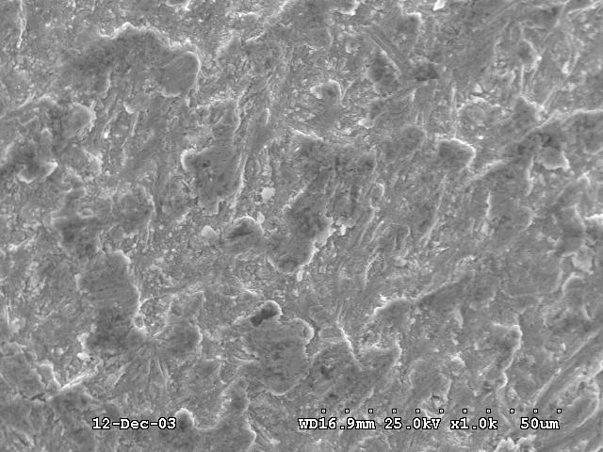
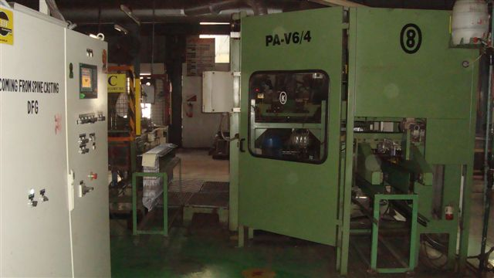
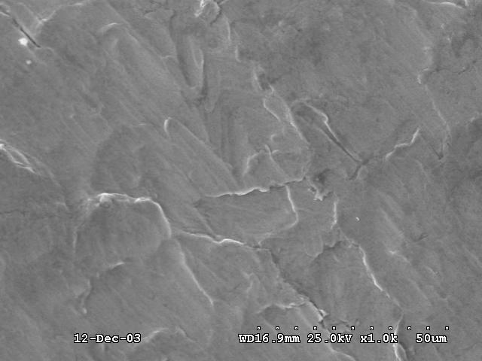
Customer Delight-Technology upgradation - looking beyond
Casting
AUTO SPINE CASTING
Microscopic view of Grain Structure
HADI SPINE CASTING
Microscopic view of Grain Structure
ADVANTAGES
High Pressure (100bar) Casting in HADI machines
Finer grain structure
Zero casting defects
Low Corrosion
Bigger moulds can be used

Slide 7
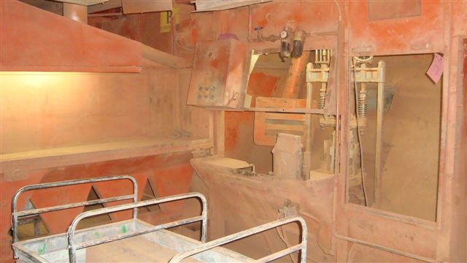
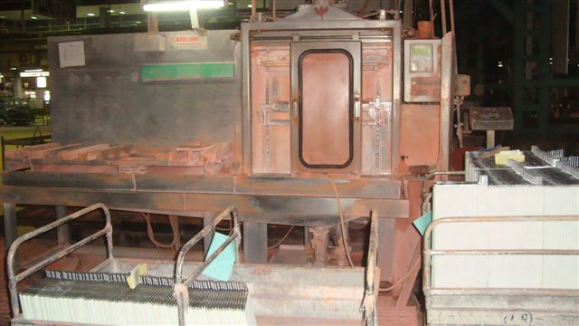
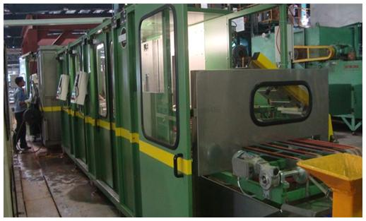
Customer Delight-Technology upgradation - looking beyond
Filling
DRY OXIDE FILLING
ADVANTAGES
Optimum packed density augments active material utilization & thus, enhanced capacity
Controlled oxide quality coupled with precise particle size ensures consistent filling performance and hence minimizes plate to plate variations
Filtration filled plates ideally suited for deep cyclic applications
Zero sound & air pollution
SLURRY FILLING
ADVANTAGES
Optimum packed density
No annular void
Flexibility of operation
Higher productivity
Minimum sludge generation
HADI PASTE FILLING

Slide 8
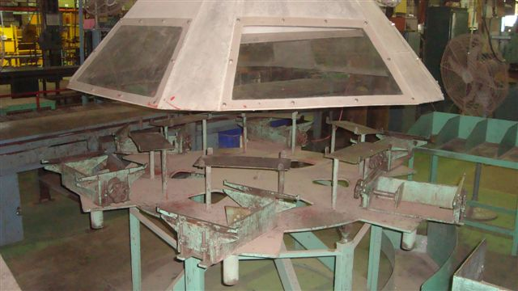
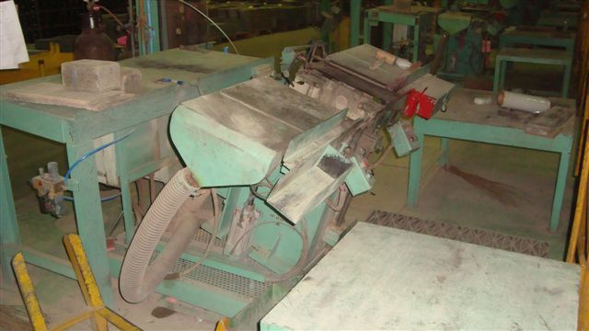
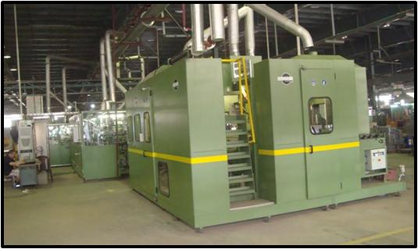
Customer Delight-Technology upgradation - looking beyond
Assembly
HAND BURNING
ADVANTAGES
Better group bar fusion leading to effective conduction of current and hence augmentation of charge / discharge efficiency
Smooth group bar prevents acid infiltration into lug & group bar interface restricting corrosion & disintegration of plates and thus, better life of cells
Proper lug fitment into comb slots prevents the chance of lead running through and hence, uproots a potential parameter for short circuiting
Compact fixture jigs ensuring improvement in pillar straightness & verticality
BURNING IN DIGANI JIG
ADVANTAGES
Superior group bar fusion
Fine grain structure- minimum corrosion
Automated process – higher productivity
CAST ON STRAP (COS)

Slide 9
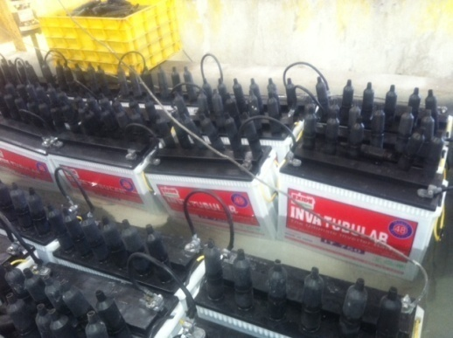
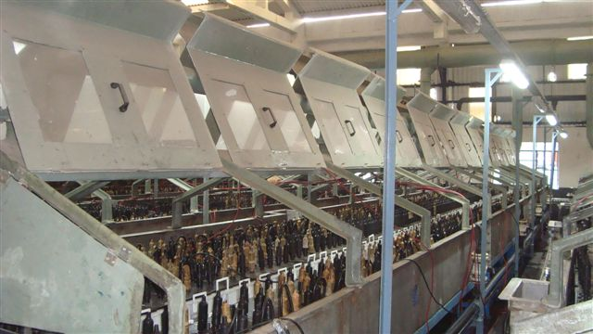
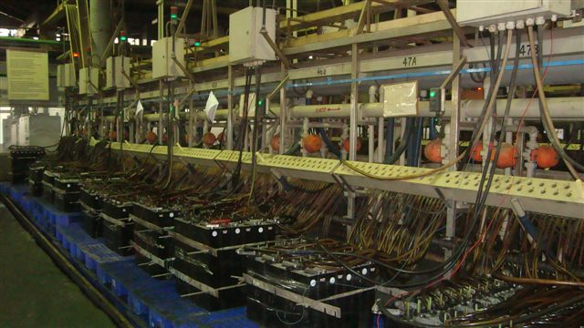
Customer Delight-Technology upgradation - looking beyond
Charging
AIR COOLED FLOOR CHARGING
ADVANTAGES
Better temperature control of battery
charging helps in reduced charging
cycle time
WATER BATH CHARGING
ADVANTAGES
Availability of optimum specific gravity acid for formation of positive & negative plates
Precise control of formation temperature
No stratification of electrolyte
Higher productivity – low charging time
100 % of the cells tested in the line itself – performance guaranteed
OMI CHARGING

Slide 10
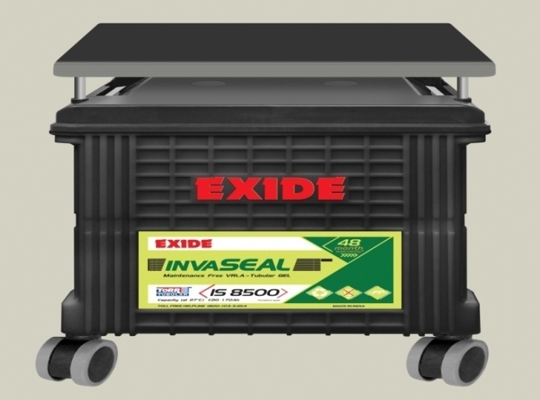
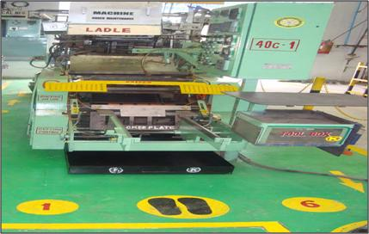
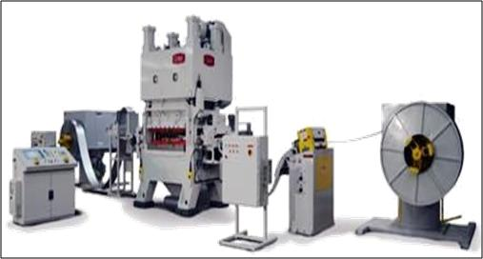
Customer Delight-Technology upgradation - looking beyond
BEFORE
AFTER
Flooded Battery
Maintenance Free Gel Battery
BEFORE
AFTER
Conventional Grid Casting
Advanced Punch Grid Technology

Slide 11
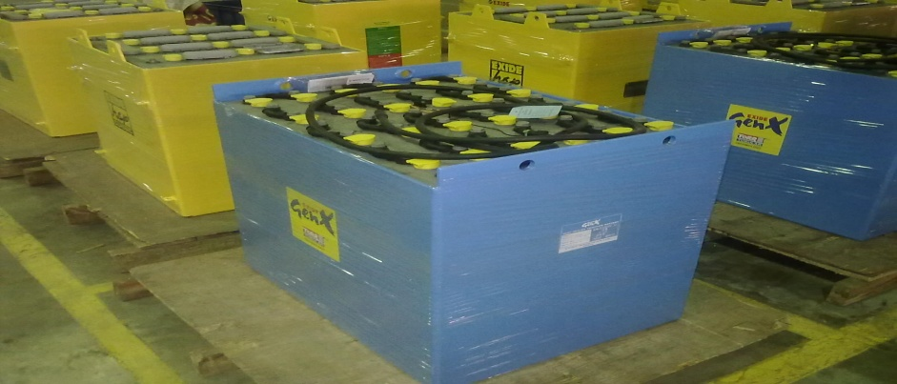
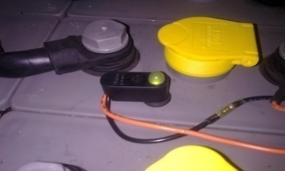
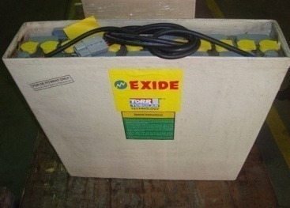
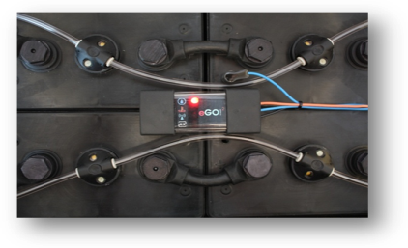
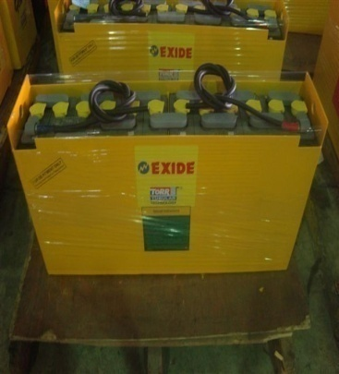
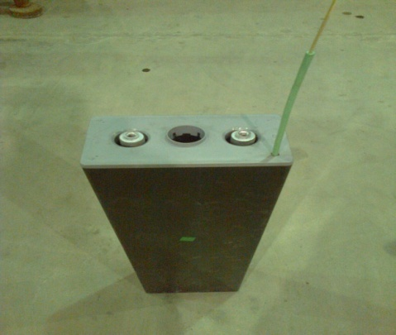
Customer Delight-Technology upgradation - looking beyond
INTRODUCTION OF EPOXY COATED TRAY To improve insulation characteristics
INTRODUCTION OF SMART & CLASSIC BLINKY
Smart Blinky gives different light colours indicating the level of electrolyte
Normal Blinky available which gives only 1 colour indication - standard feature with our batteries will remain one step ahead of competition, delight customers & OEMs
INTRODUCTION OF FLAME PROOF BATTERY
INTRODUCTION OF Ego & BATTERY FILLING SYSTEM
Monitors cycles, charge/discharge
parameters, temperature, electrolyte level
Globally used by hirers, big fleet end customers & OEMs
INTRODUCTION OF BATTERY FOR COLD STORAGE APPLICATION
INTRODUCTION OF CELLS WITH AIR AGITATION FACILITY

Slide 12
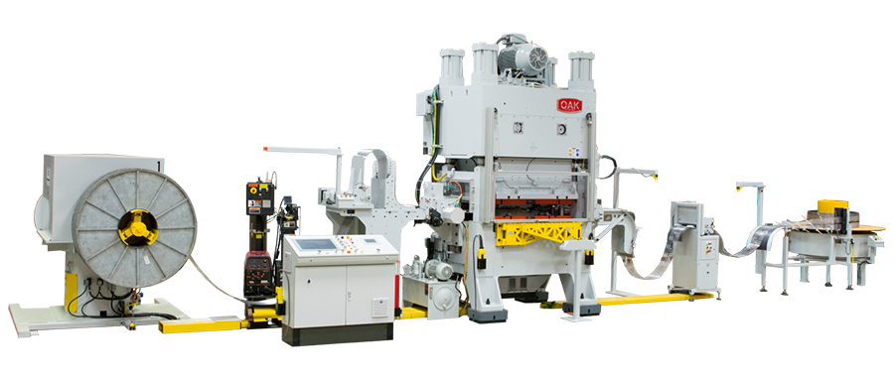
Punched Grid Technology : Key Advantages
Punched grid from rolled sheet provides homogeneous grain structure which ensures superior corrosion resistance & conductivity
Full border grid design provides structural rigidity
Low variation of grid weight & dimensions improve consistency in product performance parameters
High Productivity with less variance compared to Cast grid

Slide 13
Punch Technology for Negative Grid
Considering technicalities & learning aspects involved in Compupress Technology as well as more complex CONCAST Technology, it was recommended to consider ONLY COMPUPRESS TECHNOLOGY for POS as well as NEG PLATES at Haldia.
This will involve using same Strip Caster & Compupress Equipment for Positive as well as Negative plate production. To accommodate both strip types, strip caster was purchased with 6 nos. Lead melting pots, 3 for Positive alloy and 3 for Negative alloy. With this, we will be able to use different alloys to avoid increase of alloy cost, as planned initially.

Slide 14
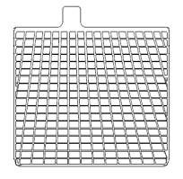
Book mould Grid Quality vis-à-vis Punched Grid Quality based on feed back from OAK Press
Technology Comparison
Grids produced on Grid Punching Systems maintain tight tolerances.
Average grid height variation is ± 0.1mm.
Average grid width variation is ± 0.1mm.
Grid weight variation as low as ± 0.3 grams.
Improve Battery Consistency / Performance.
X ± 0.1mm
X ± 0.1mm
Consistent Battery Performance.
Consistent Grid Weight
Punched Grid vs. Cast Grid
Downstream Operations
± 2.0 g
Pasting
Assembly
COS
± 0.3 g
Cycle Rate
Scrap Rate
Overall Plant Efficiency

Slide 15
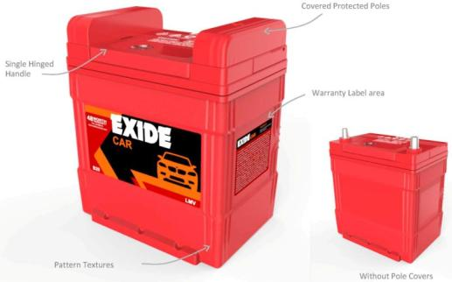
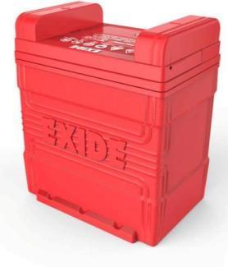
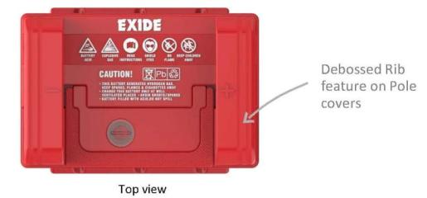
EXTERIOR STYLING FOR B20/D26/LN1 TYPE

Slide 16
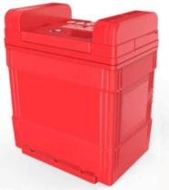
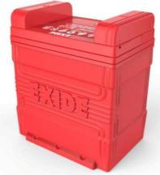
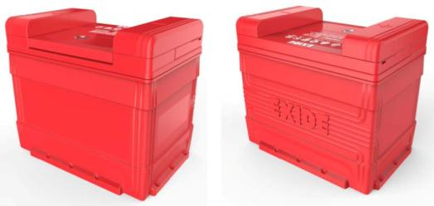
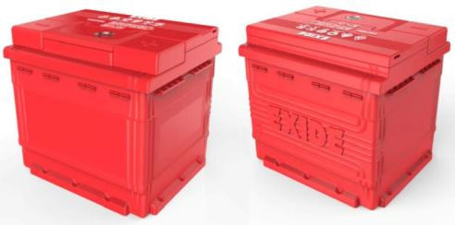
EXTERIOR STYLING FOR B20/D26/LN1 TYPE
B20 GENERIC TYPE
D26 GENERIC TYPE
LN1 GENERIC TYPE

Slide 17
EXIDE INDUSTRIES LIMITED-HALDIA
“Model TQM company”
Automotive Segment
Industrial Segment
Automotive segment mainly includes sale to major vehicle manufacturers and after market sales
Exide primarily sells its automotive batteries in the domestic market under the brand names Exide, SF, Sonic and Standard Furukawa
Dynex, Index and Sonic brands are the ones on which the company concentrates on for the export market
MARKET SHARE
Industrial segment includes sales to power back-up equipments (UPS & inverters), traction equipments (fork lifts, golf carts, electric vehicles), infrastructure sector (railway, telecom, power generation & utilities) and exports (traction & standby)
Exide markets its industrial batteries in the domestic market under Exide, Index, SF, CEIL & Power Safe brands
Internationally, CEIL, Chloride and Index are the primary brands
MNC Customers
Domestic Customers
MNC Customers
Domestic Customers
Differentiating Factors
One of the largest storage battery manufacturer in India
Strong relationships with customers and partners
Strong sales and distribution network and quality customer service
State of the art manufacturing facilities at diversified locations
Exide has well entrenched relationships with industry leaders in each of the product sectors

Slide 18
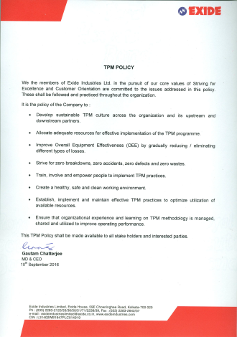
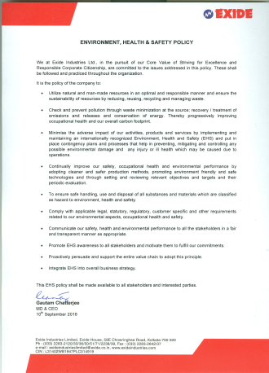
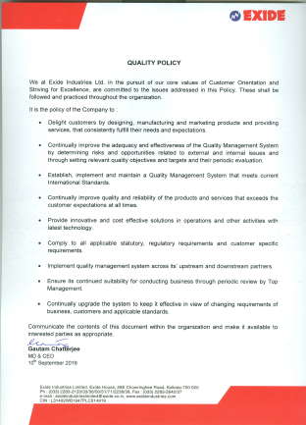
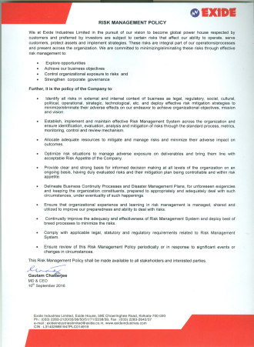
JOURNEY TO EXCELLENCE
TPM POLICY
ENVIRONMENT & OHSAS POLICY
QUALITY POLICY
HR POLICY
ISO 9001 - 2008
RISK MANAGEMENT POLICY
TS16949 - 2009
ISO 14001 - 2004
OHSAS 18001 - 2007
TPM – JIPM AWARD LEVEL -I & LEVEL-II
QUALITY CIRCLE
SMALL GROUP ACTIVITY(SGA)

Slide 19
“Model TQM company”
Quality is the primary focus
“Productivity & Production is the by-product of Quality System”.
CSI feedback
Technology upgradation to increase product reliability & durability
User friendly system like Magic eye, Ego, smart blinky etc.
1ST piece inspection by operator
Stringent Process Check
3 Tier Layered Audit
Strengthening of Mould inspection & Comb Inspection
Process Control
Human Machine Interface
Resource Management
Multi Skilling
Recognition
Communication
Customer Delight
People involvement for system & Excellence
Understanding the behaviour of products which is produced from different M/C & monitoring the performance (SPC)
Best workmen award monthly
Best workmen award yearly
Best suggestion award
Best performance award
Grade upgradation based on multi-skilling
OUR APPROACH OF TQM
Inter Kaizen Competition
Best kaizen award monthly
Best poke-yoke award
SGA
Quality Circle
On job Training
In-house class room training
External faculty provide the training
Inter departmental transfer of employees
Morning Market with all operator union
Shop floor related issues circulated to all concern
Daily Test House Report circulated to all concern
Daily Lab Report circulated to all concern
Daily Factory meeting in presence of Factory Head
Monthly meeting for review
Goal setting meeting
Reduction of power consumption
Reduction of inventory
Reduction of man power

Slide 20
Industrial Process Flow Diagram
LEAD ALLOY (Antimonial, Calcium, Pure Lead)
GRID CASTING (Antimonial alloy)
SPINE CASTING (Antimonial alloy)
GAUNTLET FORMATION
OXIDE MANUFACTURING
PASTE MIXING
SLURRY/ PASTE FILLING
RED LEAD
PASTING & FLASH DRYING
SMALL PARTS CASTING (Antimonial Alloy)
CURING / DRYING
CONTAINER, LID, SEPARATORS, LEAD PARTS, CONNECTOR & VENT PLUG
BOP
CELL ASSEMBLY
RE-CIRCULATION CHARGING
TRAY ASSEMBLY
TESTING
QUALITY CHECK POINT
DESPATCH

Slide 21
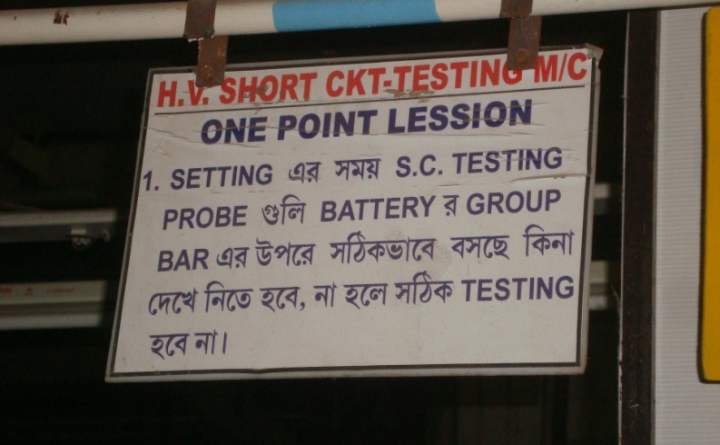
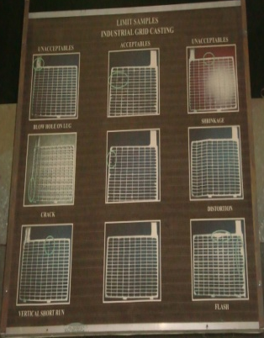
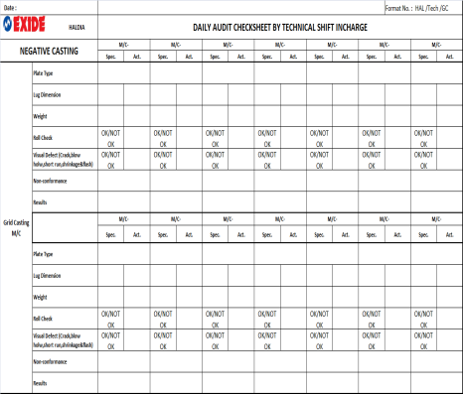
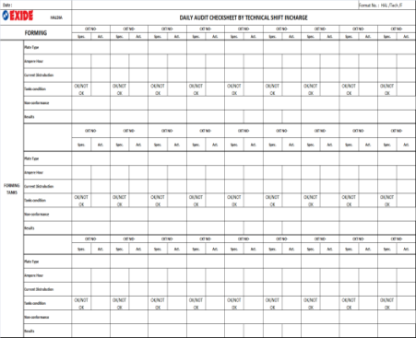
Process control
A) 1ST piece inspection by operator
At the beginning of shift operator check
Machine condition.
Machine basic parameters.
Starting product quality.
Quick check & Easy Understanding for Operator
B) Stringent Process Check
At regular interval of shift technical person check
Machine basic parameters.
Product quality as per PI/WI.
Trouble shooting & Remedies.
C) 3 Tier Layered Audit
Auditing System | Frequency | Responsibility
Daily Audit(Based on Critical parameters) | Each Day | Shift In-charge (TECH) Counter Measures – Respective Sec In-Chg.
Weekly Audit (Based on M/C) | Weekly | Section In-charge (PROD/Maintenance) Counter Measures : (Production / Maintenance In-Charge)
Quarterly Audit (Based on control Plan) | Every 3 Months | Technical/Production Head
At regular interval audit is being carried out in
the following manner
Daily Audit based on critical parameters.
Weekly audit based on Machine parameters.
Quarterly audit based on Control Plan.

Slide 22
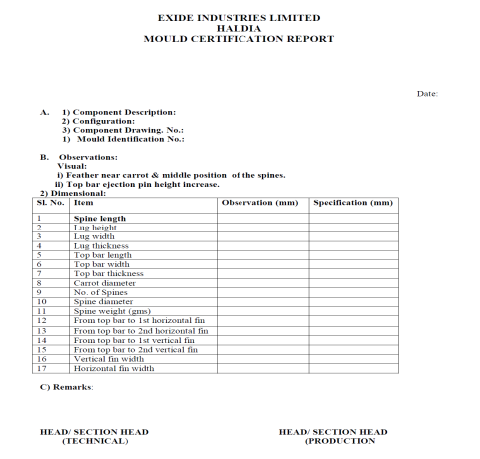
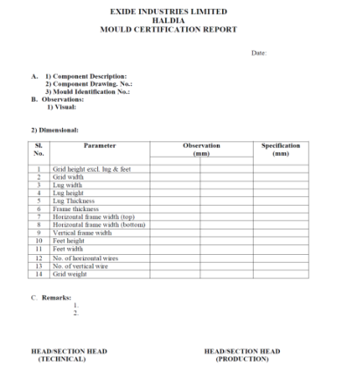
D) Strengthening of Mould inspection & Comb Inspection
Regularly Mould & comb inspection done in the following manner
Dimensional check for all running moulds- Everyday
Regular incoming new mould & comb inspection.
Human machine Interface
Understanding the behaviour of products which is produced from different M/C & monitoring the performance (SPC)

Slide 23
People involvement for system & Excellence
a) Inter Kaizen Competition
b) Best Poke-Yoke Award
c) Best Kaizen Award Monthly
d) Small Group Activity (SGA)
e) Quality Circle

Slide 24
Communication
Morning Market with all operator union
Shop floor related issues circulated to all concern
Daily Test House Report circulated to all concern
Daily Lab Report circulated to all concern
Platform for Internal communication of Shop floor problem &customer related issues amongst operator , Technical & Production section in-charge
Daily Factory meeting in presence of Factory Head
Monthly meeting for review
Goal setting meeting

Slide 25
Resource management
Cost saving due to Reduction of
power consumption (lac)
Reduction of Raw Material
Inventory
Reduction of total man power
due to Automation
Multi Skilling
On job Training
In-house class room training
Training by external faculty
Inter departmental transfer of employees
Skilled operators graph

Slide 26
Recognition
Best suggestion award
Best workmen award monthly
Best workmen award yearly
Best performance award
Grade upgradation based on multi-skilling
Annual Sport Award

Slide 27
PROCESS CONTROL APPROACH AS PER
TPM LEVEL-II
QM Pillar
Proactive
Reactive
(In-house rejection)
Customer Complaint Reduction
Quality Defect Chart
Warranty Reduction
Data Collection
Vendor Rejection Reduction
Defect Stratification
Process variation reduction
Quality Assurance Matrix
Establishment & monitoring of 3M conditions
Introduction of Statistical Process Control
Problem Table
Why Why Analysis
Counter Measures
ZERO CUSTOMER COMPLAINT.
ZERO LINE REJECTION
ZERO WARRANTY REJECTION
ZERO VENDOR’S REJECTION
ACHIEVE CpK >1.33
FMEA & P.M analysis
Review of 3M conditions
Counter Measures
Standardization
Results
Results
Future Plan

Slide 28
NEW PRODUCT DEVELOPMENT APPROACH AS PER
TPM LEVEL-II
Customer's Requirement
Idea Generation
DR1
Prodn. Capability
Feasibility study
Product Selection
Conceptual Design
DR2
Resource Planning
Laboratory Scale Prototyping
PM Pillar
QM Pillar
KK Pillar
SHE Pillar
To check whether the existing m/c is capable for the new product development or new set-up is required
To check whether Product is commensurate with existing process & facilities.
To check the losses, industrial engineering & value engineering with the new product development in the process
To check the safety of the process development of the new product
Detailed Design
Full scale prototypes
Not OK
OK
DR3
Validation of Design
Volume Production
Evaluate
DR4

Slide 29
System Excellence- HALDIA
SMALL GROUP ACTIVITY (SGA)
QUALITY CIRCLES
SUGGESTION
KAIZEN

Slide 30
???
Any Questions
THANK YOU

